Slide 1

CLR Virtual Coach Prep

Slide 2


Why Coach Prep?
Preparation = the state of getting ready
The purpose of today’s Coach Prep session is to help us get ready for infusing CLR into our instructional practice and the upcoming virtual CLR coaching cycles.
Choral Reading

Slide 3

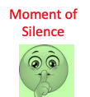
Our Flow
Mic Check (10 min)
CLR Review (5 min)
Mindset Focus (10 min)
Skillset Focus (10 min)
Coaching Overview (5 min)
Reflection & Next Steps (5 min)

Slide 4



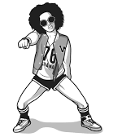

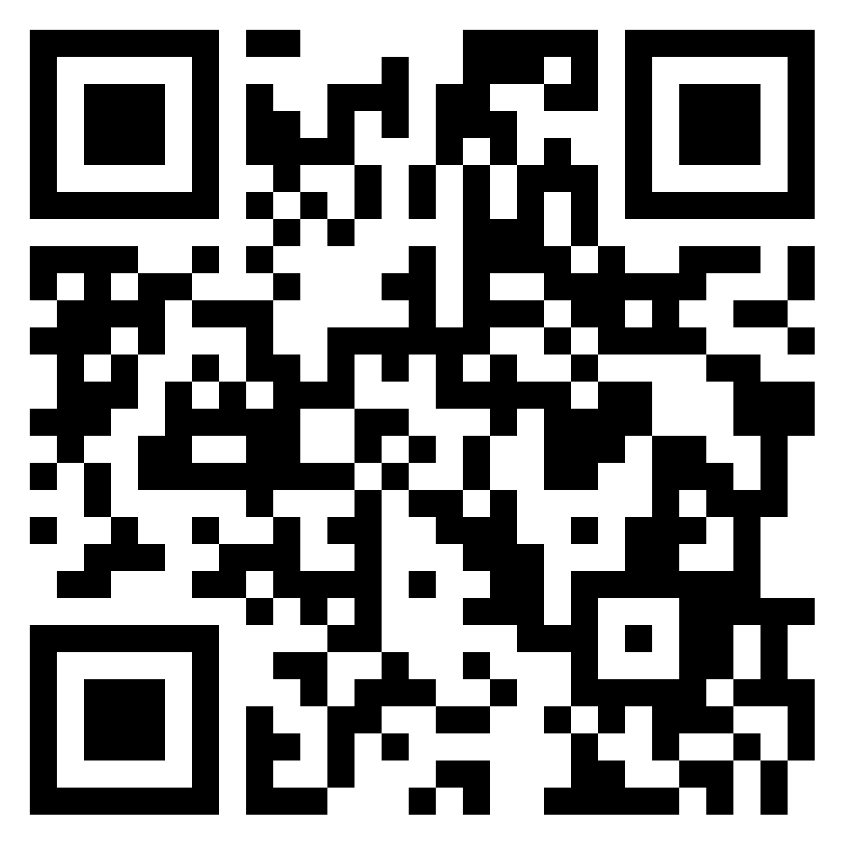
Mic Check
-Sizzling Hot
-Hot
-Warm
-Lukewarm
-Cool
-Frigid
Whip Around
“VABBometer”
Post Your Thoughts

Slide 5


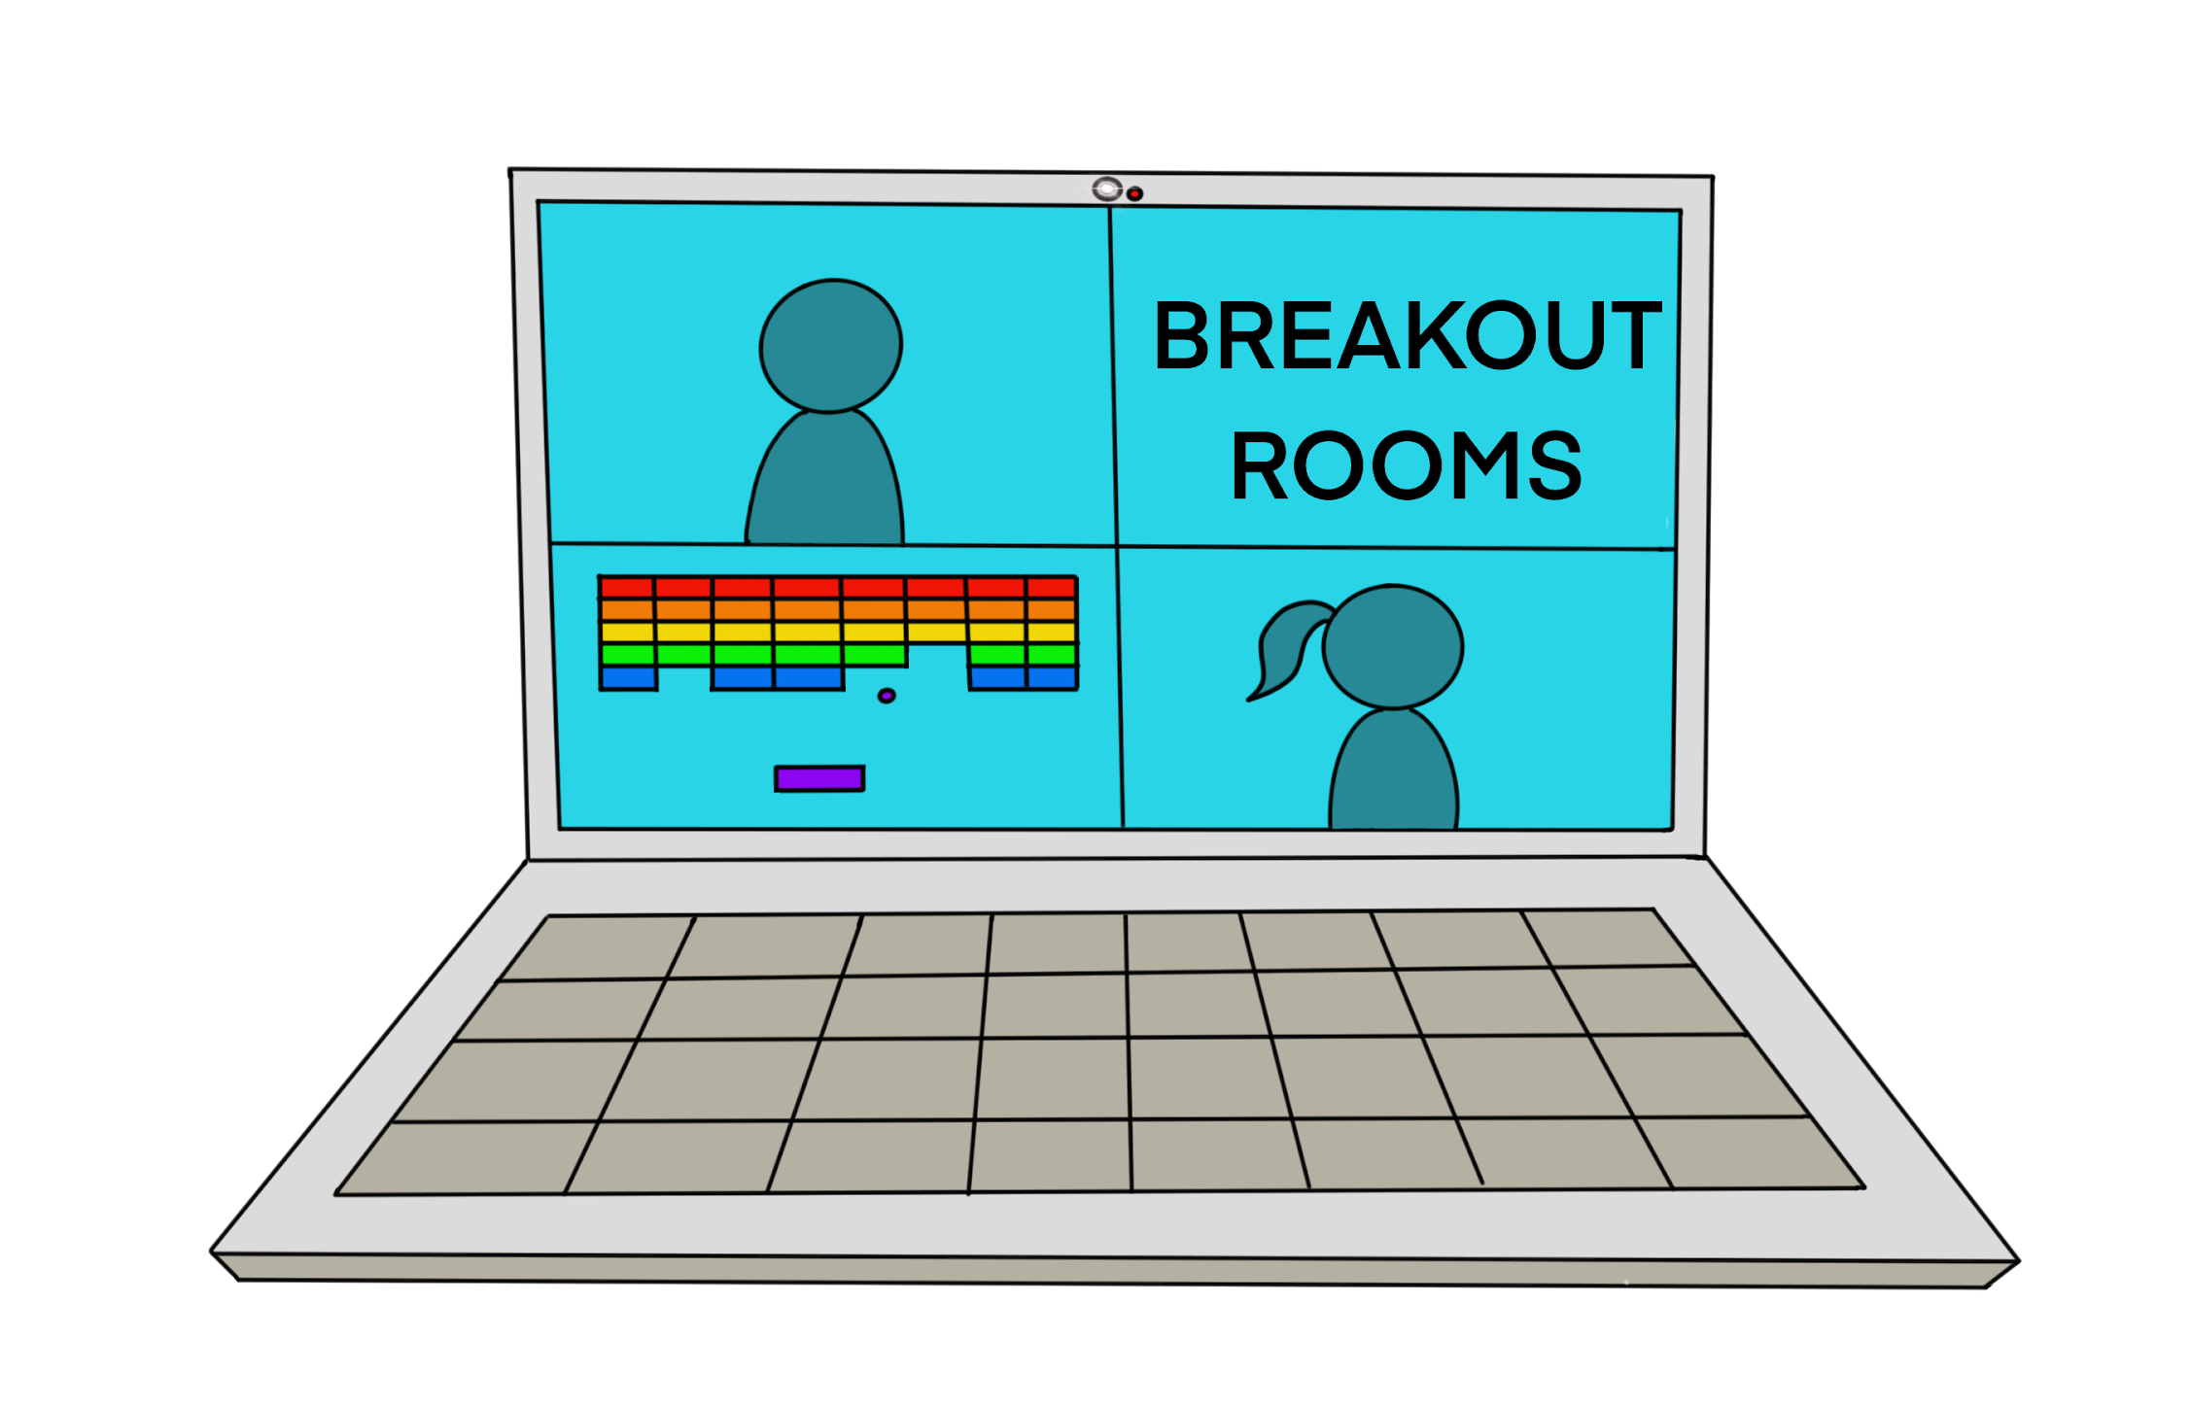
CLR Review
In your breakout rooms, discuss the following questions:
What is CLR?
What does VABB stand for?
How to VABB?

Slide 6

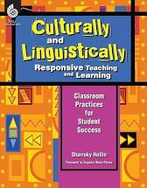
What is CLR?
Cultural and linguistic responsiveness (CLR) is the validation and affirmation of the home (indigenous) culture and home language for the purposes of building and bridging the student to success in the culture of academia and mainstream society.
- Dr. Hollie

Slide 7

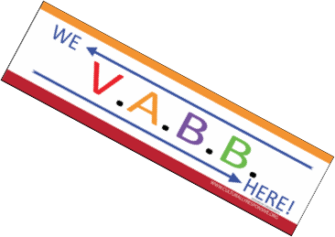







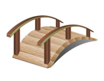

What does VABB stand for?
Shout Out

Slide 8
Three Ways To VABB
Relate To Differently
Talk To Differently
Teach Differently
Difference =
Responsiveness

Slide 9
CLR is VABBing
VALIDATE Make legitimate that which the institution (school) and mainstream have made illegitimate | BUILD Making the connections between the home culture and language and the school culture/language through instructional strategy and activity
AFFIRM Making positive that which the institution (school) and mainstream media have made negative | BRIDGE Giving opportunities for situational appropriateness or utilizing appropriate cultural or linguistic behavior

Slide 10



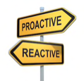


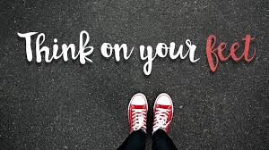
What are Reactive and Proactive VABBing?
During the Lesson
Using teachable moments to have either VA a cultural behavior or have students cultureswitch to a culturally and linguistically appropriate behavior.
Before the Lesson
(During Lesson Planning)
Intentionally planning validating and affirming strategies while also juxtaposing them with
traditional strategies to build and bridge.

Slide 11

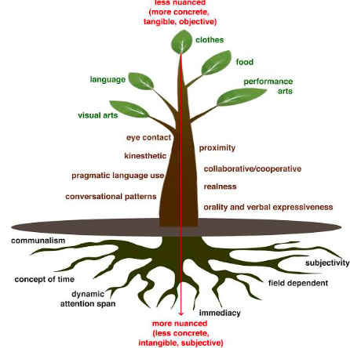
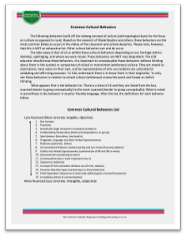
CLR Mindset

Slide 12
  Do I even consider it a cultural behavior?
  What are my/our biases?
  How to validate and affirm?
  How to build and bridge?
What are the preferred cultural behaviors at school?

Slide 13

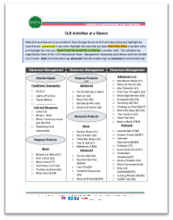
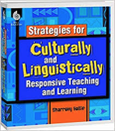




CLR Skillset
Quantity + Quality + Strategy = CLR Success
use of many different activities and with frequency
activities implemented with fidelity and technical precision
knowing when to use a particular activity and for what instructional purpose
Increased engagement and learning

Slide 14
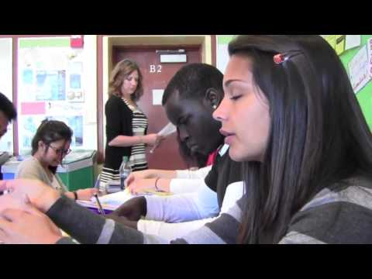

Slide 15
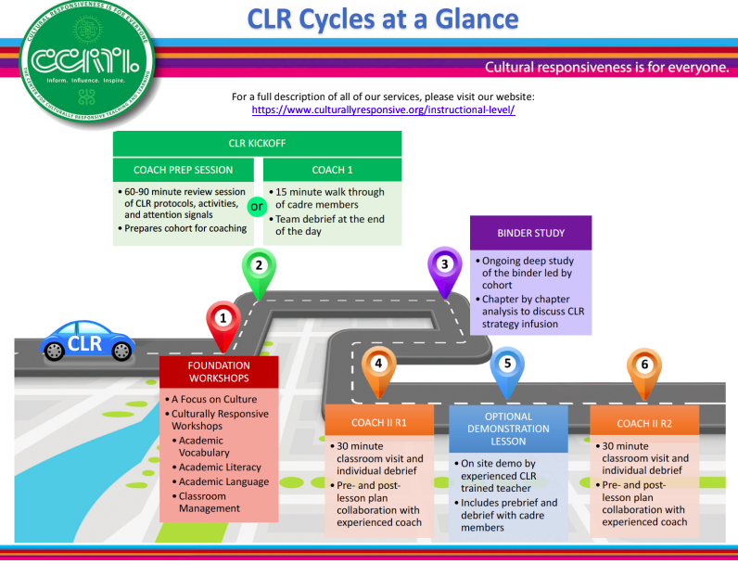
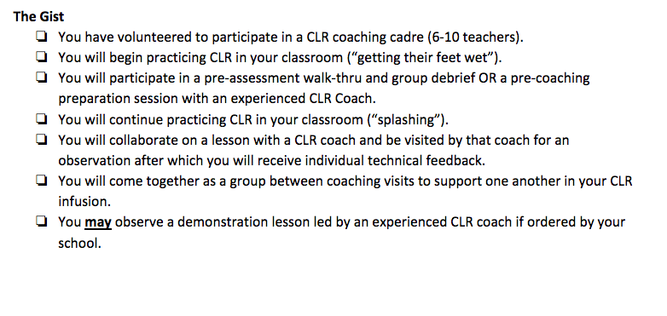
Coaching Cycles

Slide 16

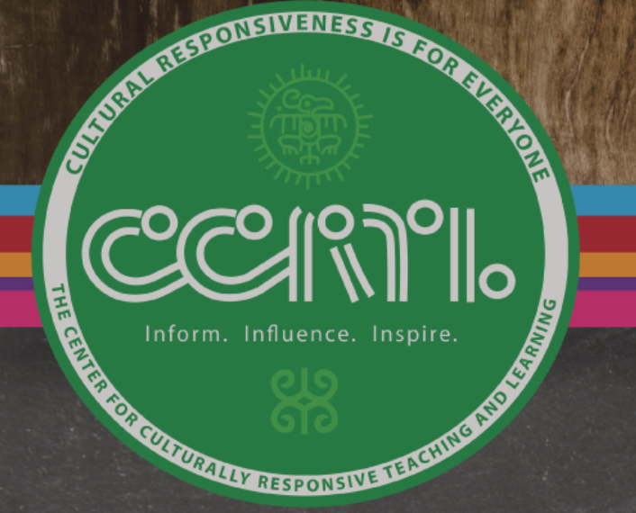





Stay Connected
Center for Culturally Responsive Teaching and Learning
www.culturallyresponsive.org
Facebook
facebook.com/culturallyresponsive@validateaffirm
Twitter
Twitter.com/validateaffirm
You Tube
Search ValidateAffirm Youtube
Instagram
@validateaffirm
@responsivereads

Slide 17

Cultural and Linguistic Responsiveness (CLR) is…
When you VALIDATE and AFFIRM who your students are culturally and linguistically, you are showing them more LOVE.

Slide 18
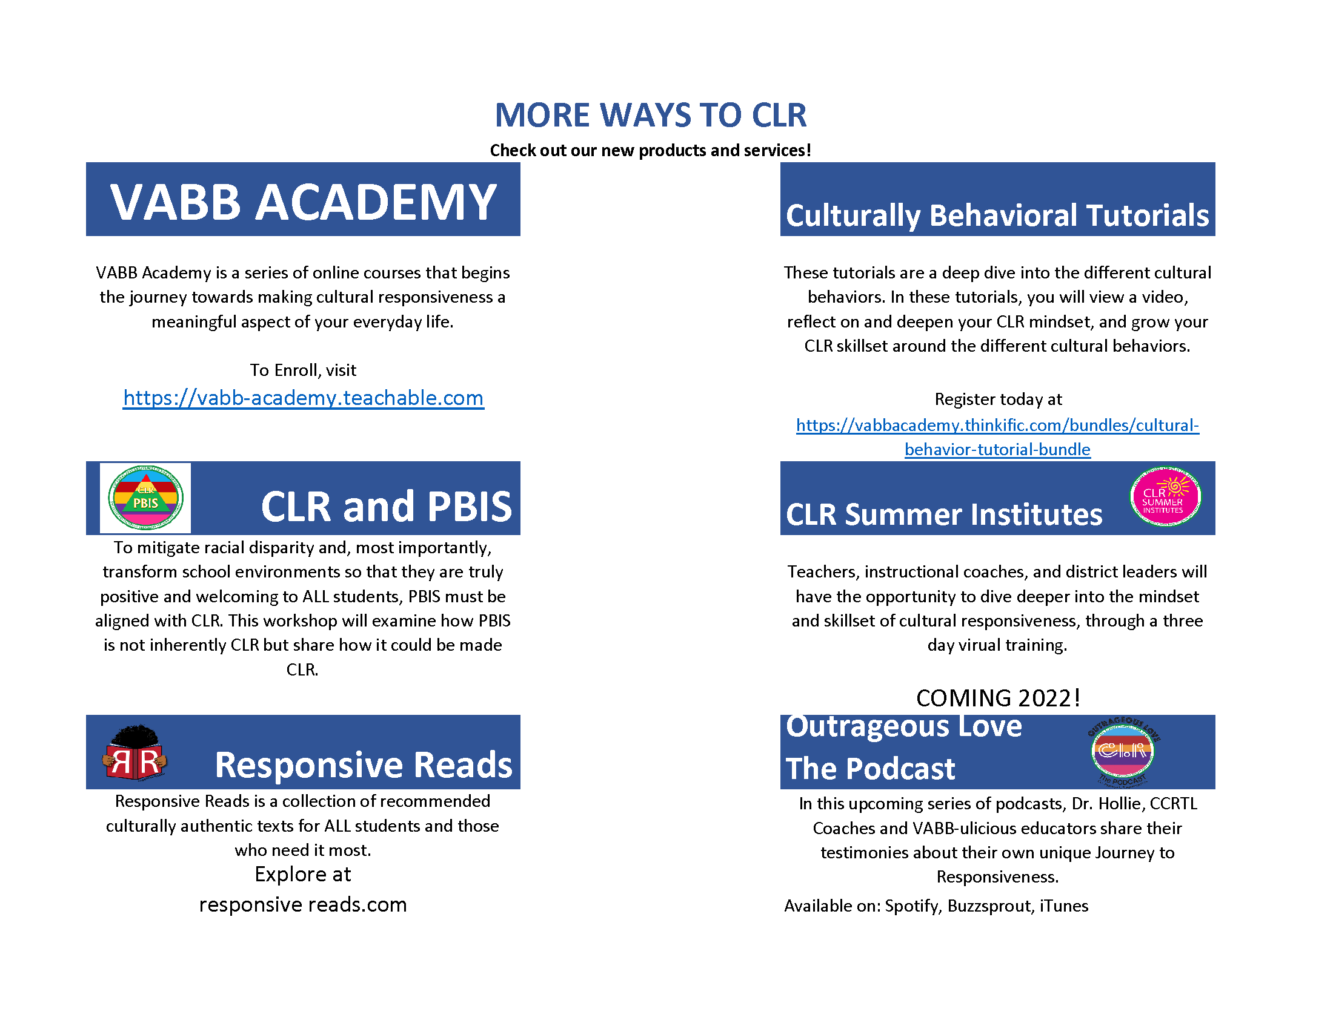

Slide 19
