Slide 1
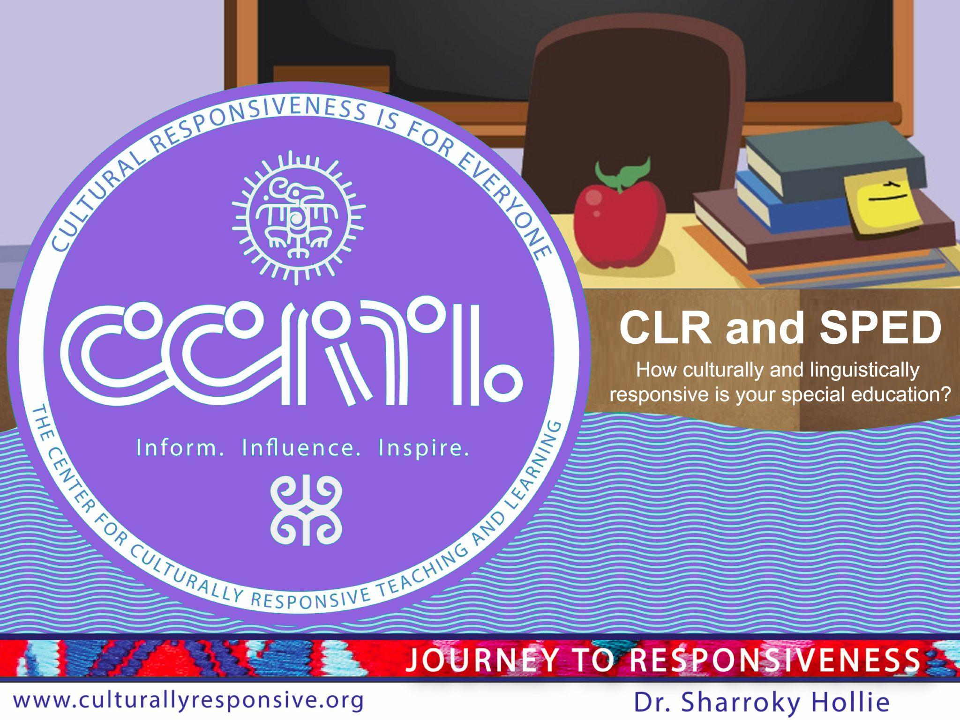
CLR and SPED
How culturally and linguistically responsive is your special education?
Kiechelle Russell, MA
CLR Coach and Special Education Consultant
Notes:
http://www.youtube.com/watch?v=h1vKOchATXs

Slide 2
Brainstorming the Broader Issues of CLR and SPED
Activity: Make a link/connection from the quote to broader issue that keeps the quote from being realized.
Quote:
“CRP (CLR) has the potential to disrupt the disproportionate referral of Black and Latino students receiving special education services (Connor, 2017), suggesting that prior to the thought of a special education referral, questions should be raised as to whether all of the student’s teachers have employed culturally responsive measures in their instruction. Those doing the assessment for special education services (typically the school psychologist along with the special education teacher) should also have some level of cultural awareness of the students they are assessing rather than assuming that the assessment materials are culturally neutral (Chen & Lindo, 2018) since even the delivery of the assessment material could be expressed in a culturally responsive way.”
Putting the Brakes on the Overrepresentation of Black and Latino Students in Special Education: Broadening Our Understanding of Culturally Responsive Pedagogy, Christopher Cormier, 2021
a

Slide 3
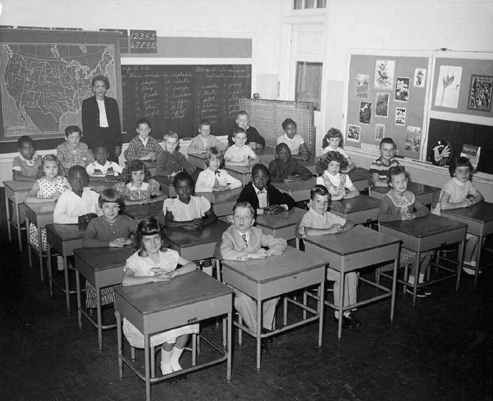
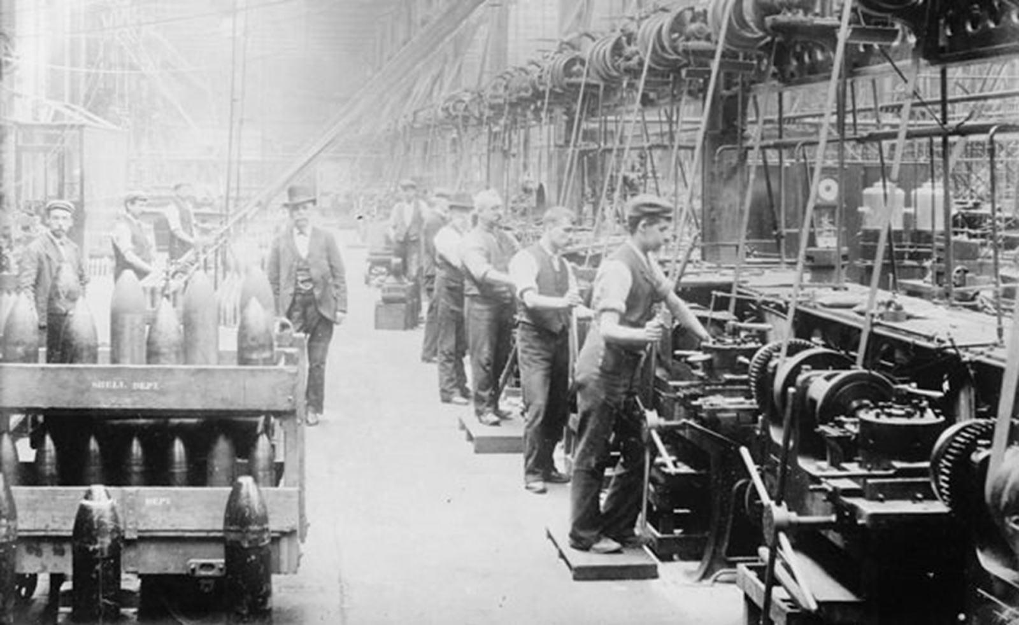
How does the history of the factory model inform access to education for diverse learners today?

Slide 4
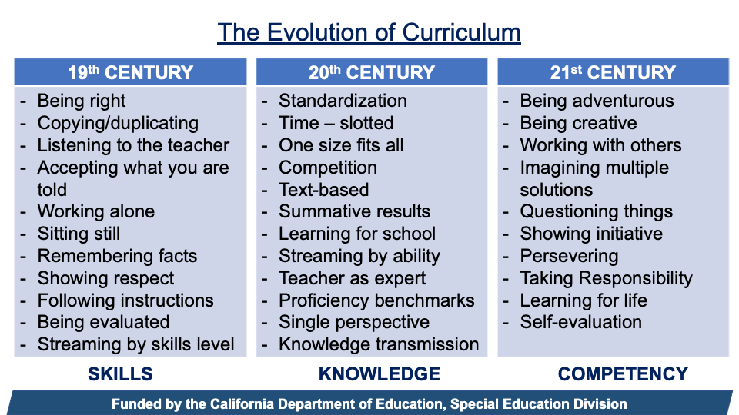

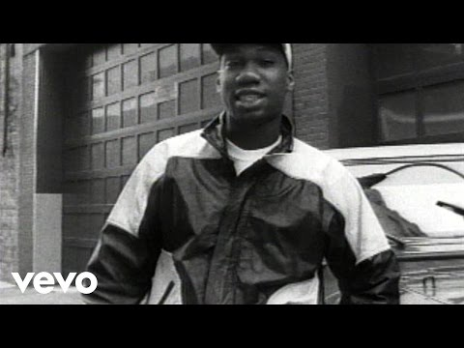
The Evolution of Curriculum
Notes:
MyCreate a poll with the following tag lines:
On my way
Out the door but running late
Took the scenic route
Close, but stuck in traffic
Almost there
Arrived

Slide 5
The Broader Issues To Consider In Order To Be CLR in your SPED Programs
Teacher attitude and expectations for children of color
Limited knowledge of CLR strategies
The language we use to describe our SWDs and its impact
Confusing disabilities with diversity
A gap between philosophy and practice
Creating safe and supportive spaces for all students/class climate
Changing lens towards perceived challenging behavior
Taking a deep look at one's own identity and privilege (able bodiedness, cognitive advantages, authority, power to impact change, deficit meter, etc.)
Who is identified for SPED? Pre/referrals. Overidentification.
Should SWDs earn their way into GE classes? Or should they be fully included to the extent the law allows?

Slide 6
Four CLR Infusion Areas to Establish for SPED
Validating and affirming language Establish an agreed upon language for the purpose of the workshop which will be Student 1st Language; however, in the presence of SWDs, use the Ss preferred descriptors | Validating and affirming policies Establish/Review policies (past and present) so that the needs of underserved students can be met.
Validating and affirming instructional practices Establish the intersection between the use of CLR activities and the differentiated need(s) of the students. | Validating and affirming cultural behaviors Establish with the utmost clarity the difference between cultural behaviors (that are frequently misunderstood) and other behaviors

Slide 7
VALIDATING AND AFFIRMING POLICIES

Slide 8
Then and Now: A History in Education Policy
Gr. level division & bells, average is the target.
ESSA replaces NCLB “…universally designed”
Covid-19 pandemic,
quarantine orders, all school districts closed, start of "remote learning"
No universal HS ed (6% grad rate)
194,650 people with intellectual disabilities housed in institutions​
Buck v Bell: Eugenic sterilization, “three generations of imbeciles are enough”
Americans w/ Disabilities Act
1912
1954
1975
2004
2017
1900
1920
1967
1990
2015
2020
General Education Board published Taylorist ed. essay
Brown v Board of Education: ruling to end segregation “with all deliberate speed”
P.L. 94-142…,
FAPE and LRE
Endrew F. v. Douglas County School District…”merely more than de minimis”​
IDEA reauthorization “…integrated w/ non-disabled peers”
Notes:
After reviewing the timeline ask participants what surprises them the most. Share in the chat
Take a look at this timeline. It shows the progress in our education system.
1900 – there was not universal HS – those that did go to high school only 6% graduated
1975- the Individuals with Disabilities Education Act (IDEA) included in the law Least Restrictive Environment and Free and Appropriate Public Education.
2015 – Every Student Succeeds Act (ESSA) is the main federal law for K–12 general education. It replaced No Child Left Behind and it includes Universal Design for Learning
This entire timeline shows that we have made progress towards providing Equity and access for all students. Remote Learning has made us think again about how we can provide access for all. As we have those conversations about policy we should be questioning if we truly want to make progress where does CLR fit in the conversation?

Slide 9
Validating and Affirming Policies
CLR Infusion: Did policy ever meet the needs of underserved students and do they now?
Think of a educational policy that was well-intended but ended up being harmful or not helpful to underserved students.

Slide 10
VALIDATING AND AFFIRMING LANGUAGE

Slide 11
Validating and Affirming Language
CLR Infusion: Establish an agreed upon language for the purpose of the workshop.
Group A will read the USA Today Article by David Oliver
Group B will read the Edutopia Article by Foley and Graff
After reading the article, be able to agree on the 3 key points around the use of affirmative language.
Mix and Mingle Round 1 - How does using people first language humanize PWDs?
Mix and Mingle Round 2 - What language respects both identity and dignity? How so?
Last word share out
Notes:
https://www.usatoday.com/story/life/health-wellness/2021/06/11/disabled-not-special-needs-experts-explain-why-never-use-term/7591024002/
https://www.edutopia.org/article/getting-started-person-first-language
Student 1st Language; however, in the presence of SWDs, use the Ss preferred descriptors

Slide 12
VALIDATING AND AFFIRMING BEHAVIORS

Slide 13
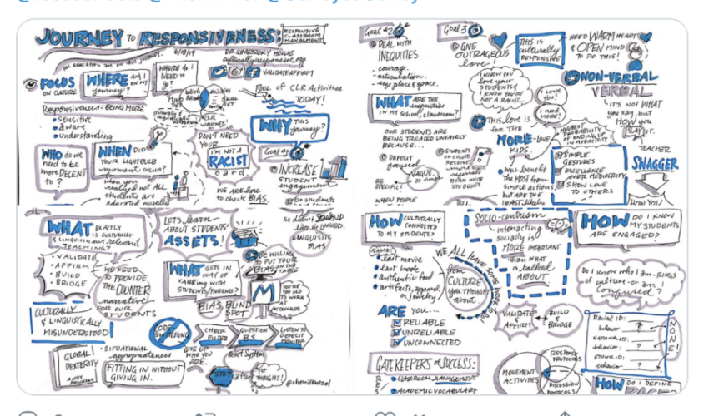
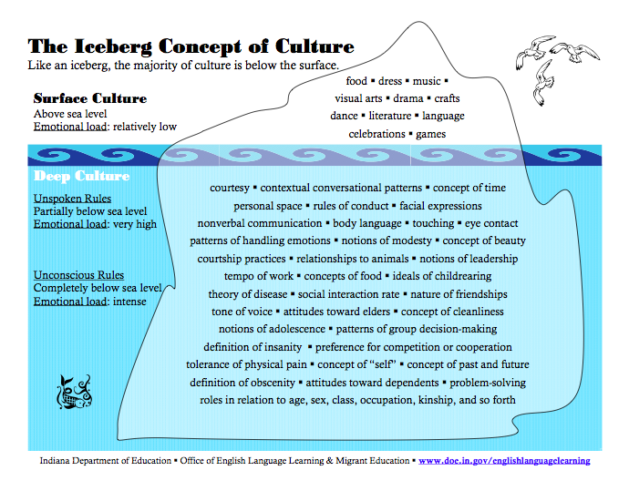
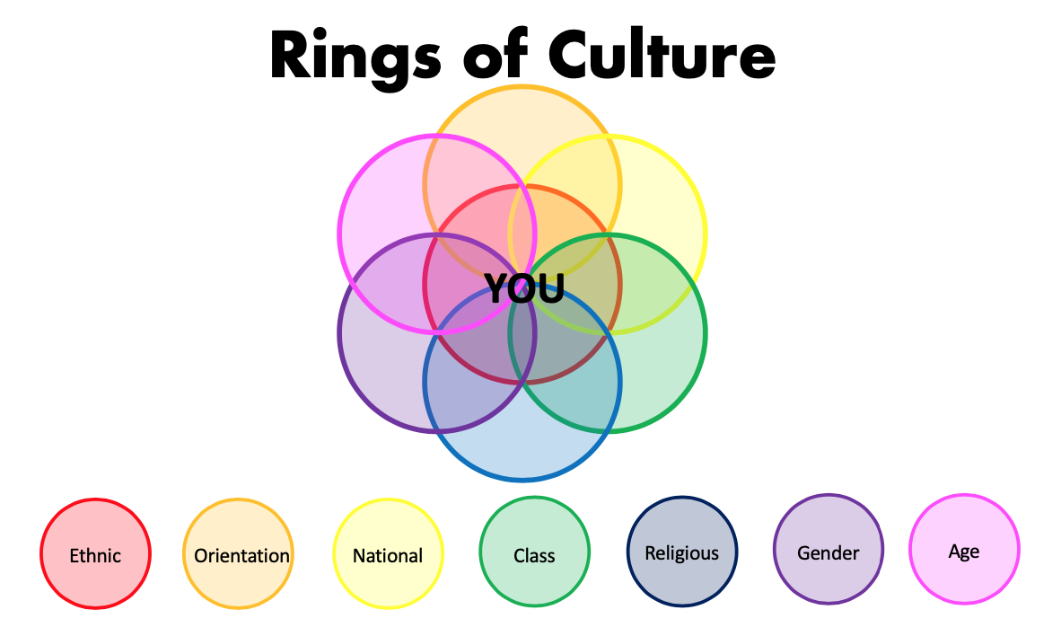
CLR is About Deep Culture and the Rings of Culture

Slide 14
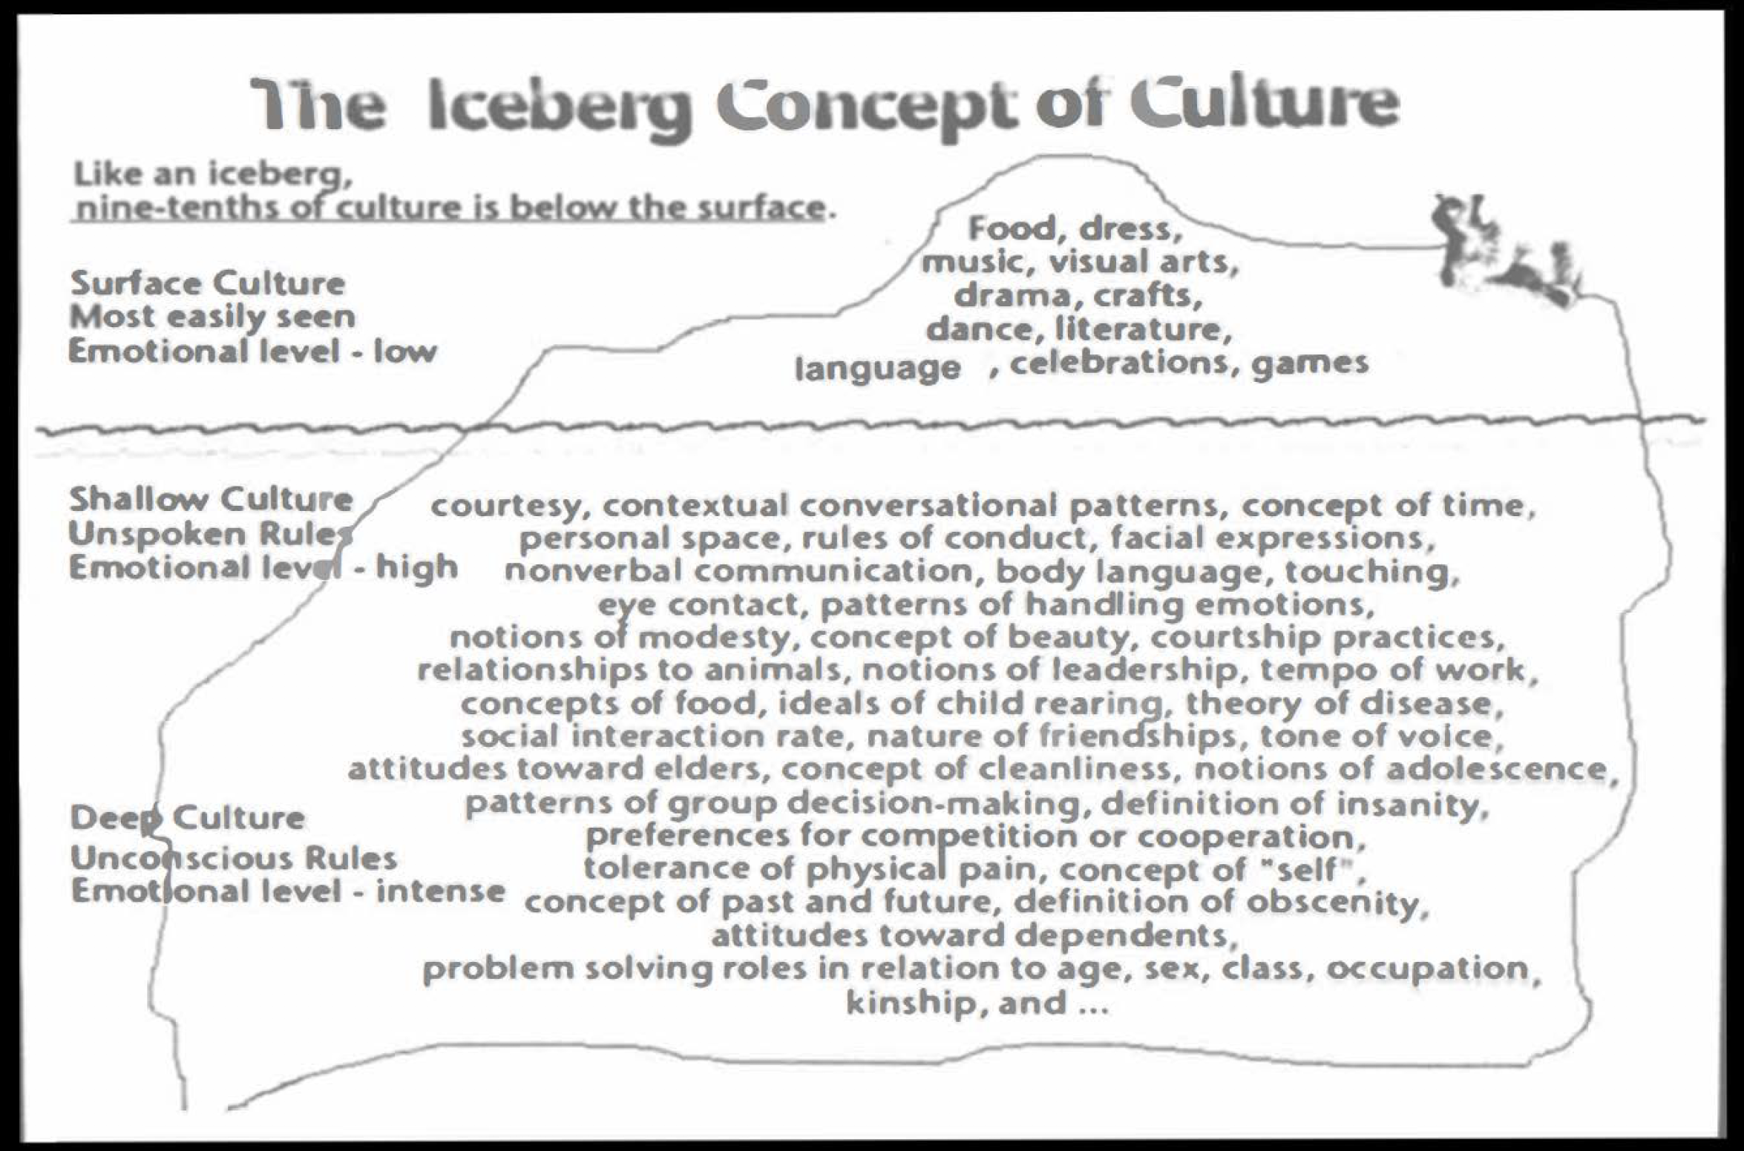
Culture is Intangible (invisible)

Slide 15
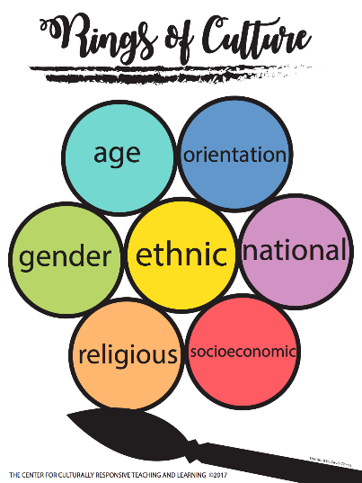

Slide 16

Rings of Culture = “Intersectionalities”
Ethnic
Orientation
National
Class
Religious
Gender
Age

Slide 17
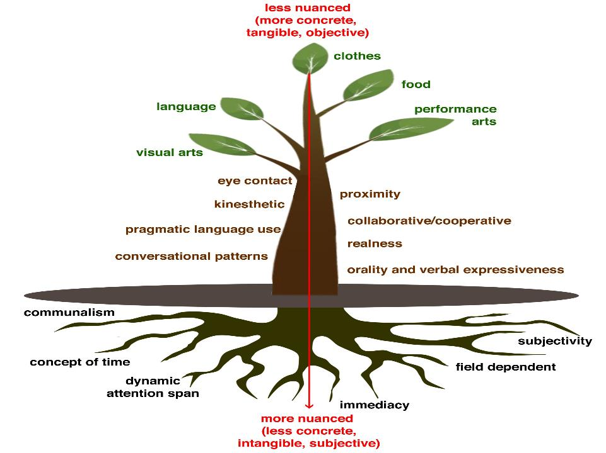
Food
Performing arts
Language
Clothes
Visual arts
Cultural Behaviors We Can See
Communalism
Cultural Behaviors We Cannot See
Proximity
Eye Contact
Non-Verbals
Concept of Time
Heritage
Adapted
Conversational
Patterns
Patterns for Handling Emotions
Tone
of Voice

Slide 18
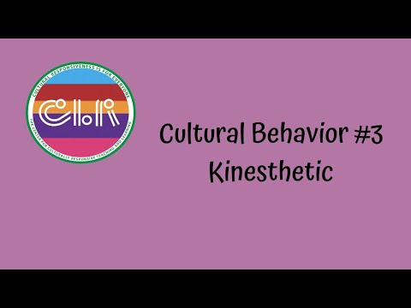

Slide 19
Validating and Affirming Behavior
CLR Infusion: Establish with utmost clarity the difference between cultural behaviors (that are frequently misunderstood) and other behaviors
Activity: Make a list of challenging behaviors, characteristics, traits, etc. that you see in schools. In your breakout rooms sort the behaviors into categories based on cultural behaviors, unacceptable behaviors, characteristics of a disability/disorder or manifestation of a mental health issue.
Name It, Don’t Shame It!
Cultural Behaviors (that are misunderstood) | Unacceptable | Characteristic of a Disability/Disorder | Mental Health
1) Questioning authority /realness 2) Communalism | Quarrelling Antagonizing others | Emotional outburst Overly friendly | Strong feelings of anger Cry for help
Notes:
LIST: https://docs.google.com/spreadsheets/d/1hFFrHCyCXvWvhOdJSoL8fV5Sbn4uxqyf1CT6RPMu5-A/edit?usp=sharing
Suggested ANSWERS: https://docs.google.com/spreadsheets/d/1yiGmQx6x1kzXN3eyoa8Yk-ciCDvKTV9CL-JEVJAfNW0/edit?usp=sharing

Slide 20
Cultural Behaviors (that are misunderstood) | Unacceptable | Characteristic of a Disability/Disorder | Mental Health
1) Questioning authority /realness 2) Communalism | Quarrelling Antagonizing others | Emotional outburst Overly friendly | Strong feelings of anger Cry for help

Slide 21
VALIDATING AND AFFIRMING INSTRUCTIONAL PRACTICES

Slide 22

Let’s Go Bowling
Notes:
Now Let’s Go Bowling with Shelli Moore- While watching this video I want you to think about how the concepts of bowling supports implementation of CLR with SWDs. I want you to jot down 3 or more ideas discussed that really resonate.
Drop them in the chat.

Slide 23
Validating and Affirming Instructional Practices
CLR Infusion: Establish the intersection between the use of CLR activities and the differentiated need(s) of the students.
Activity: Meet Me in the Middle: Applying the concept from the 7-10 Split video, identify (two pins) a characteristic of a disability/disorder (SLD, ID, AUT, ADHD, etc.) and a cultural behavior to VA/BB. Name a CLR activity (the bowling ball) that supports learning for both SWDs and underserved youth. Identify an activity from (here comes the curve) the Protocols for Increasing Student Engagement and the Common Cultural Behaviors of Underserved Children lists.
Characteristics of a Disability | CLR Activity | Cultural Behavior VA/BB
hyperactivity | Musical Shares | high movement
social withdrawal | Two Cents | socio-centrism
Notes:
Drop this in the chat
https://drive.google.com/file/d/1u4MpnsmJKLY4oQNoMiK0WysOdPQnKMvB/view?usp=sharing
https://digitalcommons.uncfsu.edu/cgi/viewcontent.cgi?article=1086&context=jri
https://www.theedadvocate.org/culturally-responsive-teaching-in-special-education/

Slide 24

TAKE-AWAYS
https://vabbacademy.thinkific.com/bundles/cultural-behavior-tutorial-bundle

Slide 25


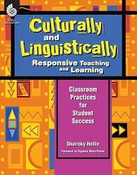
Suggested Next Steps
Subscribe to VABB Perspective Newsletter
Plan a mini-VABBed lesson using the template.
Constantly return to and review Common Cultural Behaviors document.
Summary of CLR Activities At A Glance sheet.

Slide 26
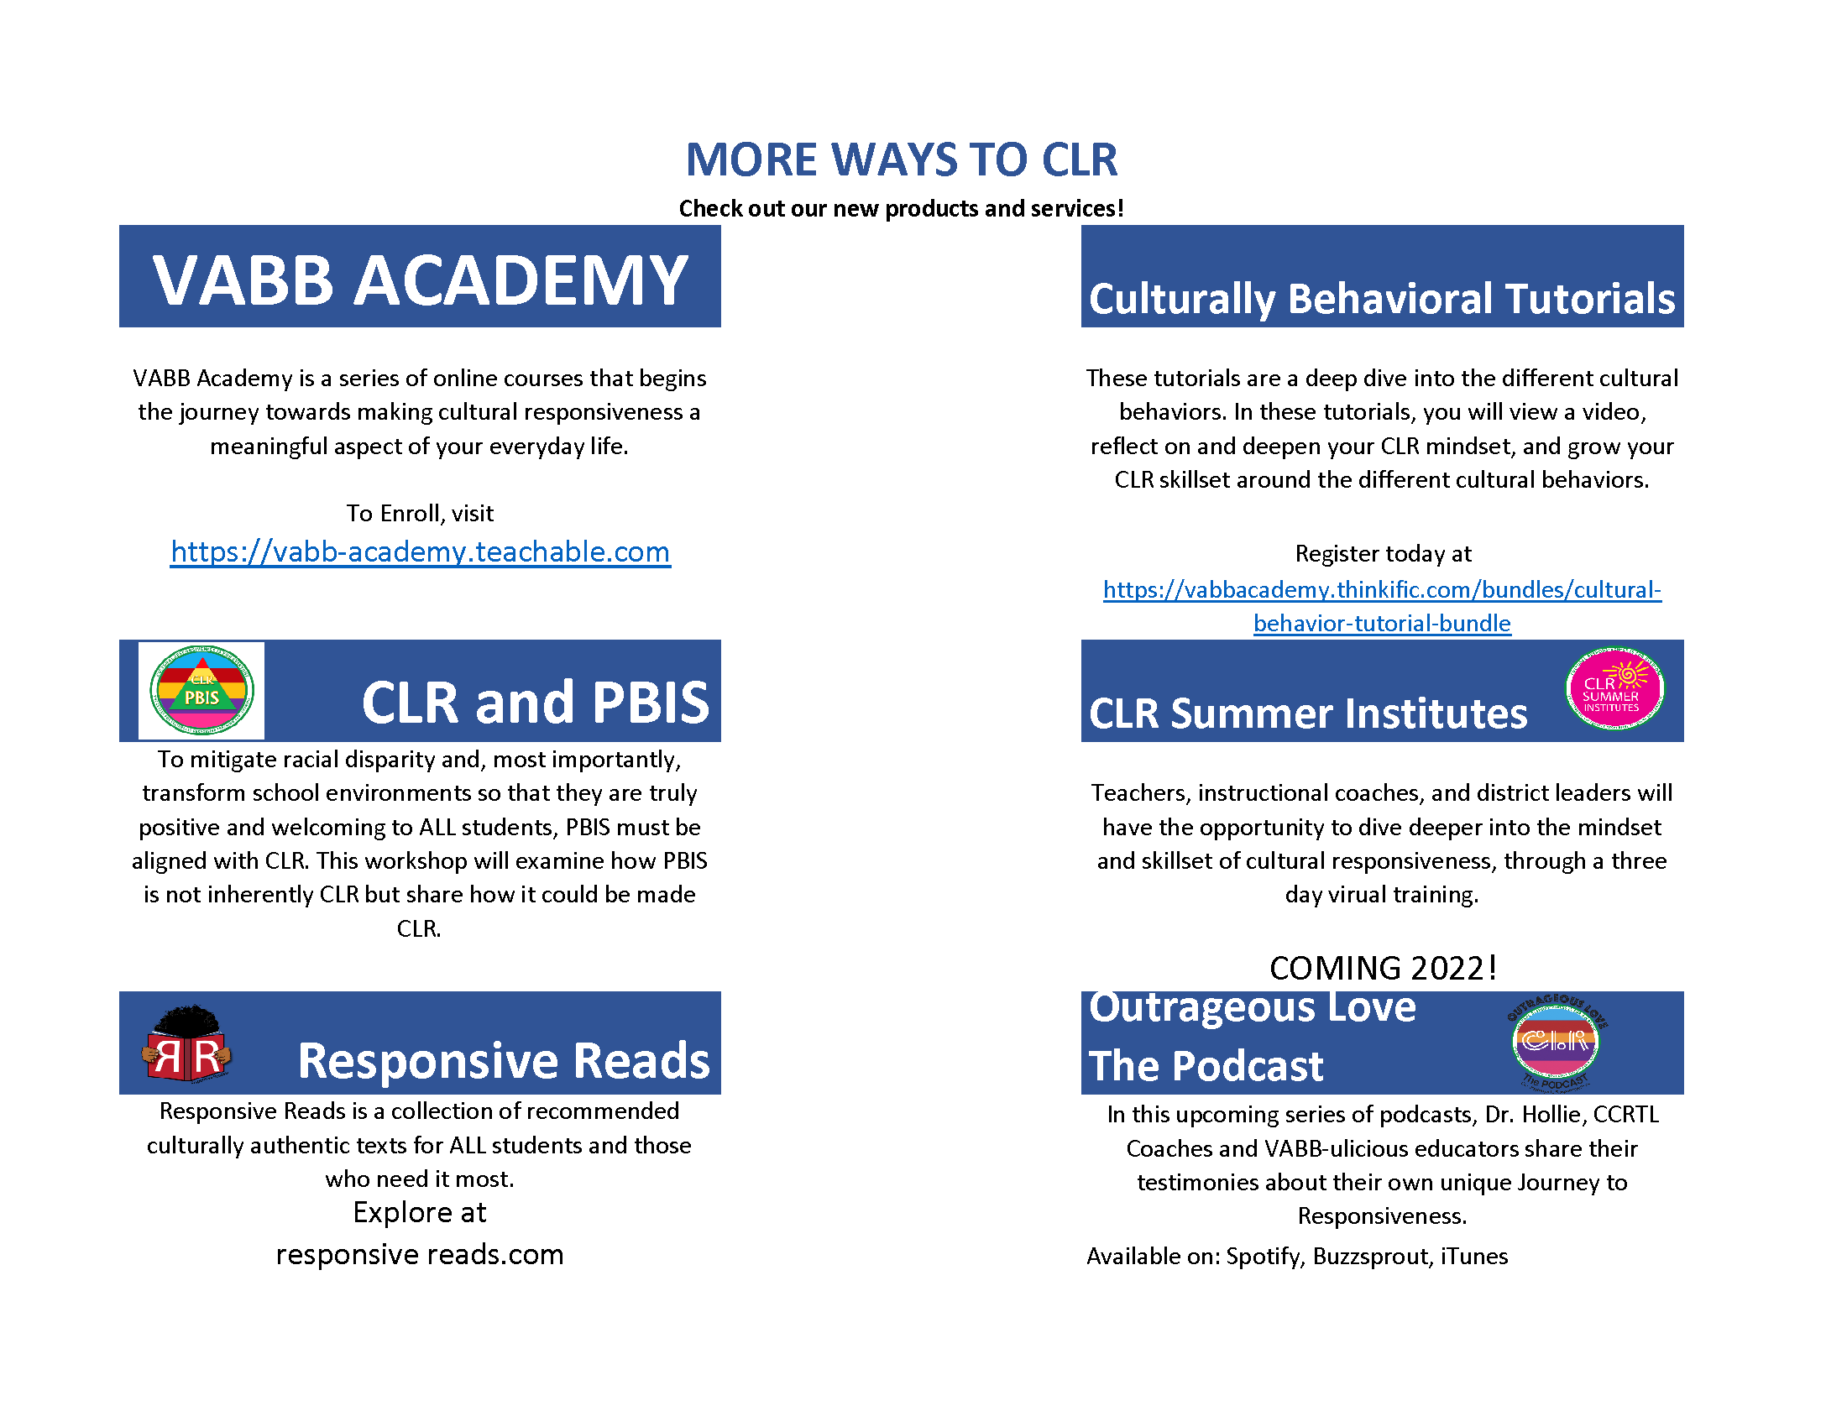

Slide 27
