Slide 1
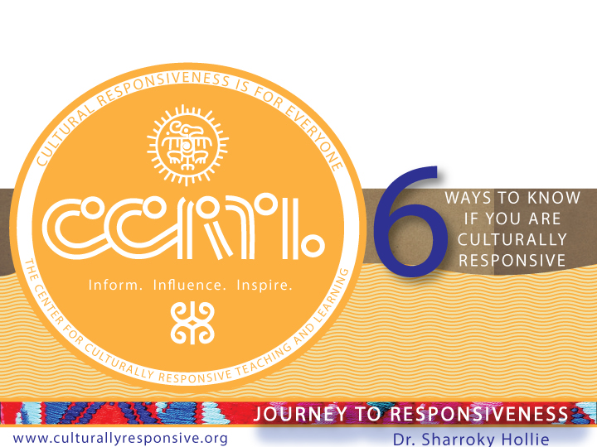

Slide 2
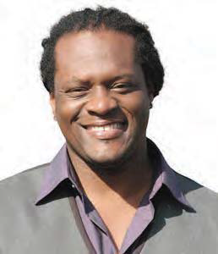

About our Dr. Hollie
Professor Sharroky Hollie is a national educator who provides professional development to thousands of educators in the area of cultural responsiveness. Since 2000, Dr. Hollie has trained over 150,000 educators and worked in nearly 2000 classrooms. Going back 25 years, he has been a classroom teacher at the middle and high school levels, a central office professional development coordinator in Los Angeles Unified School District, a school founder and administrator, and university professor in teacher education at the Cal State University. Sharroky has also been a visiting professor for Webster University in St. Louis and a guest lecturer at Stanford and UCLA.

Slide 3
Our Flow
What is cultural and linguistic responsiveness (CLR)?
Why is it important for all students?
Are YOU culturally and linguistically responsive?
Questions and Answers

Slide 4


Slide 5
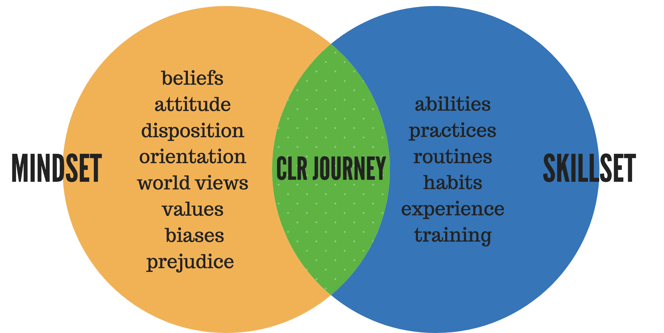

Slide 6
Goal #1 Increase Student Engagement
Do students have a sense of belonging?
🔲 Yes 🔲 No
Are students engaged pedagogically? (instruction)
🔲 Yes 🔲 No
Goal #2 Deal with Inequities
Courage. Articulation. Safe place and space.
Goal #3 Give Outrageous Love
Who needs more love?
Is my heart and mind in the right place?
🔲 Yes 🔲 No

Slide 7
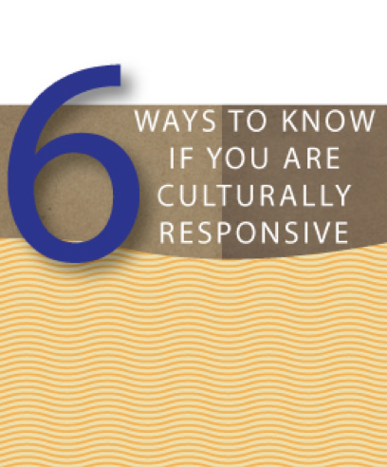
You can define it
Something that you are, not that you do
You are not confused about your identity
You know who you are serving or not serving
You don’t celebrate Black History Month
Practice everyday in everyway

Slide 8
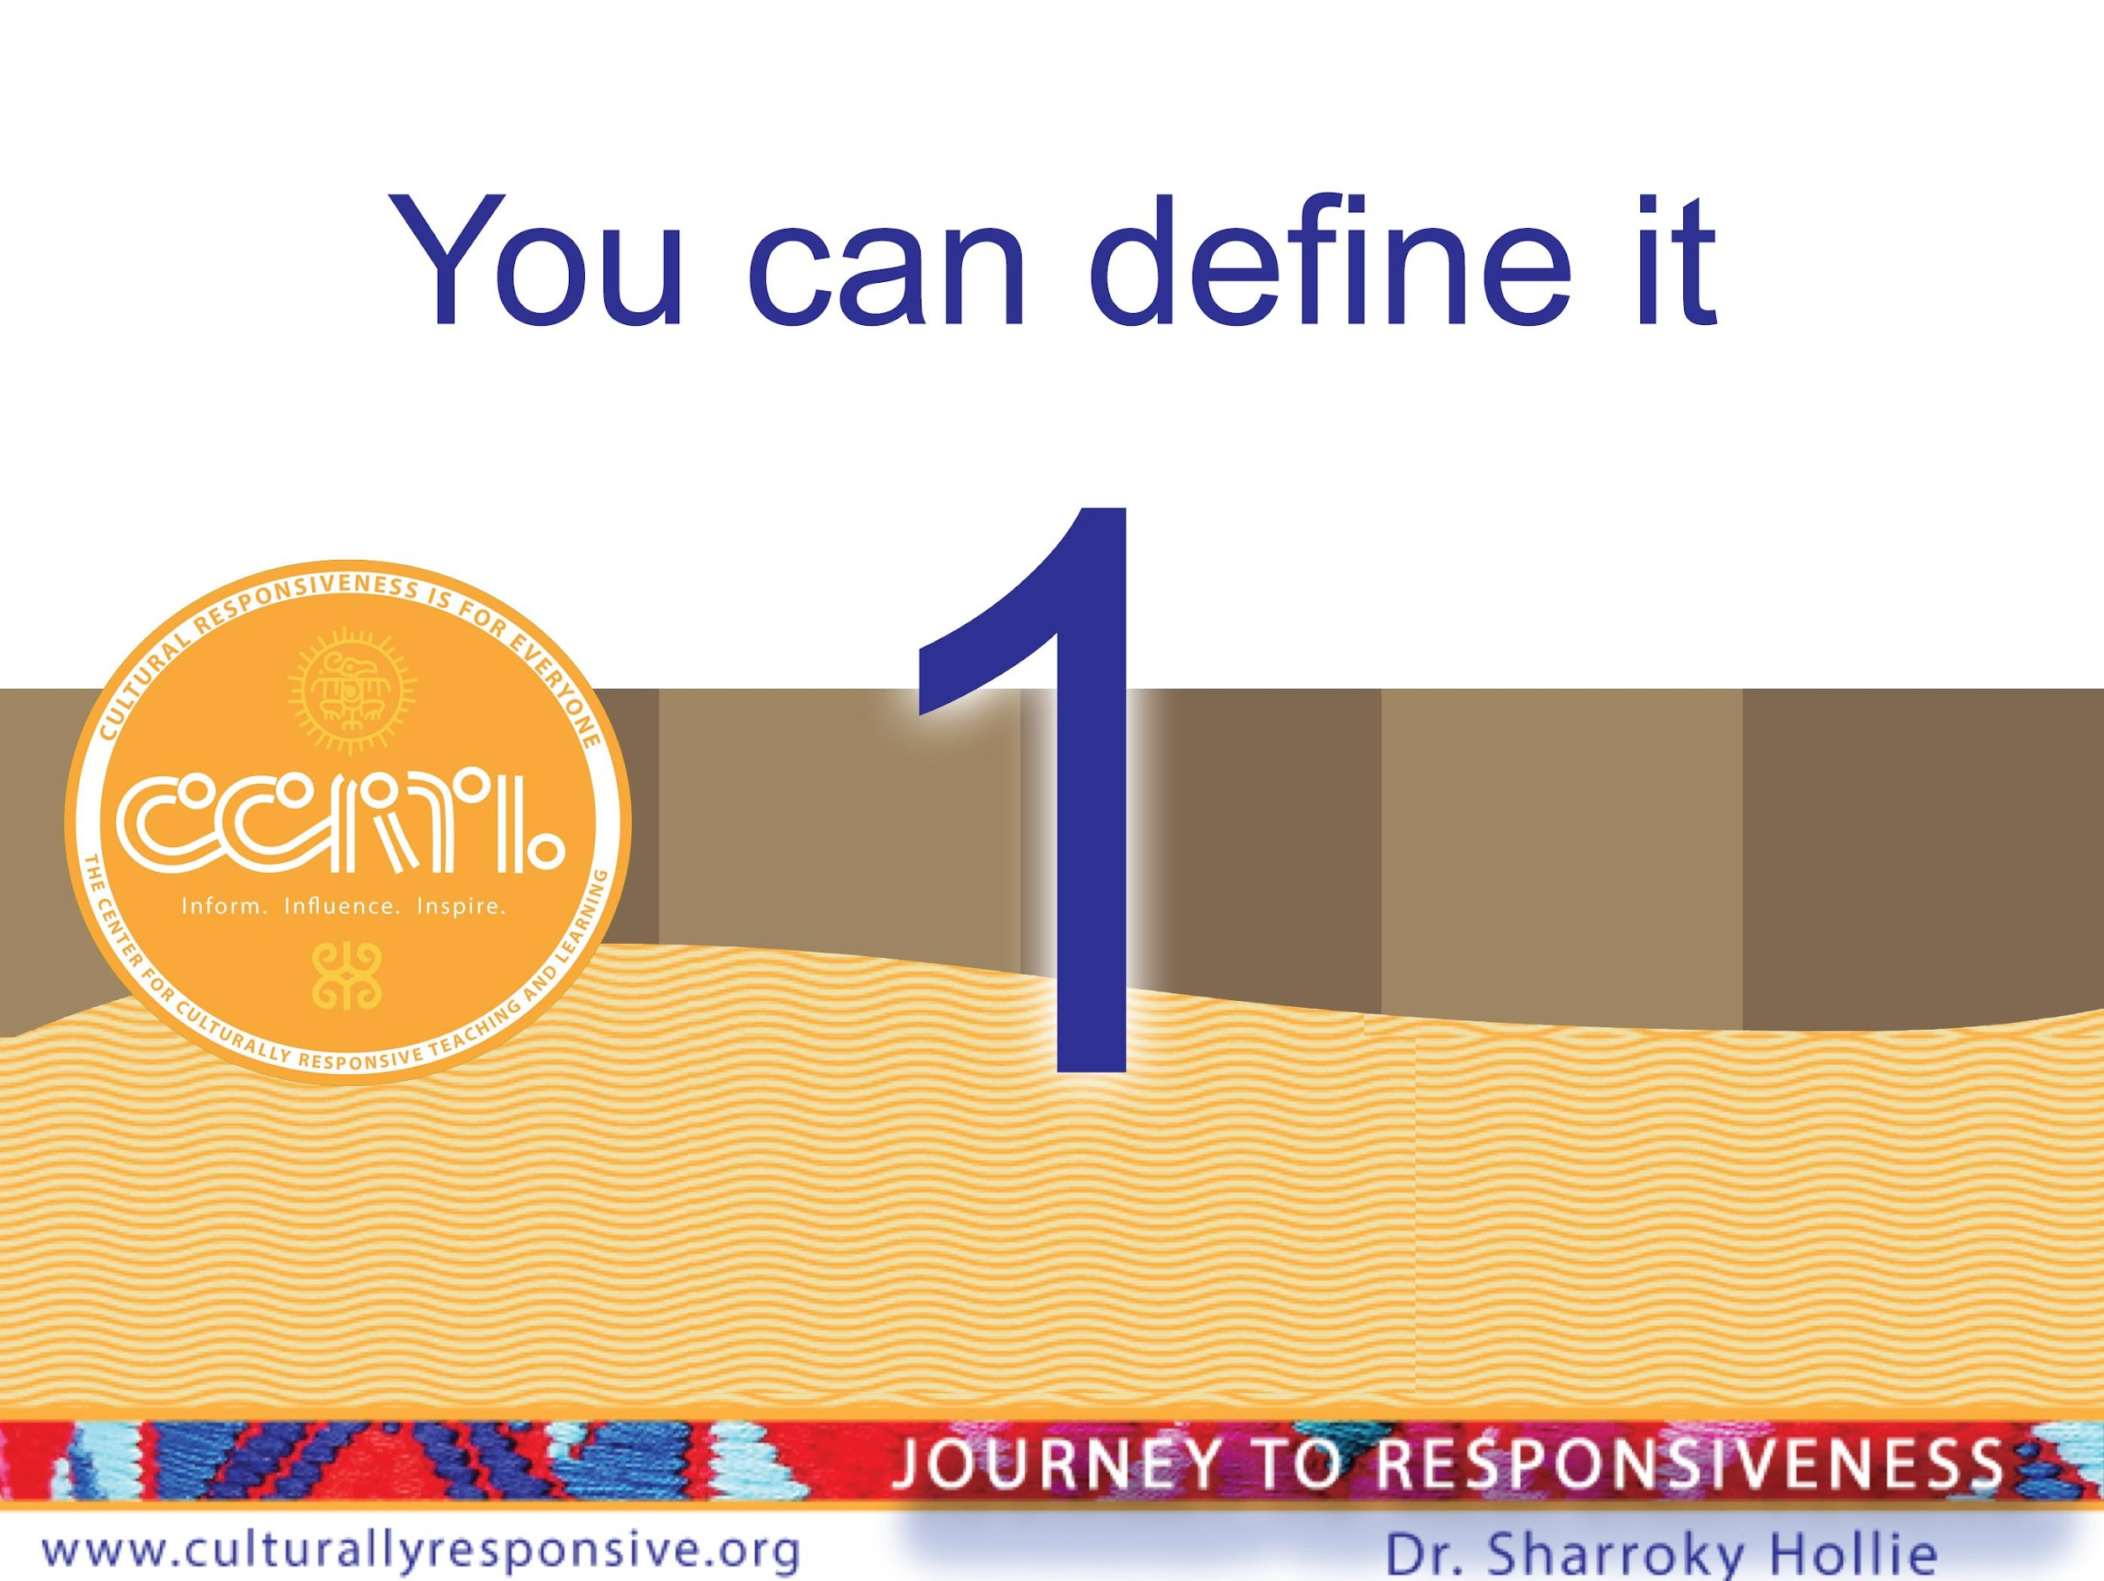
WAY 1
You can define it

Slide 9
Equity
Equity is the umbrella term.
Instruction
Cultural Responsiveness (CLR)
Know your brand of cultural responsiveness.

Slide 10
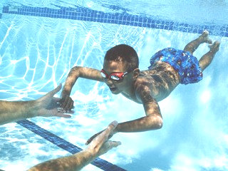
What Exactly Is Culturally and Linguistically Responsive Teaching and Learning (CLR)?
CLR is:
“The validation and affirmation of the home (indigenous) culture and home language for the purposes of building and bridging the student to success in the culture of academia and mainstream society.”
—Hollie, Culturally and Linguistically Responsive Teaching and Learning: Classroom Practices for Student Success (2017)
CLR is going where the students are culturally and linguistically for the purpose of bringing them where they need to be academically.
CLR is the opposite of the sink-or-swim approach to teaching and learning, or traditional schooling.

Slide 11
VABB
VALIDATE Make legitimate that which the institution (academia) and mainstream media have made illegitimate culturally and linguistically
Validate
Making legitimate that
which the institution (academia) and mainstream media have made illegitimate culturally and linguistically
Affirm
Making positive that which
the institution (academia)
and mainstream media have made negative culturally and linguistically
V
A
Build
Making the connections between the home culture/language and the school culture/language through instruction (teaching necessary skil) for success in school and the broader social context
Bridge
Providing opportunities for situational appropriateness or utilizing appropriate cultural or linguistic behaviors
AFFIRM Make positive that which the institution (academia) and mainstream media have made negative culturally and linguistically
BUILD Create the connections between the home culture/language and the school culture/language through instruction (teaching necessary skills) for success in school and the broader social context
B
B
BRIDGE Create opportunities for situational appropriateness or utilizing appropriate cultural or linguistic behaviors

Slide 12
Three Ways To VABB
Relate To Differently
Talk To Differently
Teach Differently
Difference = Responsiveness
Responsiveness

Slide 13
Our Thesis
Students come to school with valid cultural and linguistic behaviors that the school culture, as an institution, misconstrues or misunderstands, which then lead to a series of inequities.

Slide 14

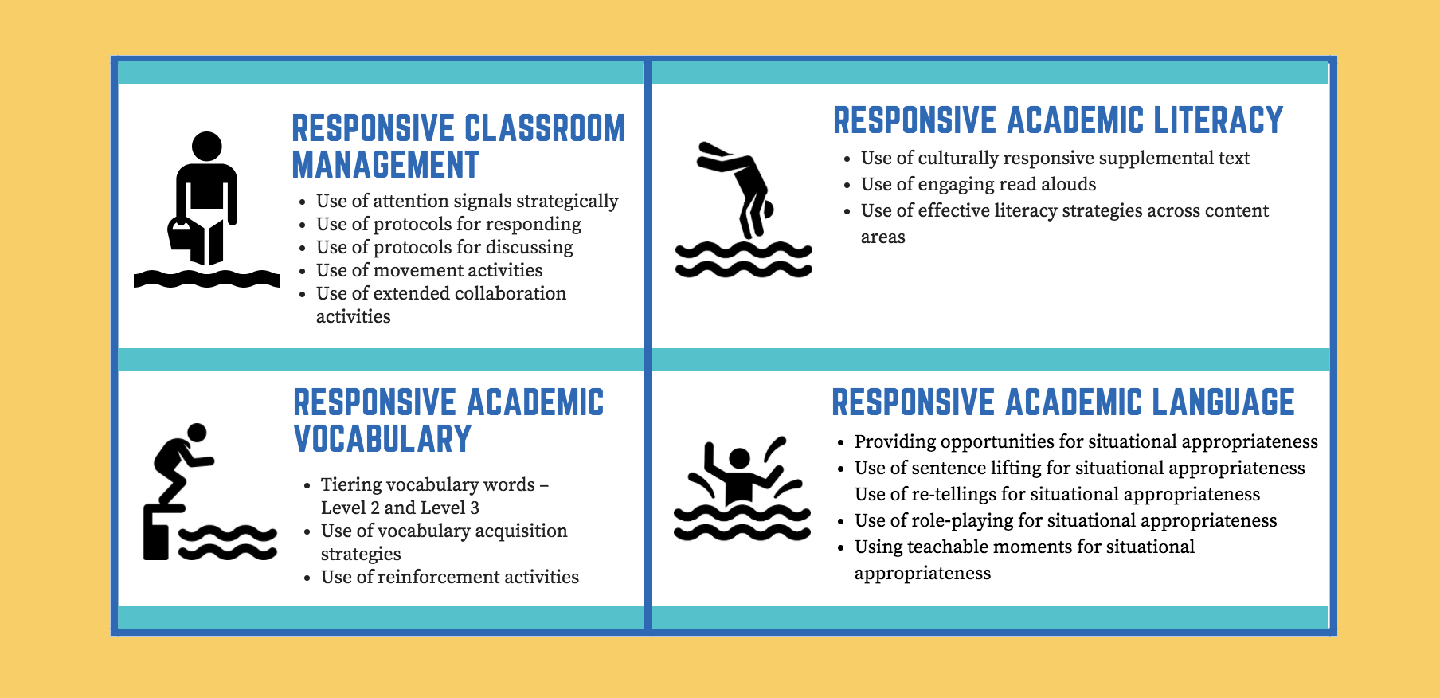
Diving Into Pool of CLR Activities
1
3
2
4

Slide 15
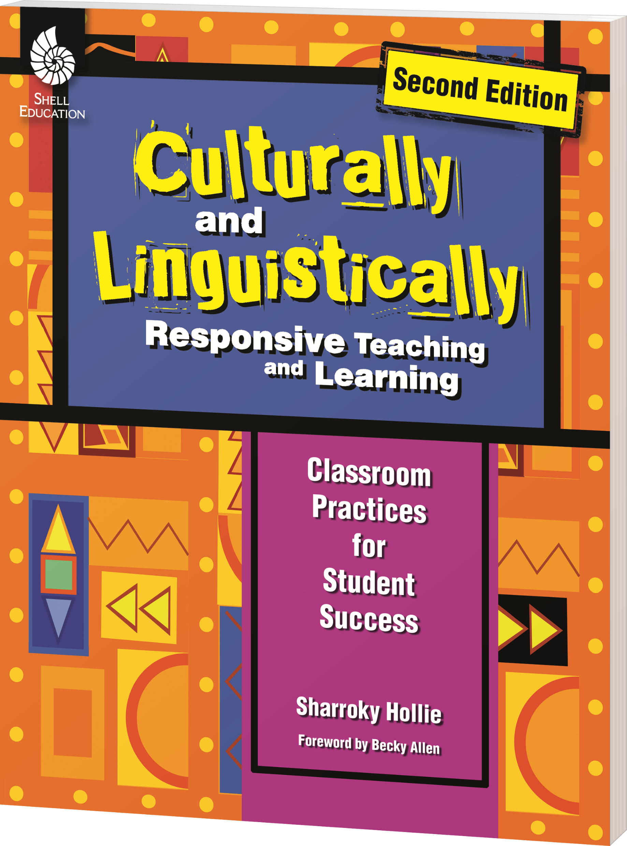
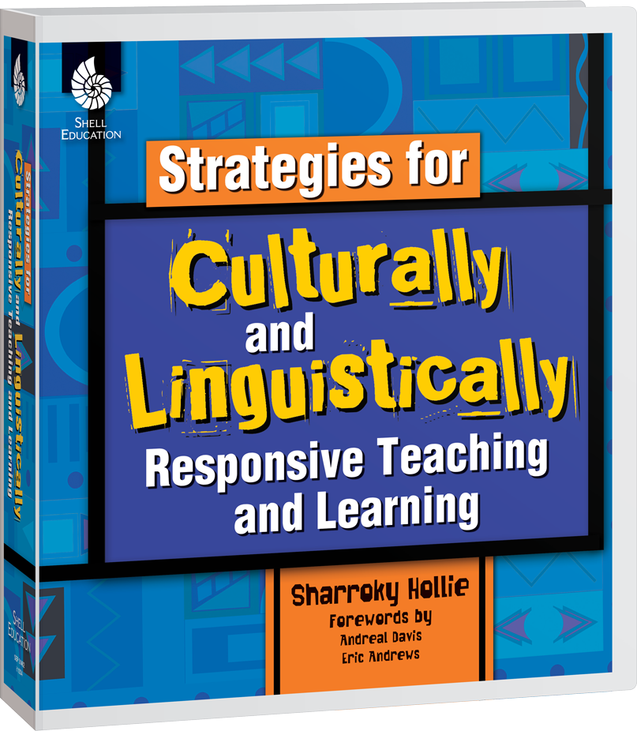
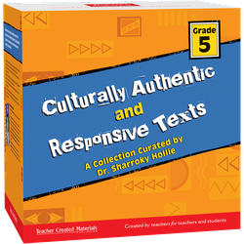
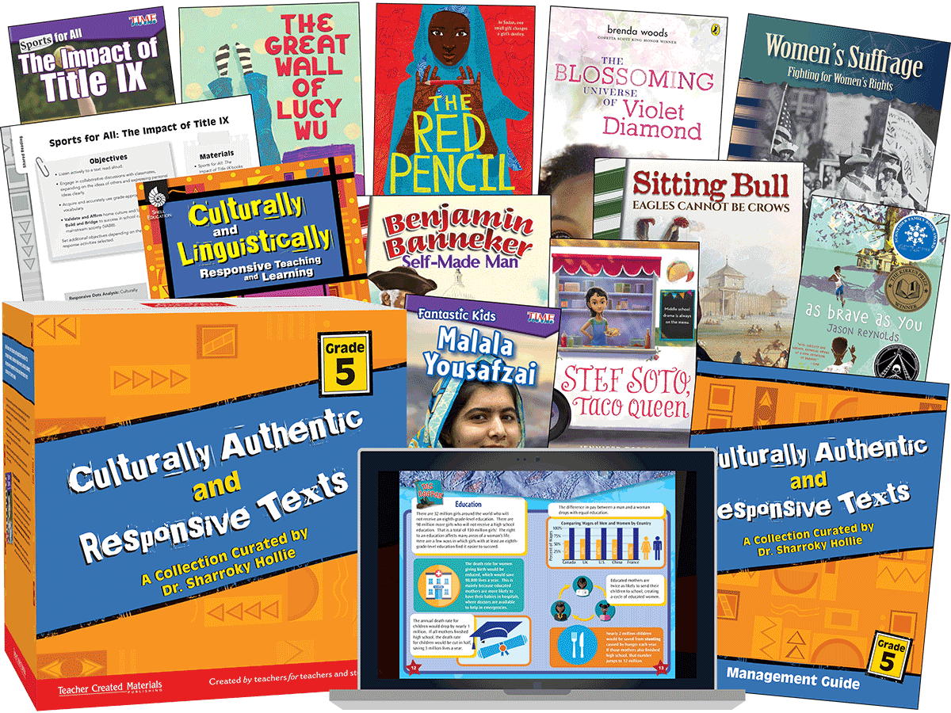

Slide 16
WE
V.A.B.B.
HERE!
Dr. Sharroky Hollie
Design and Illustration by Carleen Matts

Slide 17
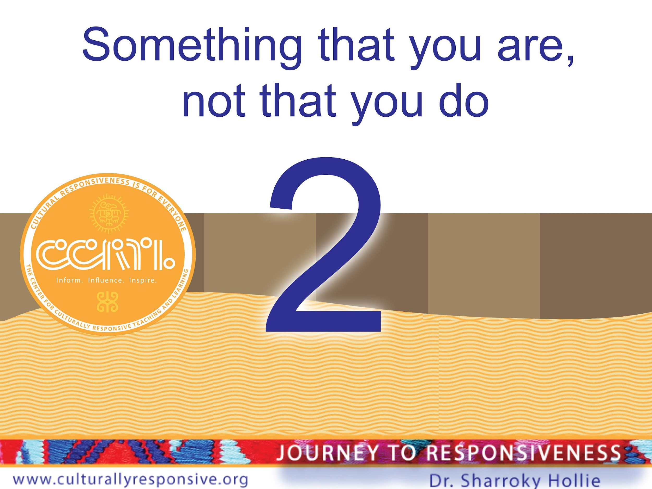
WAY 2

Slide 18
Are culturally responsive educators
born or made?

Slide 19
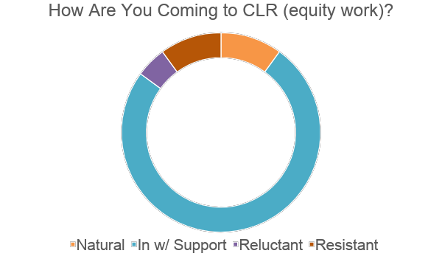

Slide 20
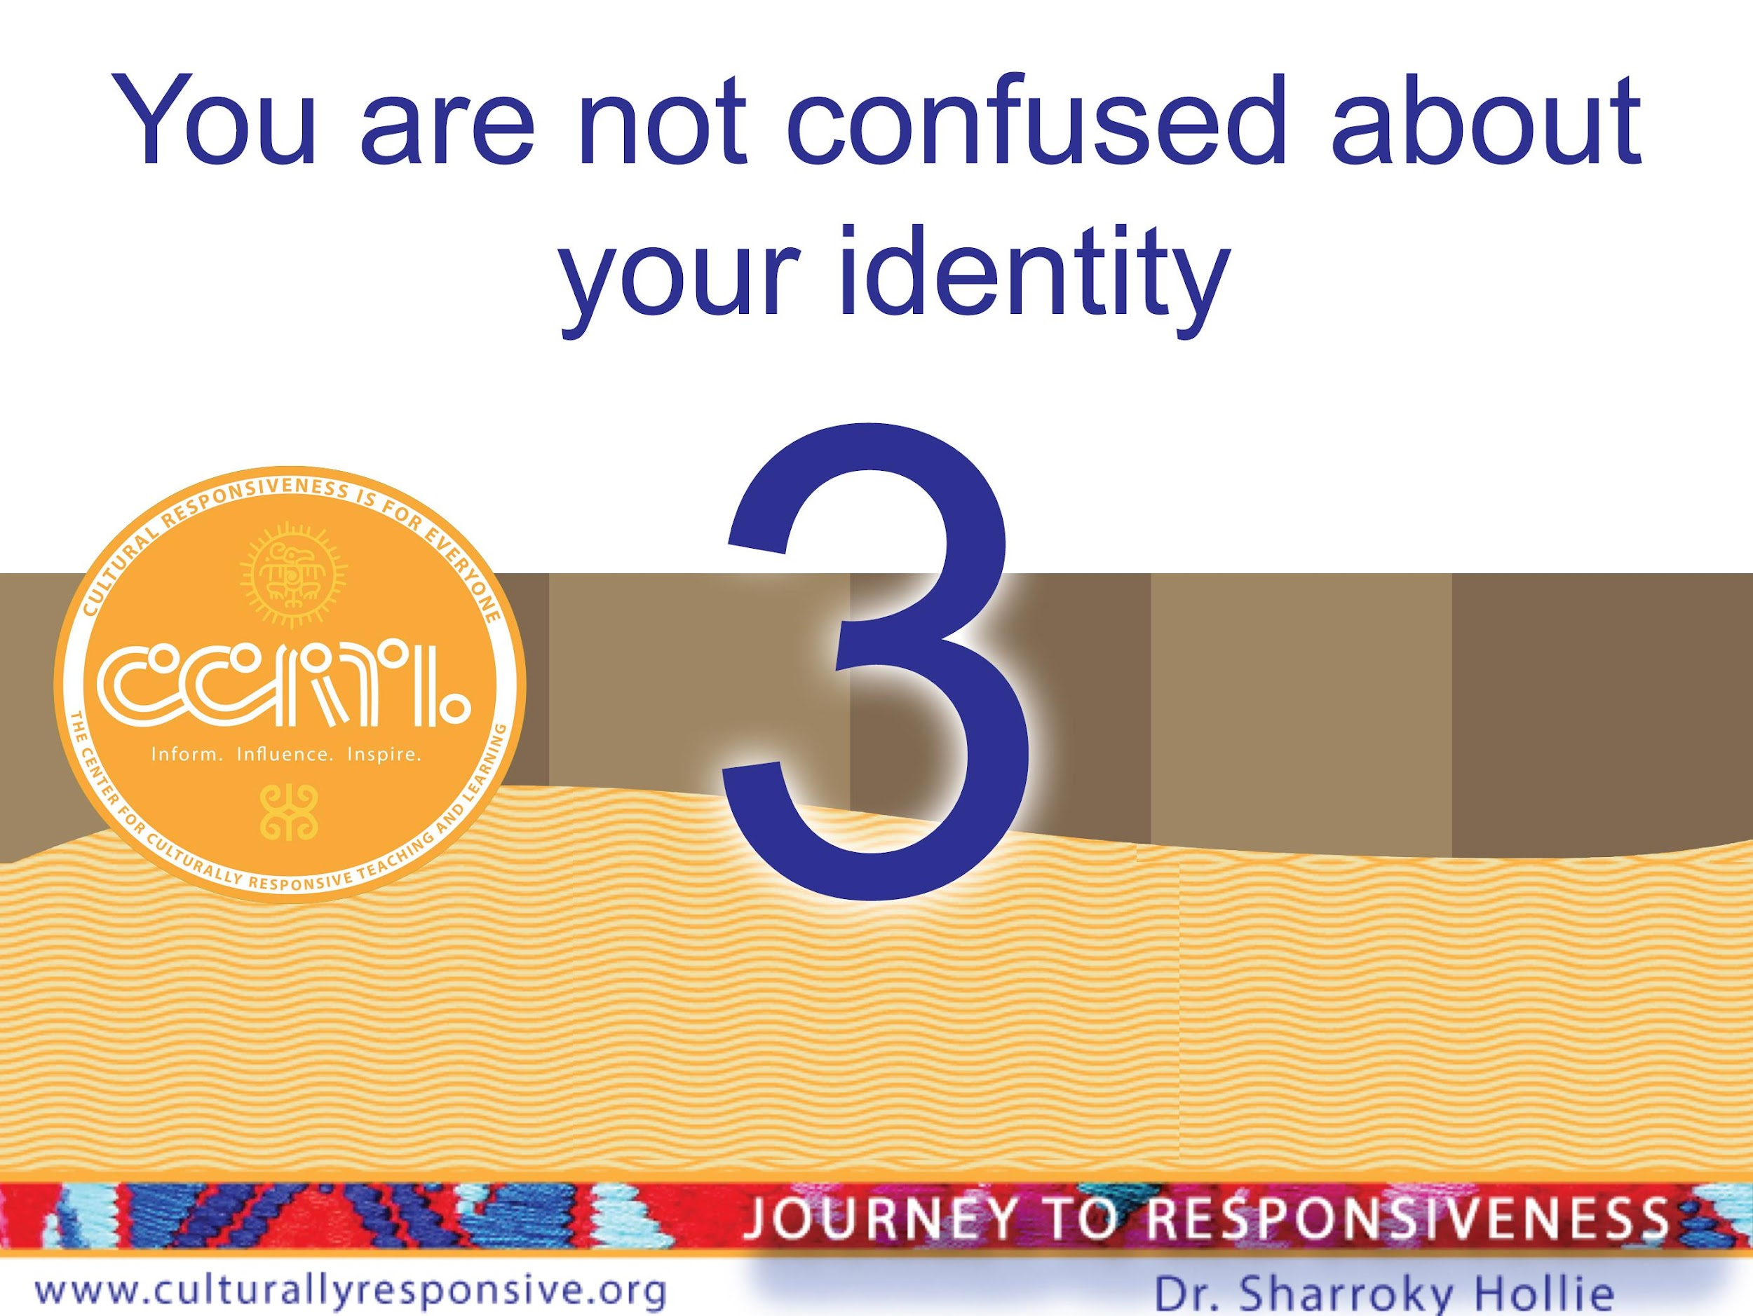

Slide 21
Do You Know Who You Are…Culturally Speaking?
SECTION THREE: ANTHROPOLOGY
My Racial Identity
Identity
Behavior
My Ethnic Identity
Identity
Behavior
Notes:
Separate first box from second box on handout

Slide 22
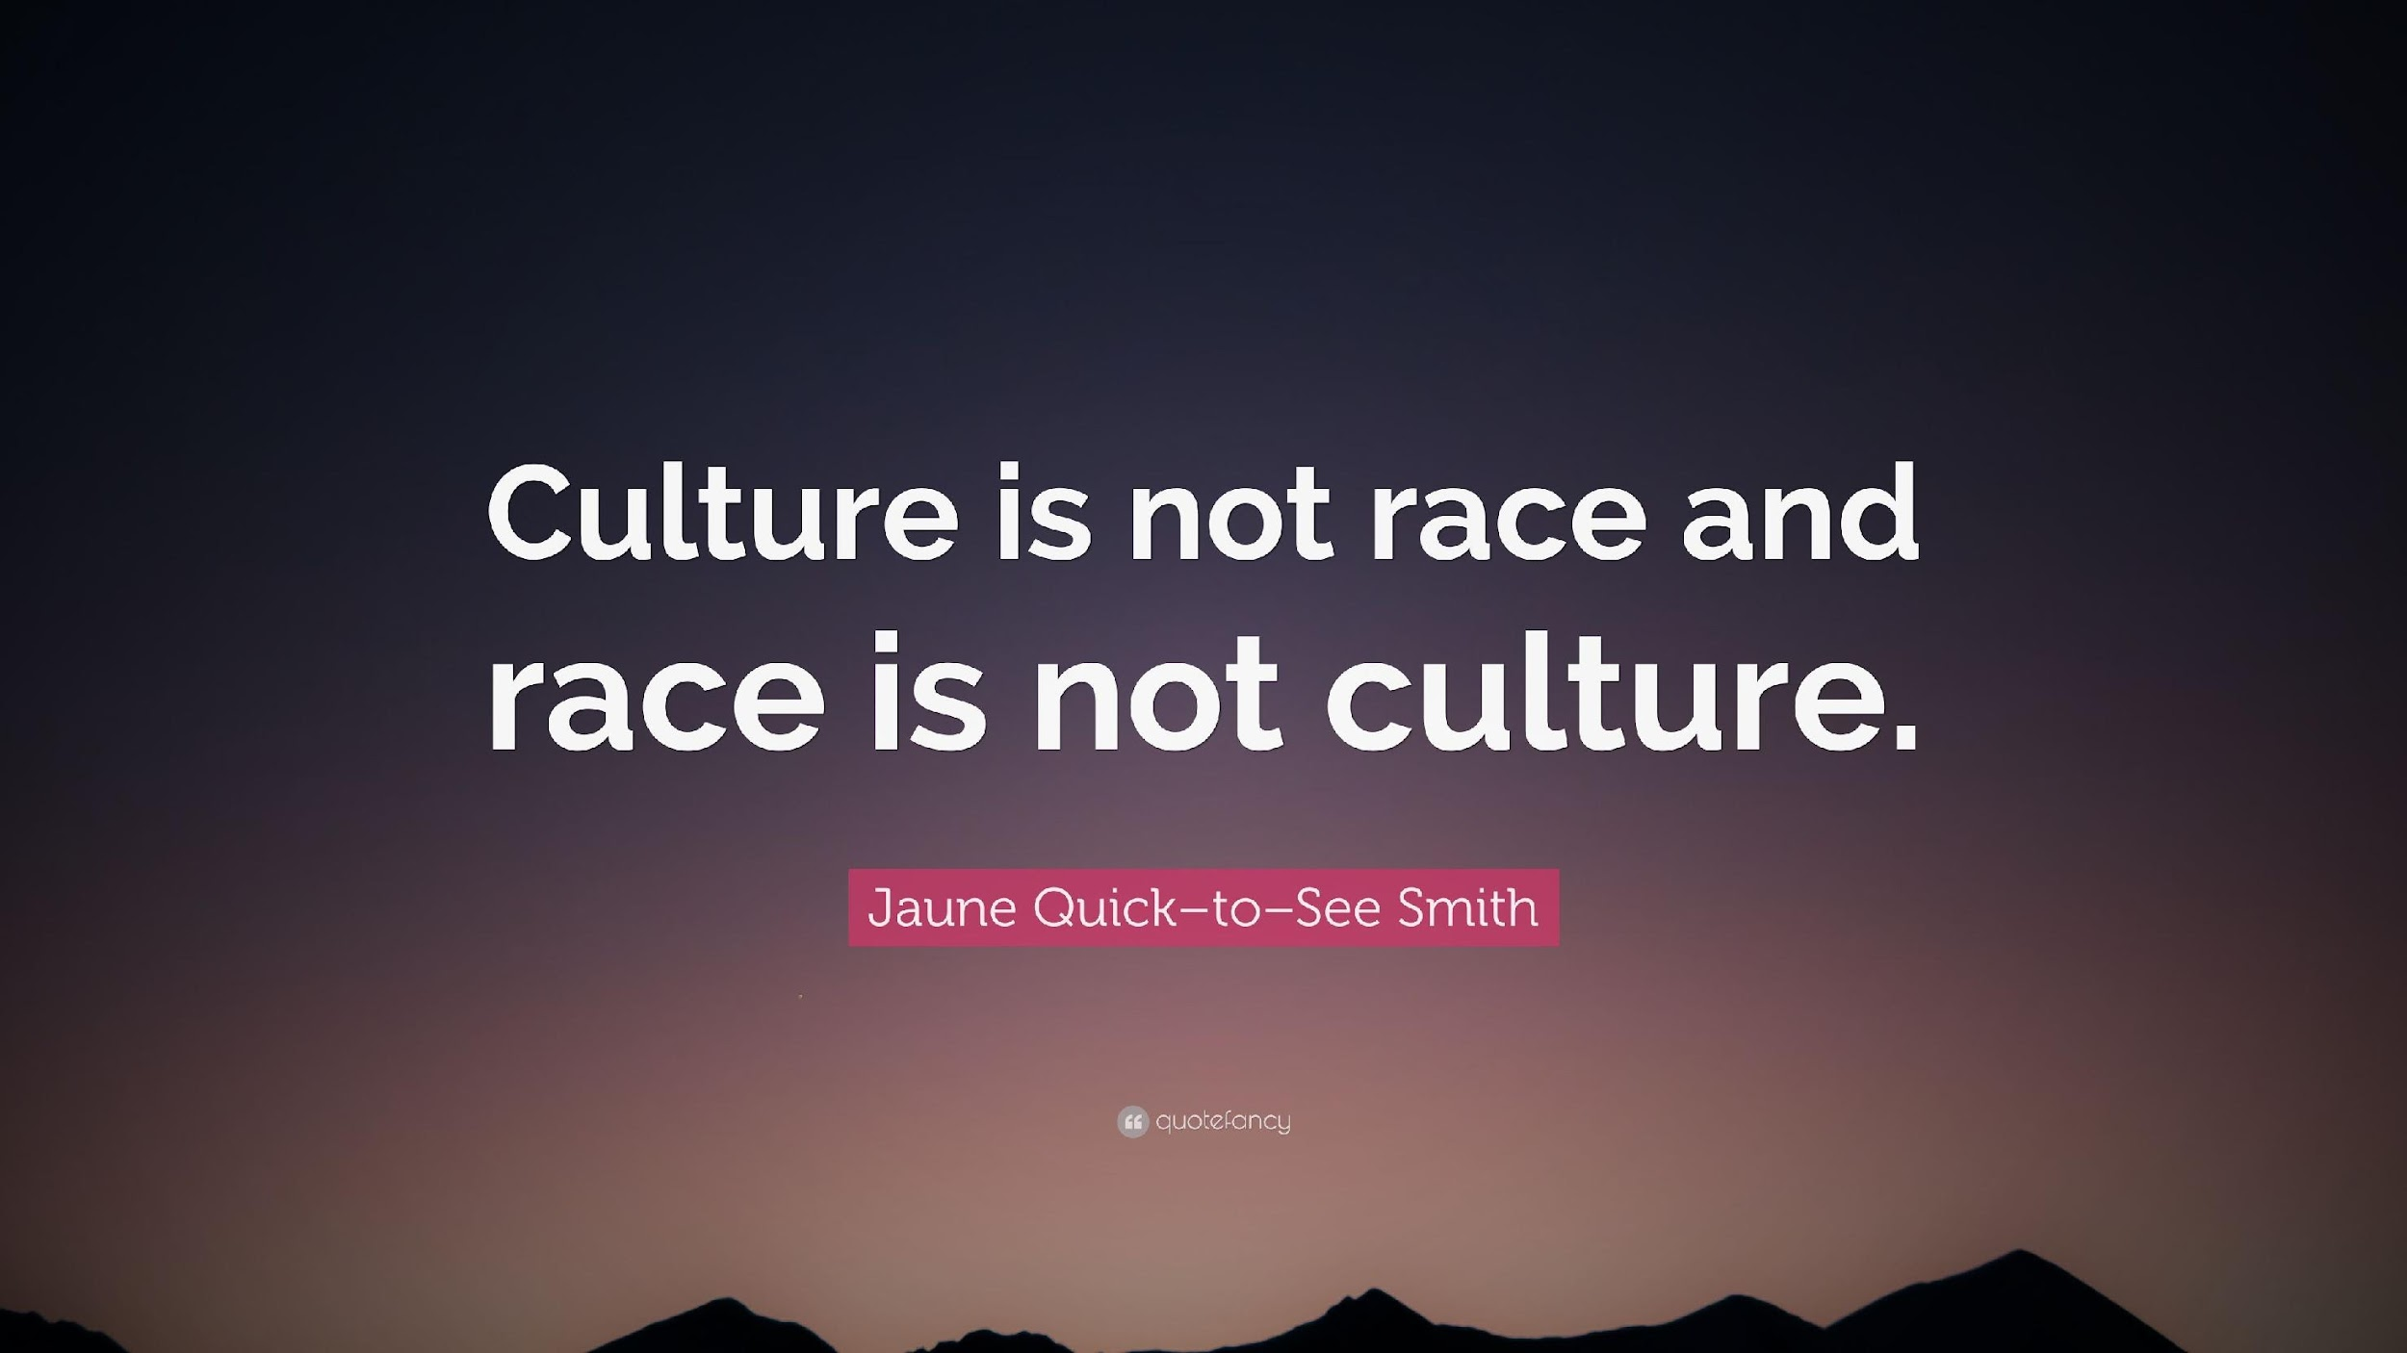

Slide 23
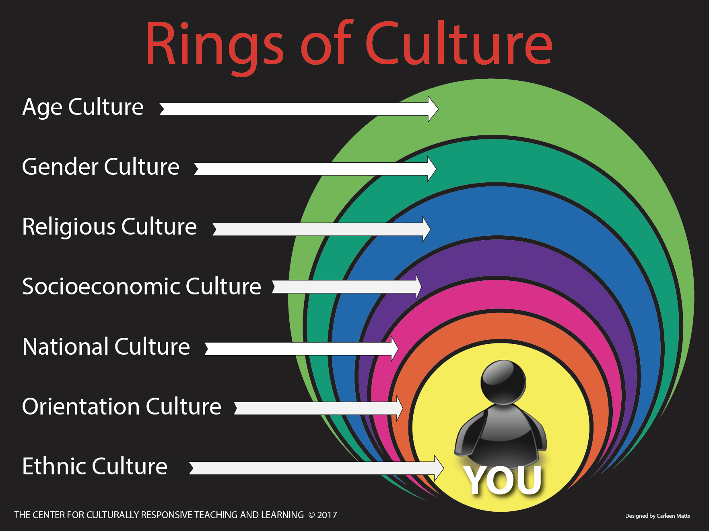

Slide 24
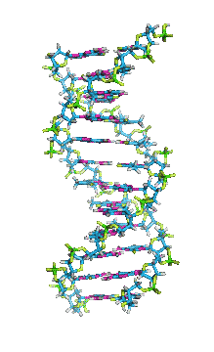
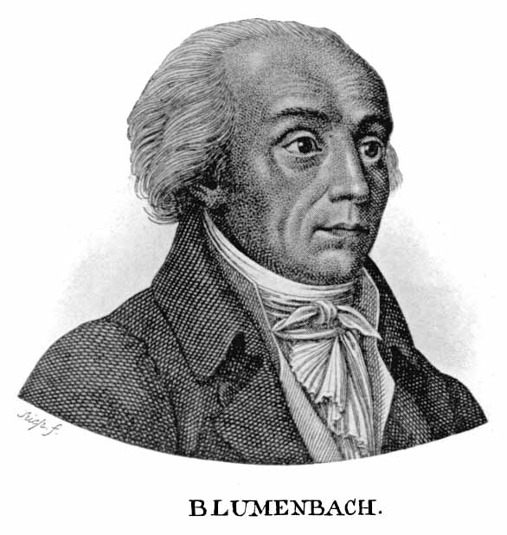
Have You Been Blumenbached?
How have you defined race? What is/was your source?
What is your
racial identity?

Slide 25
History of Racial Classification
“Caucasian variety. I have taken the name of this variety from Mount Caucasus, both because its neighborhood, and especially its southern slope, produces the most beautiful race of men, and because … in that region, if anywhere, we ought with the greatest probability to place the autochthones [original forms] of mankind.”
—J. F. Blumenbach, German naturalist, quoted from his 1795 seminal work, On the Natural Variety of Mankind, in Gould, The Mismeasure of Man (1996)
Notes:
New background/theme

Slide 26
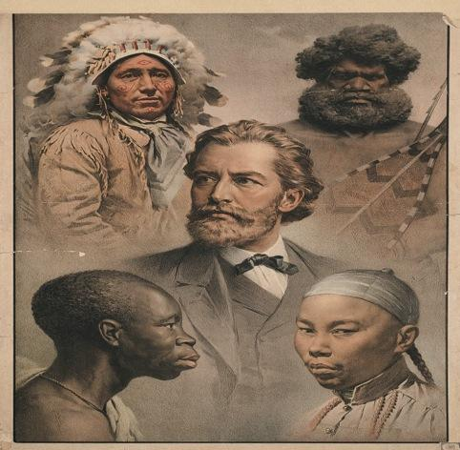
Original Five Classified Races
Mongolian (Eastern Asia)
Ethiopian (Africa)
Caucasian (Europe and adjacent areas)
Natives (Americas)
Malaysian (Pacific Islands)
Race is arbitrary.
Notes:
Cleaner image of five original races if you can find it.

Slide 27
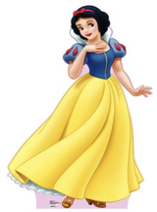
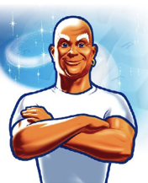
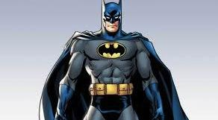
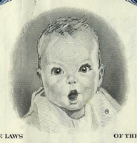
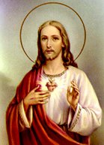
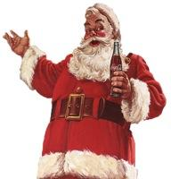
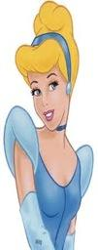
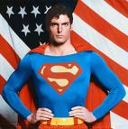
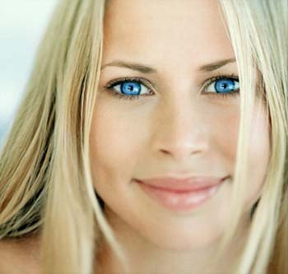
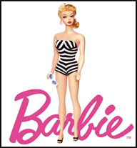

Slide 28
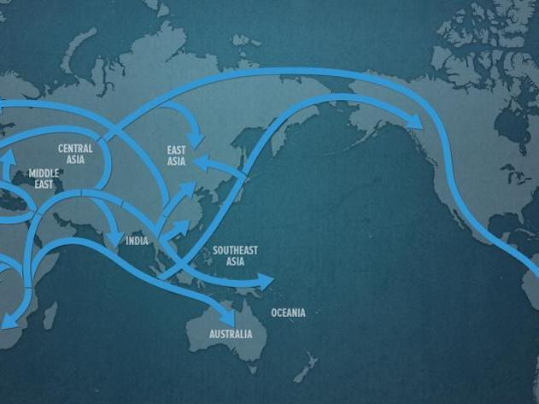
So, What is Race?
Genetic Lineage (forensic identification, possible diseases, phenotypes)
Story of human geography
Socially constructed (historically)

Slide 29

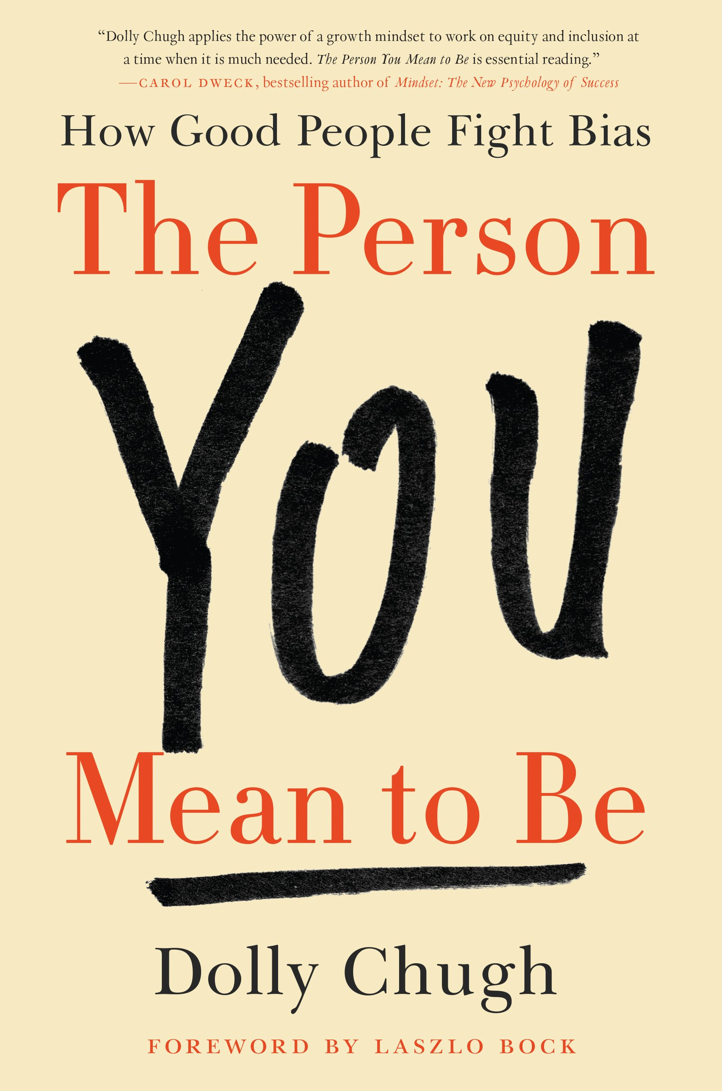
Are you attuned to your biases?
“[We all] have reminiscences which [we] would not tell everyone but only to [our] friends. [We] have other matters in [our] mind which [we] will not reveal to even [our] friends, but only to [ourselves], and that in secret. But there are other things which [we] are afraid to tell even to ourselves, and every decent person has a number of such things stored away in [our] minds.”

Slide 30
It may be your
FIRST
thought;
LAST
don’t let it be your
thought!
Dr. Sharroky Hollie
Design and Illustration by Carleen Matts

Slide 31
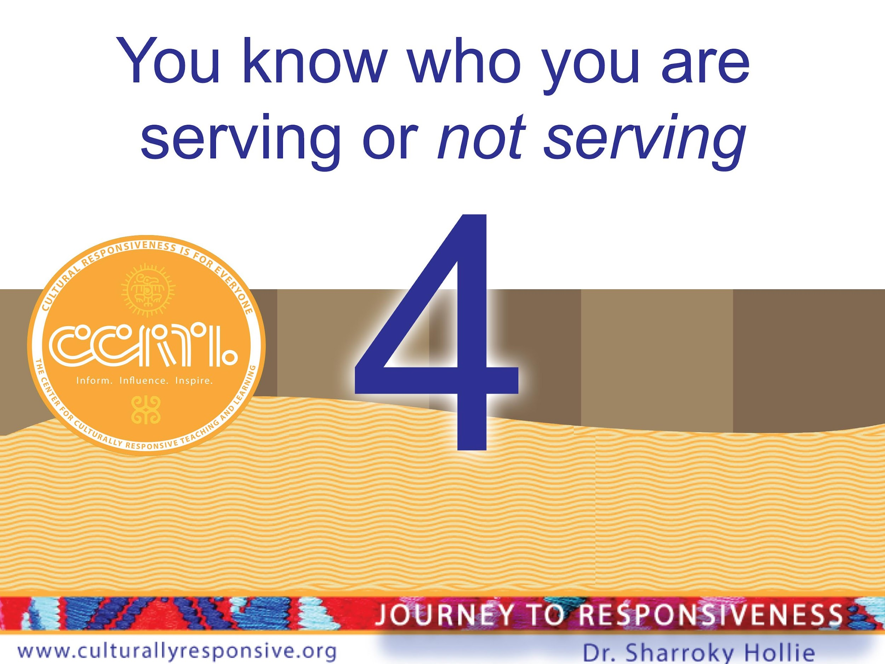

Slide 32
You Know Who You are Serving
Key term 2 is underserved:
An underserved student is any student who is not successful academically, socially, and/or behaviorally in school because the school as an institution is not being responsive to the student.
Words to consider when thinking of your underserved:
Disproportionality – Historic - Institutional

Slide 33

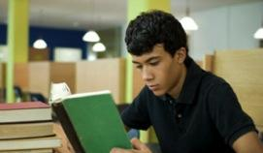
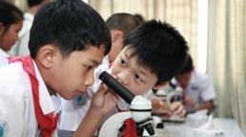
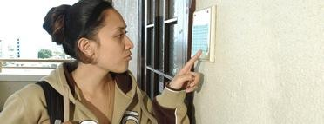
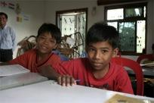
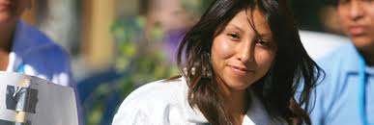
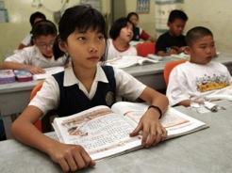
Top Five Underserved Populations
Native Americans
African Americans
Mexican Americans*
Hawaiian Americans
Asian Americans*
*Not all Latinx (code)
*Not all Asians (code)
Notes:
New background. Re-image. Need an image of a student from each ethnic background.

Slide 34
Break The Code
Go Four Deep
Are there any ____________ students having success?
Yes or No. If yes, go to next question.
If no, then stop here.
Among those students not having success, who is the most likely to be underserved?
Of that group, are there any ____________ students having success? Yes or No. If yes, go to next question. If no, then stop here.
Among those students not having success, who
is the most likely to be underserved?

Slide 35
Go Four Deep (Variables). No More Generalizations.
English Learners
Boys
Non-Spanish Language
Poor

Slide 36
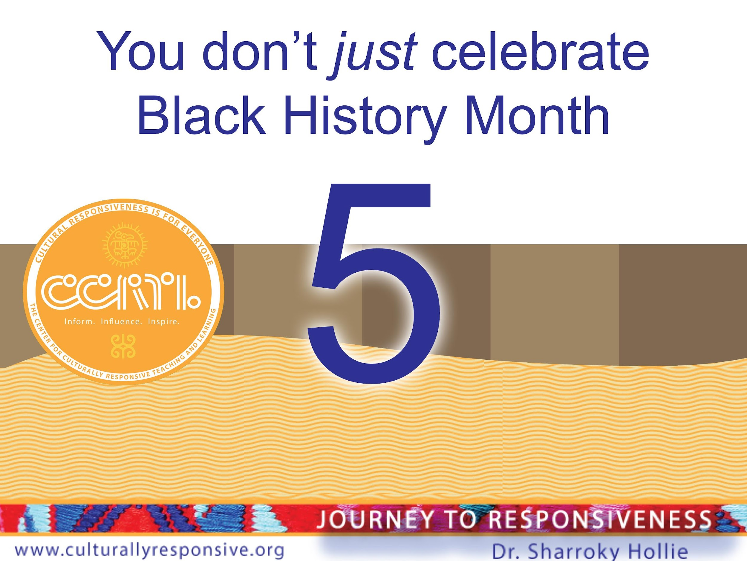

Slide 37
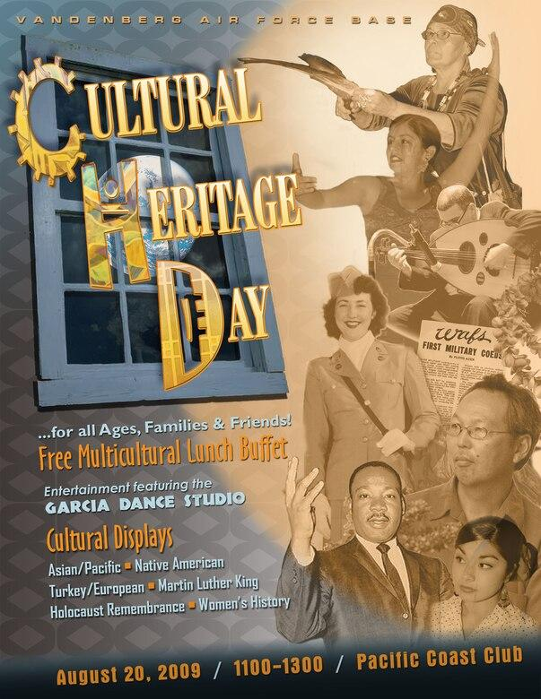
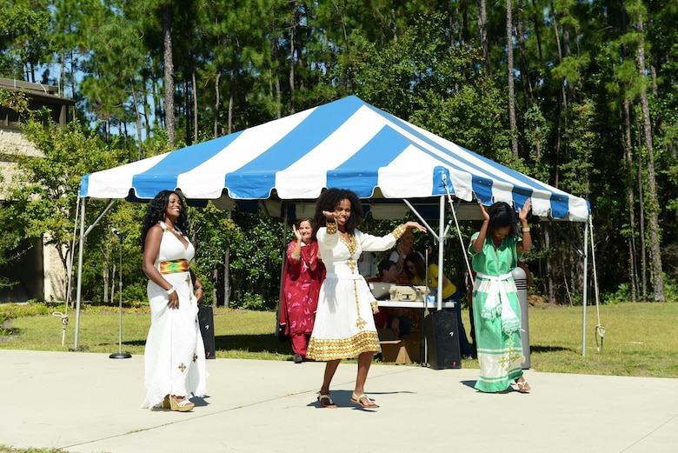
Celebrate Culture Everyday in Any Way!

Slide 38
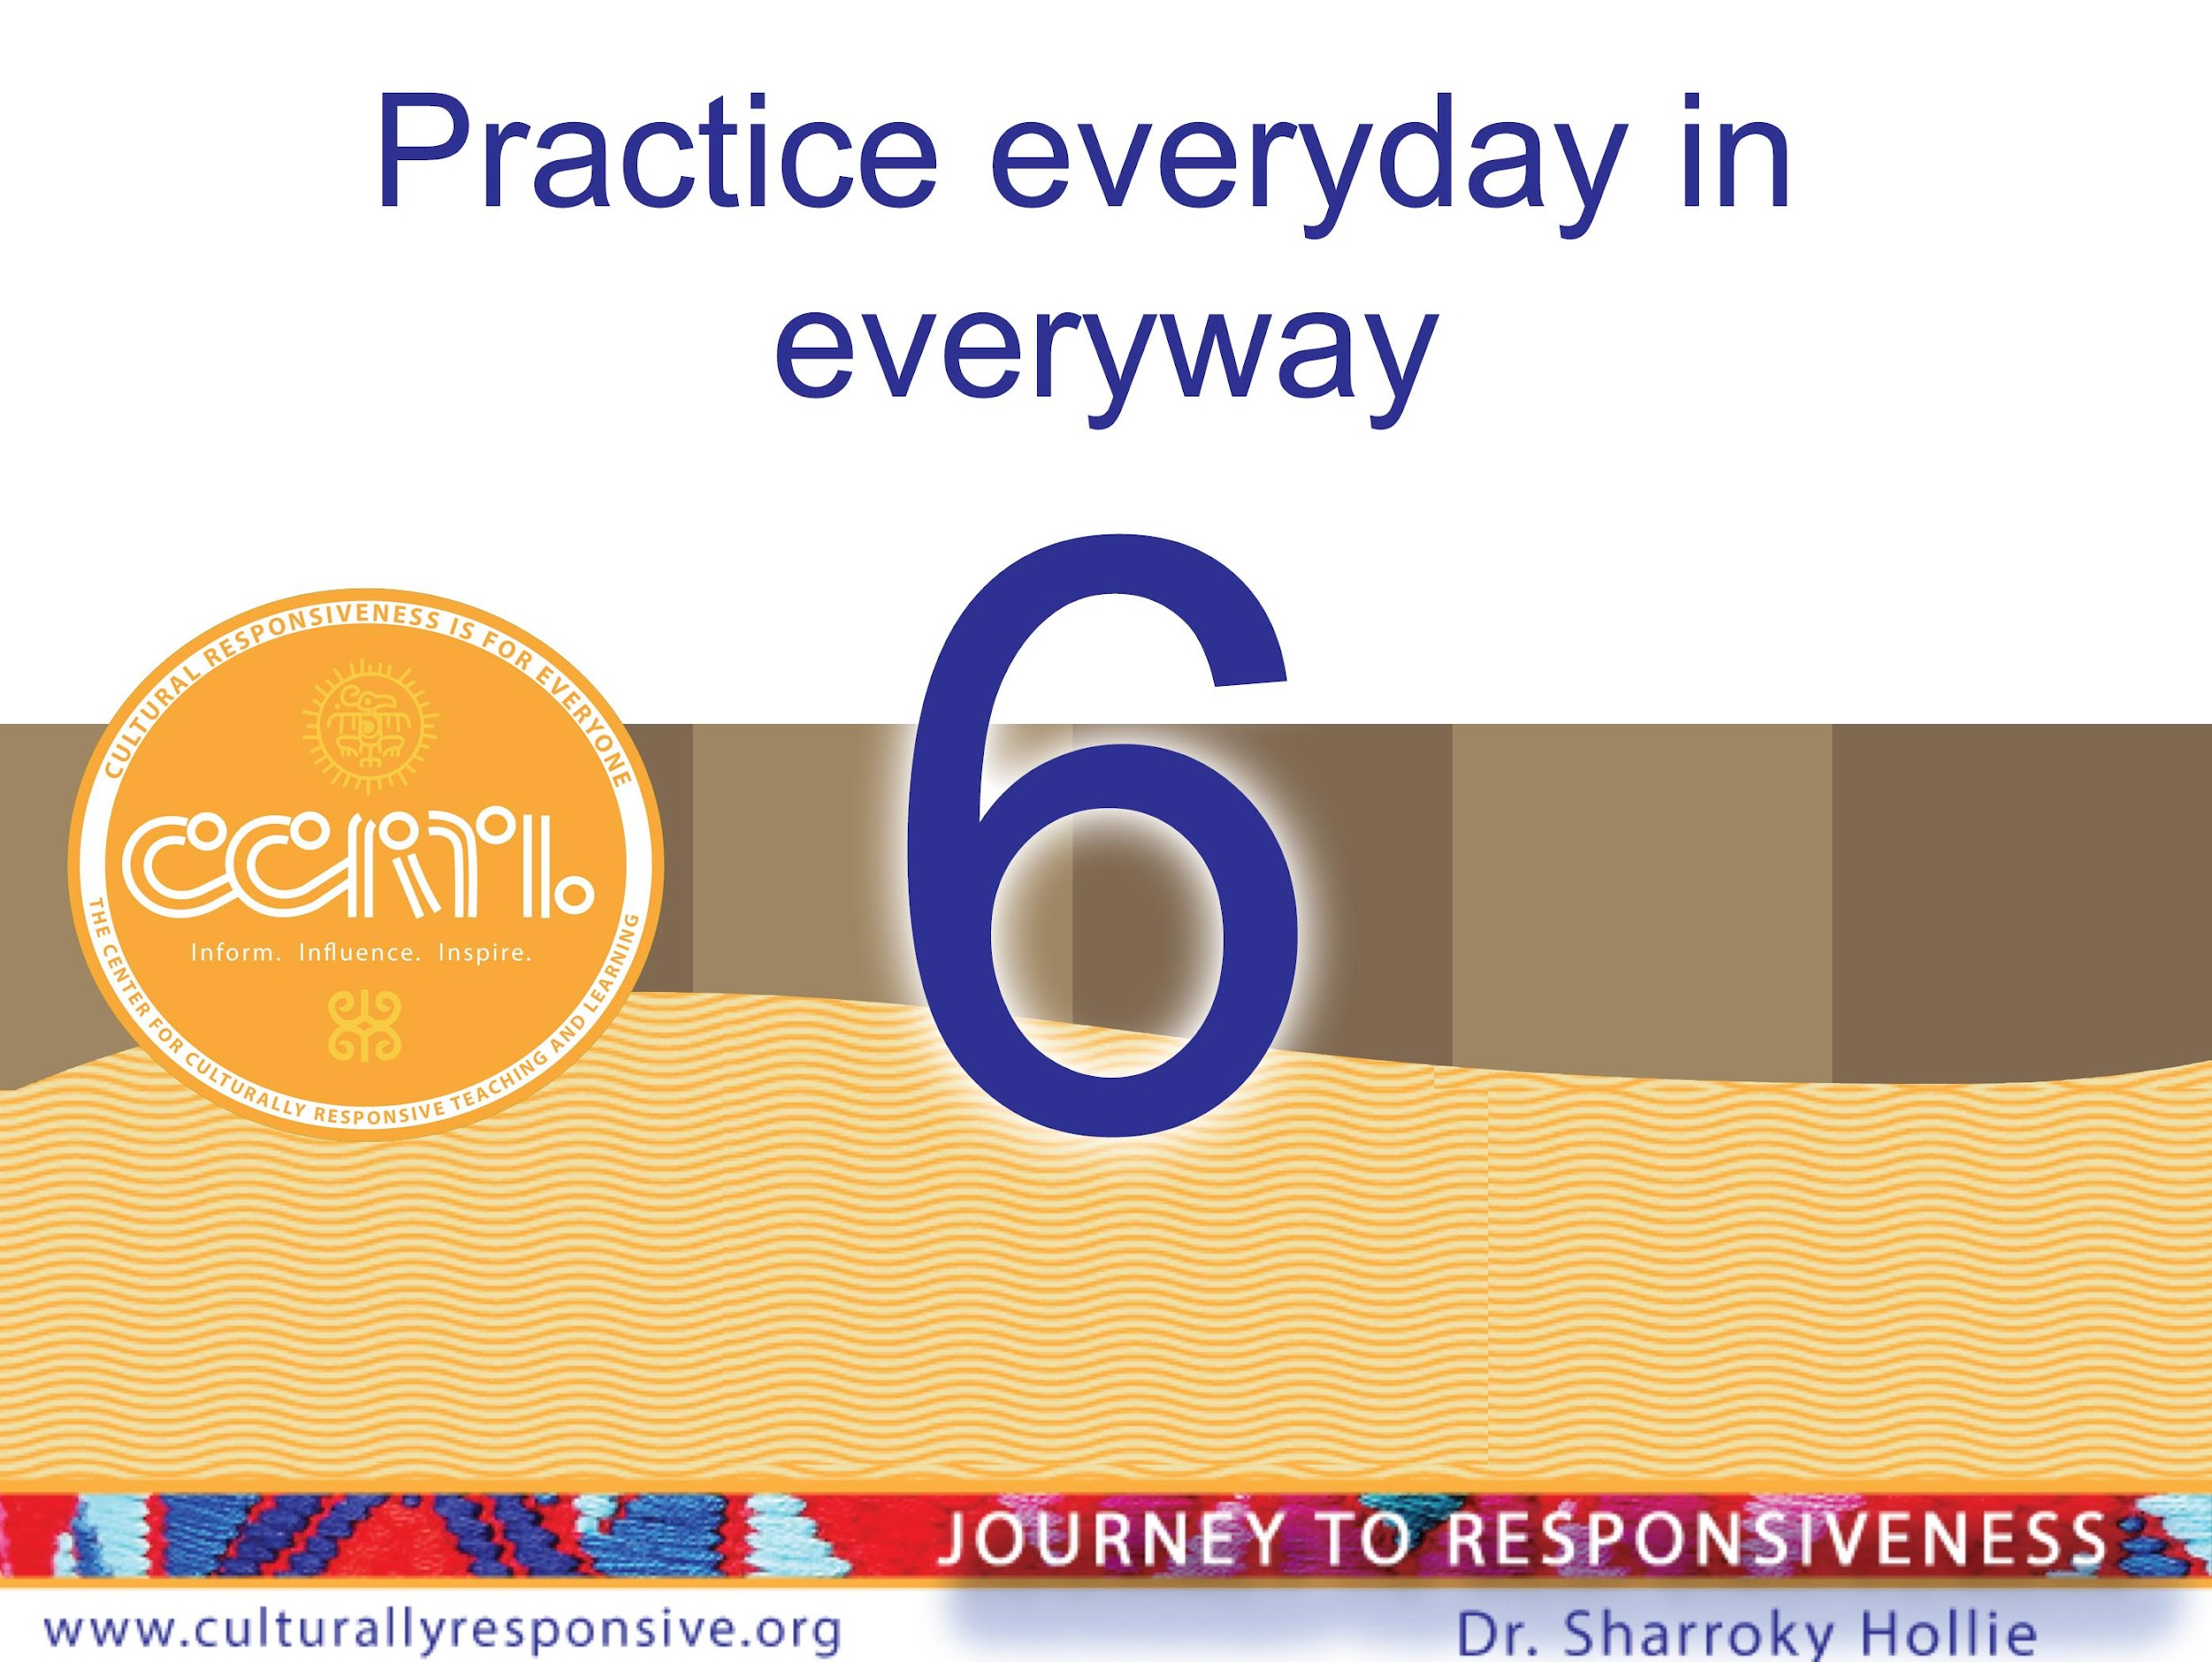

Slide 39
CLR and Separating
Content vs. Pedagogy
Content
What I Teach
Pedagogy
How I Teach It
Notes:
Add to handout (before the trad -> culturally responsive)

Slide 40
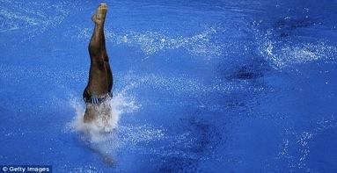
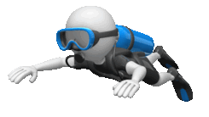
Creating Instructional Range
A Continuum of Traditional Instruction and Responsive Instruction
Culturally
Responsive
Traditional
Responsive
Fill instructional toolbox (activities).
Dive into the pool of CLR activities

Slide 41
Increase Engagement
Decrease Disengagement (classroom management/discipline issues)

Slide 42
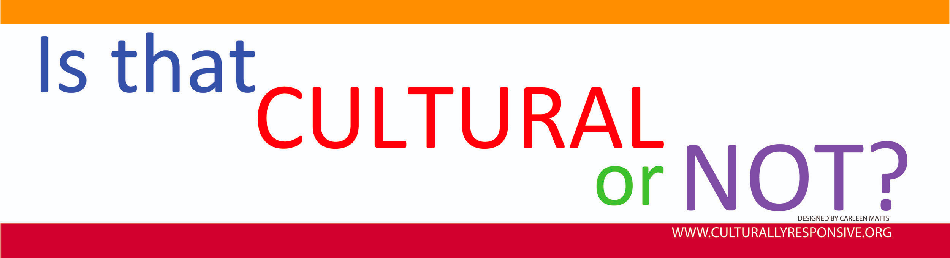
Designs and Illustrations by Carleen Matts

Slide 43
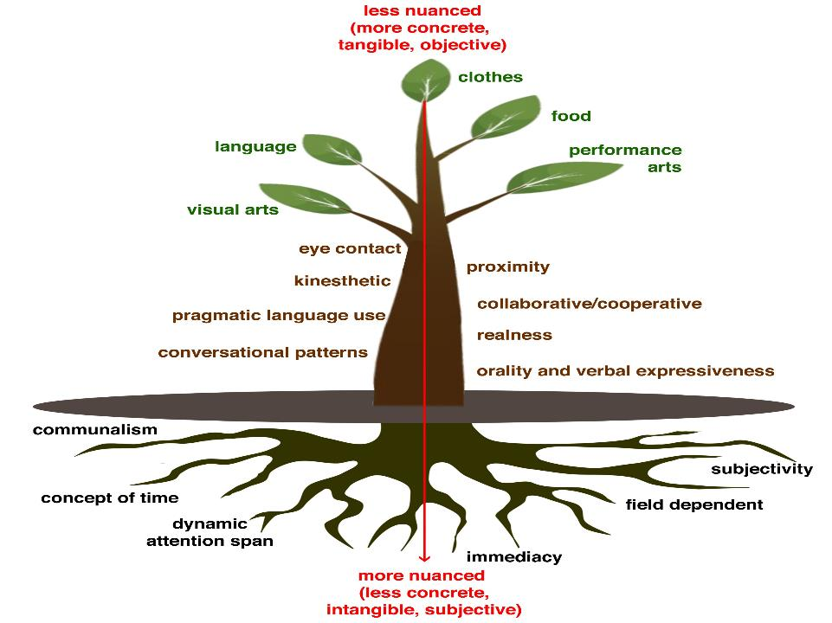
Food
Performing arts
Language
Clothes
Visual arts
Cultural Behaviors We Can See
Communalism
Cultural Behaviors We Cannot See
Proximity
Eye Contact
Non-Verbals
Concept of Time
Heritage
Adapted
Conversational
Patterns
Patterns for Handling Emotions
Tone
of Voice

Slide 44
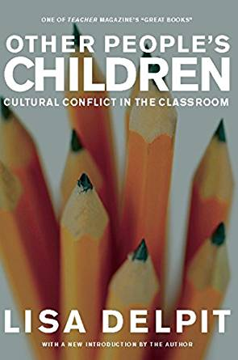
"We all interpret behaviors, information, and situations through our own cultural lenses; these lenses operate involuntarily, below the level of conscious awareness, making it seem that our own view is simply “the way it is.” Learning to interpret across cultures demands reflecting on our own experiences, analyzing our own culture, examining and comparing varying perspectives. We must consciously and voluntarily make our cultural lenses apparent. Engaging in the hard work of seeing the world as others see it must be a fundamental goal for any move"
—Delpit, Other People's Children (2006)

Slide 45
Check Off List
You can define it
Something that you are, not that you do
You are not confused about your identity
You know who you are serving or not serving
You don’t just celebrate Black History Month
Practice everyday in everyway

Slide 46


Slide 47
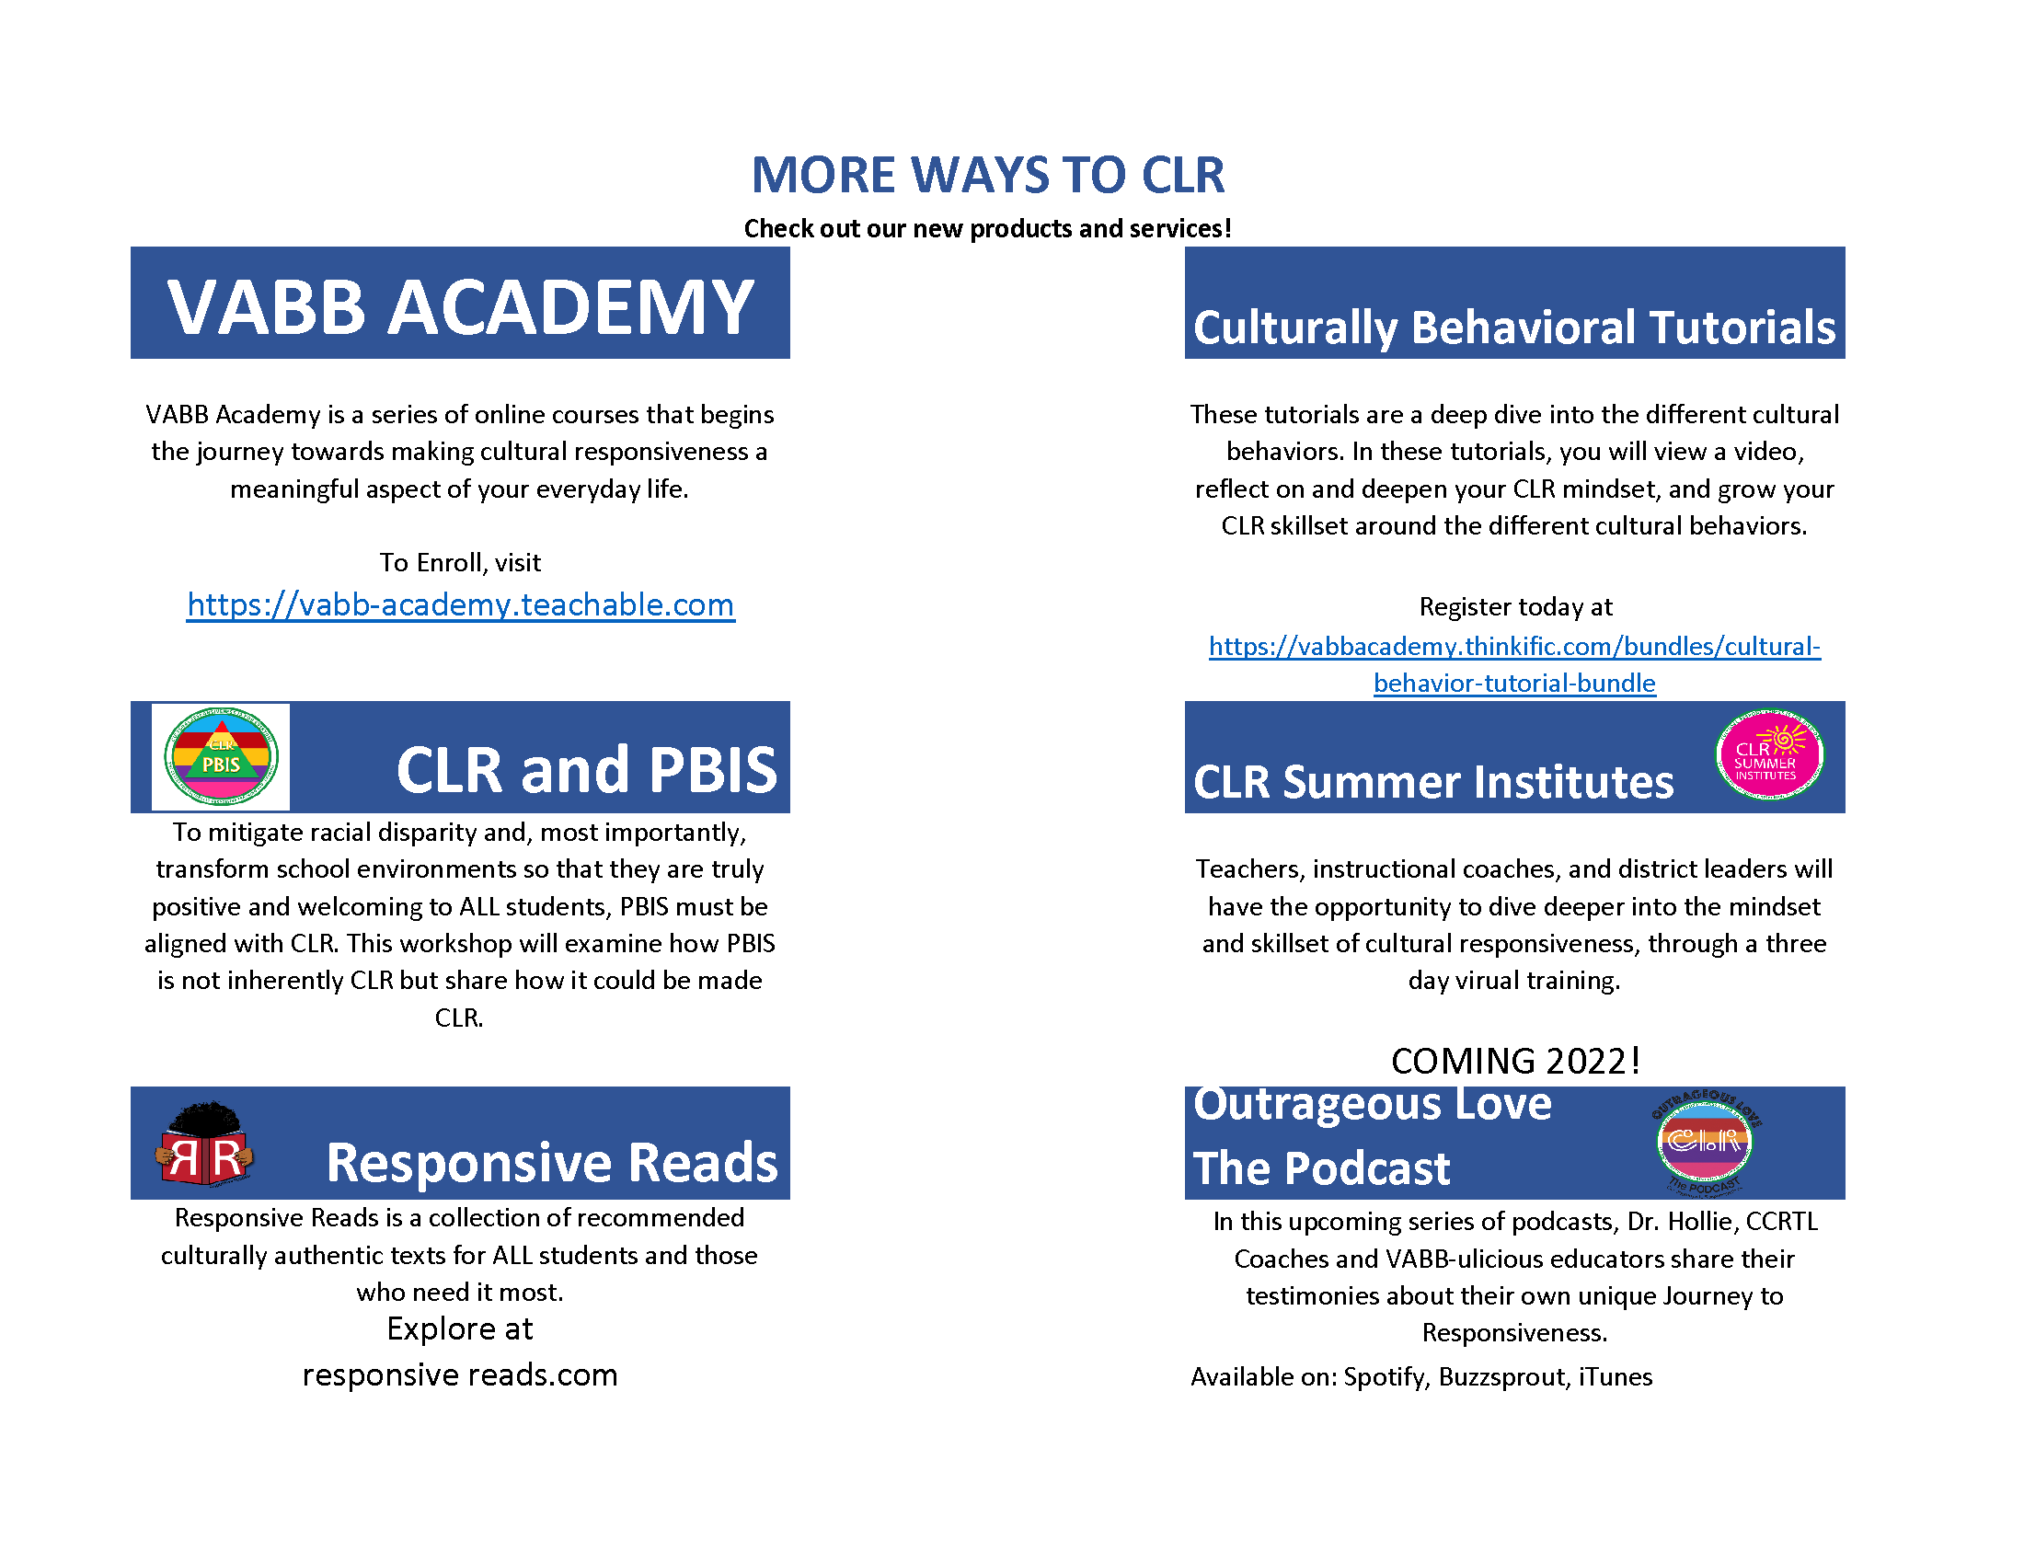
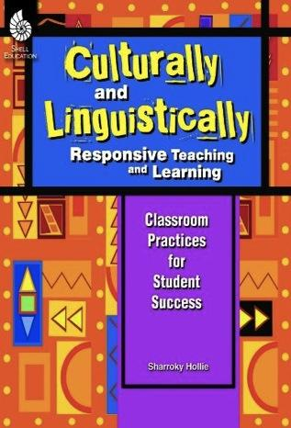
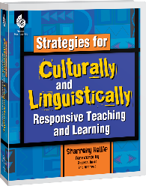

Slide 48


Slide 49

Cultural and Linguistic Responsiveness (CLR) is…
When you VALIDATE and AFFIRM who your students are culturally and linguistically, you are showing them more LOVE.

