Slide 1
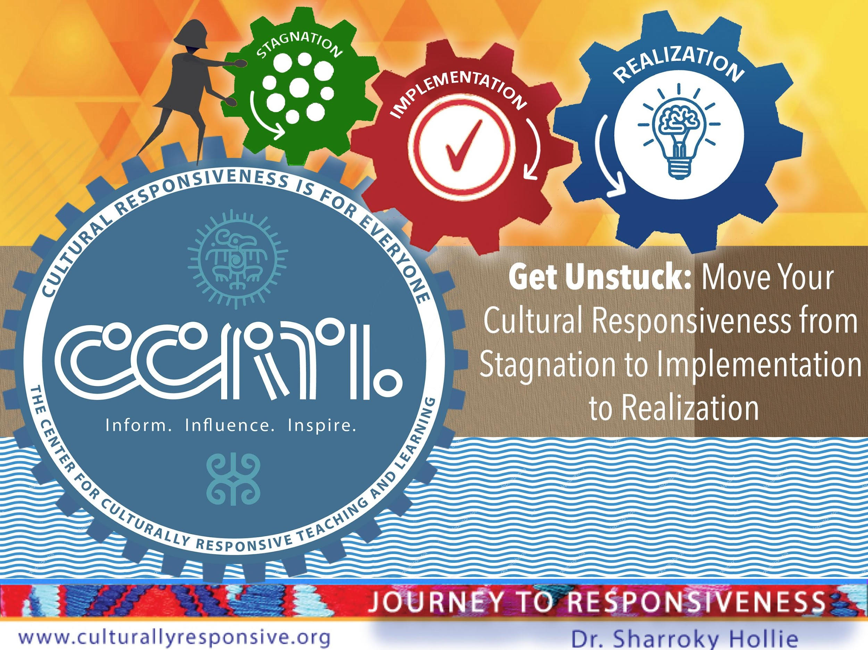
Racial Justice and Equity

Slide 2
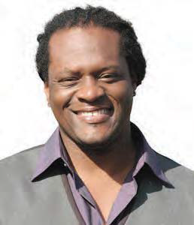

About our Executive Director
Dr. Sharroky Hollie
Professor Sharroky Hollie is a national educator who provides professional development to thousands of educators in the area of cultural responsiveness. Since 2000, Dr. Hollie has trained over 150,000 educators and worked in nearly 2000 classrooms. Going back 25 years, he has been a classroom teacher at the middle and high school levels, a central office professional development coordinator in Los Angeles Unified School District, a school founder and administrator, and university professor in teacher education at the Cal State University. Sharroky has also been a visiting professor for Webster University in St. Louis and a guest lecturer at Stanford and UCLA.

Slide 3

Six Stagnators
Moment of Recognition
Lack of Clarity
No Implementation Plan
Confused about Audience
Temporary or Lack of Funding Source
Readiness and Ripeness

Slide 4
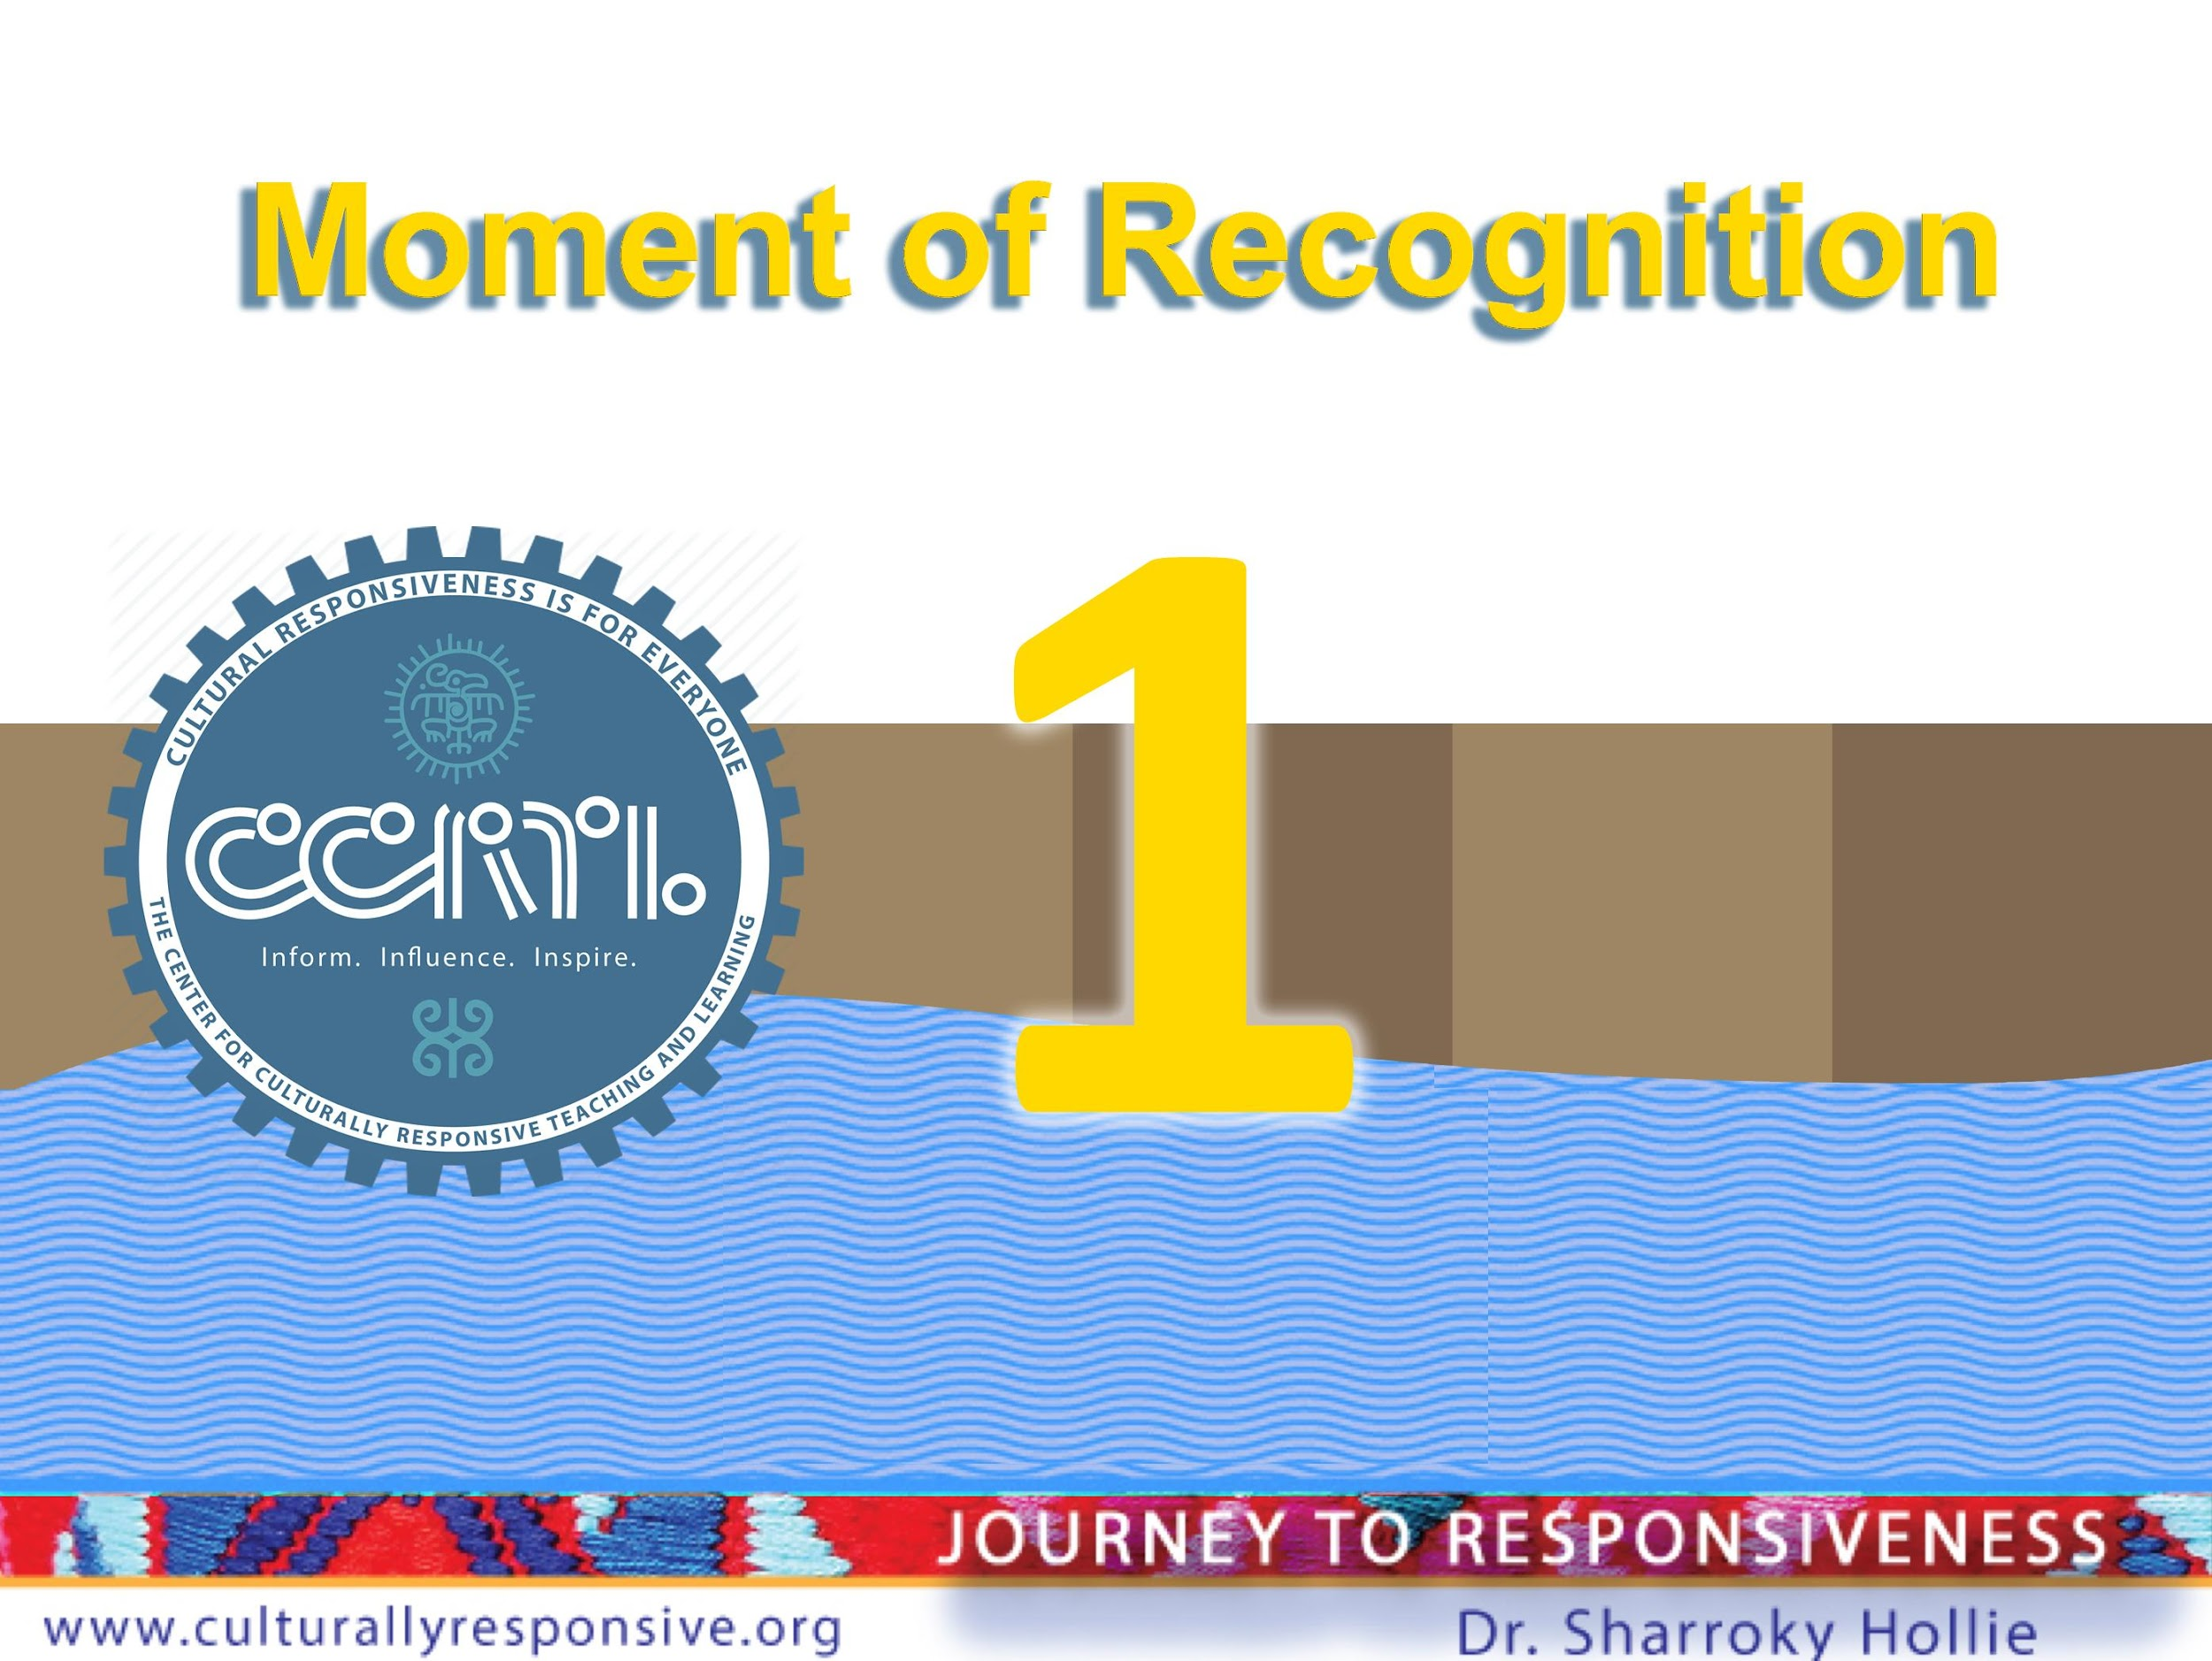


Slide 5


Slide 6
Black Students Need a Movement, Not a Moment
Year | Black Student Achievement Reform History “Moments”
1963 | The NAACP sued the district in Crawford vs. Board of Education, City of Los Angeles seeking resolve to the issue of underachievement
1979 | A Court Order required the district to develop programs for children attending racially isolated minority schools.
1986 | A report by the district's Evaluation and Assessment Branch concluded that since the 1979 order modest gains in achievement had occurred but not nearly enough to indicate systemic change and to have significant impact.
2001 | LAUSD convened a panel of nationally renowned experts to address the persistent disparities for African American students.
2019 | Another resolution was put forth under the banner of making good on LAUSD's commitment to all students: maximizing the talents and gifts of African American students
2020/21 | BIPAR

Slide 7
So-called Moments Fading Across America
“The Memory of George Floyd Is Literally Fading Across America”
Charles M. Blow
NYT Op-Ed May 2022
“In the end, transformative national change proved to be an illusion. Inflation, a war in Ukraine, public safety, abortion and even a baby formula crisis have overtaken the zeitgeist. Support for Black Lives Matter has diminished. Federal police reform and federal voter protection both failed to pass the Senate. And the founders of Black Lives Matter have been drawn into controversies about how they handled its money.”

Slide 8
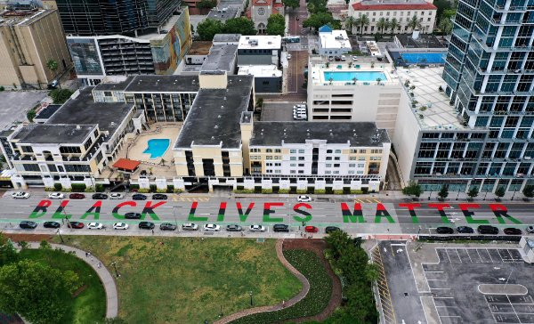
Approximately 2700 murals, graffiti, stickers, posters affixed to surfaces and light projections created in response to Floyd’s killing
115 Murals between 20-21
37 Murals Today Remain Fully Intact

Slide 9
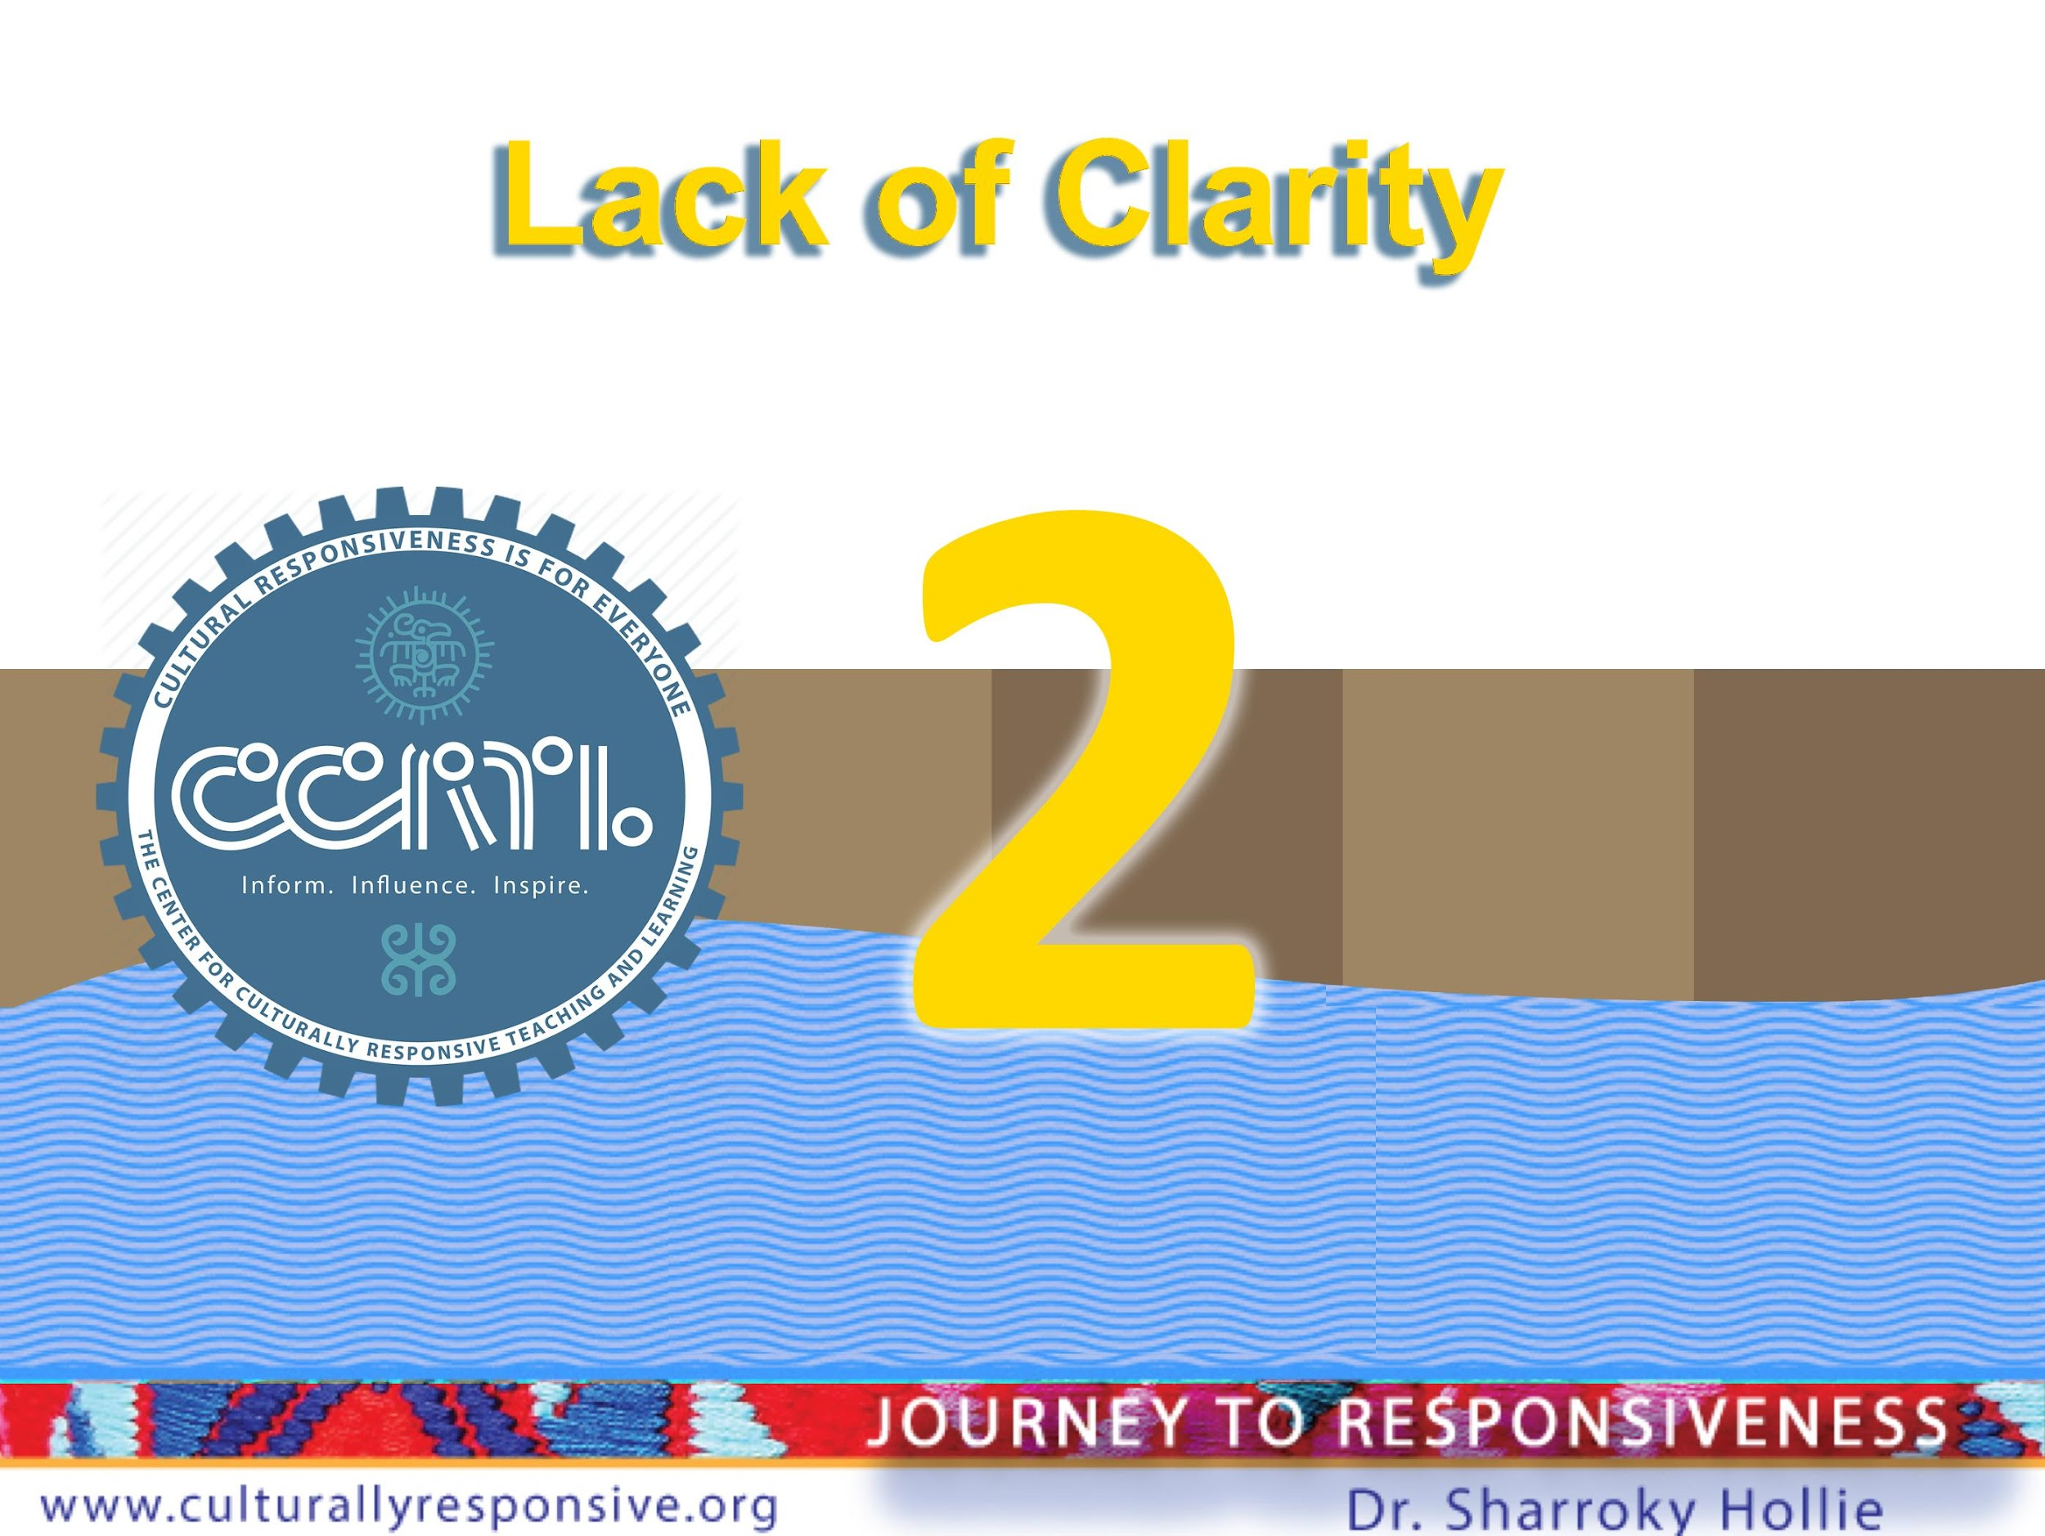

Slide 10
Equity
Equity is the umbrella term.
Instruction
Cultural Responsiveness (CLR)
Know your brand of cultural responsiveness.

Slide 11
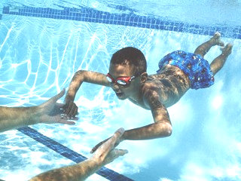
What Exactly Is Culturally and Linguistically Responsive Teaching and Learning (CLR)?
CLR is:
“The validation and affirmation of the home (indigenous) culture and home language for the purposes of building and bridging the student to success in the culture of academia and mainstream society.”
—Hollie, Culturally and Linguistically Responsive Teaching and Learning: Classroom Practices for Student Success (2017)
CLR is going where the students are culturally and linguistically for the purpose of bringing them where they need to be academically.
CLR is the opposite of the sink-or-swim approach to teaching and learning, or traditional schooling.

Slide 12
VABB
VALIDATE Make legitimate that which the institution (academia) and mainstream media have made illegitimate culturally and linguistically
V
A
AFFIRM Make positive that which the institution (academia) and mainstream media have made negative culturally and linguistically
BUILD Create the connections between the home culture/language and the school culture/language through instruction (teaching necessary skills) for success in school and the broader social context
B
B
BRIDGE Create opportunities for situational appropriateness or utilizing appropriate cultural or linguistic behaviors

Slide 13
WE
V.A.B.B.
HERE!
Dr. Sharroky Hollie
Design and Illustration by Carleen Matts

Slide 14
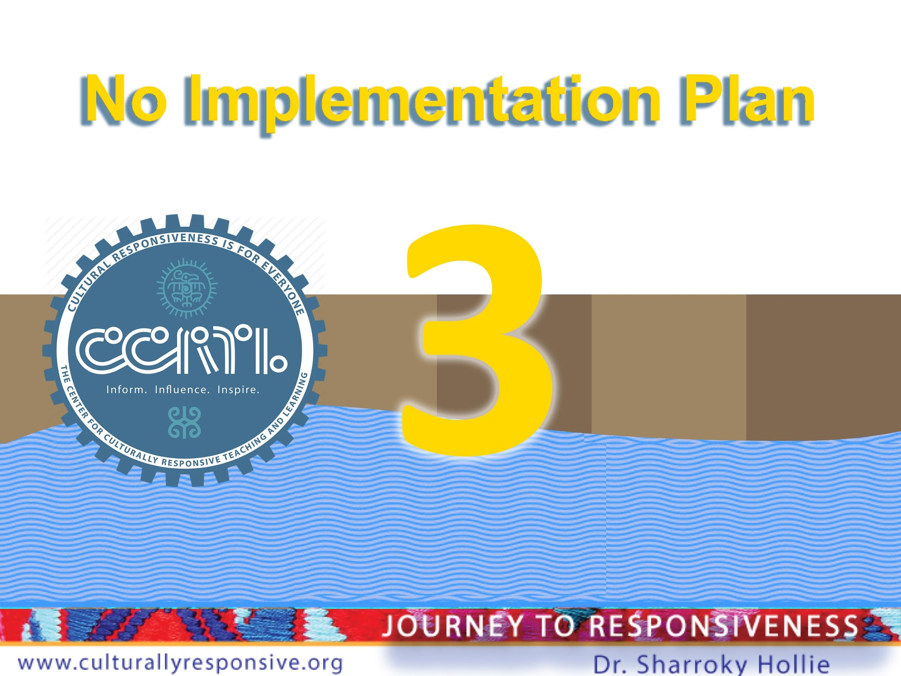

Slide 15
No Plan vs Professional Learning Plan vs. Implementation Plan
Superficially Based
One and Done (or two and through) Professional Learning
Focused on Evidence-based Districtwide/Schoolwide Implementation

Slide 16
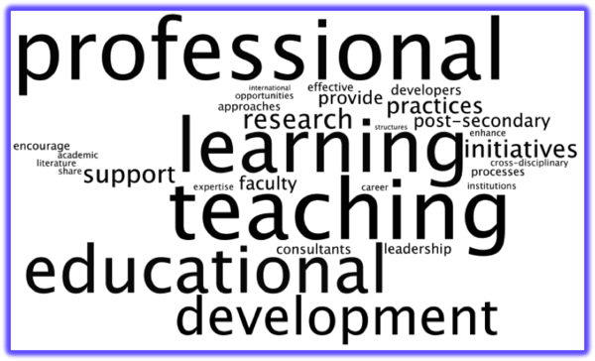
What/When Was Your Last Professional Learning around “This Work”?

Slide 17
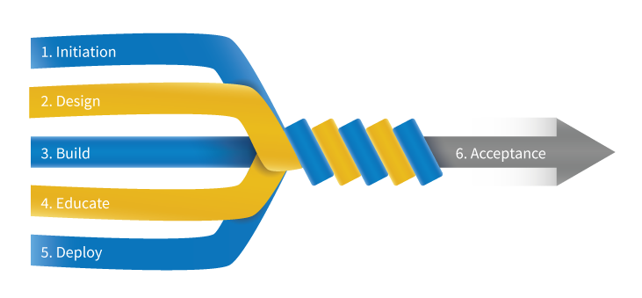
What Is Your Implementation (Practice) Plan For Cultural Responsiveness In Every Classroom?

Slide 18
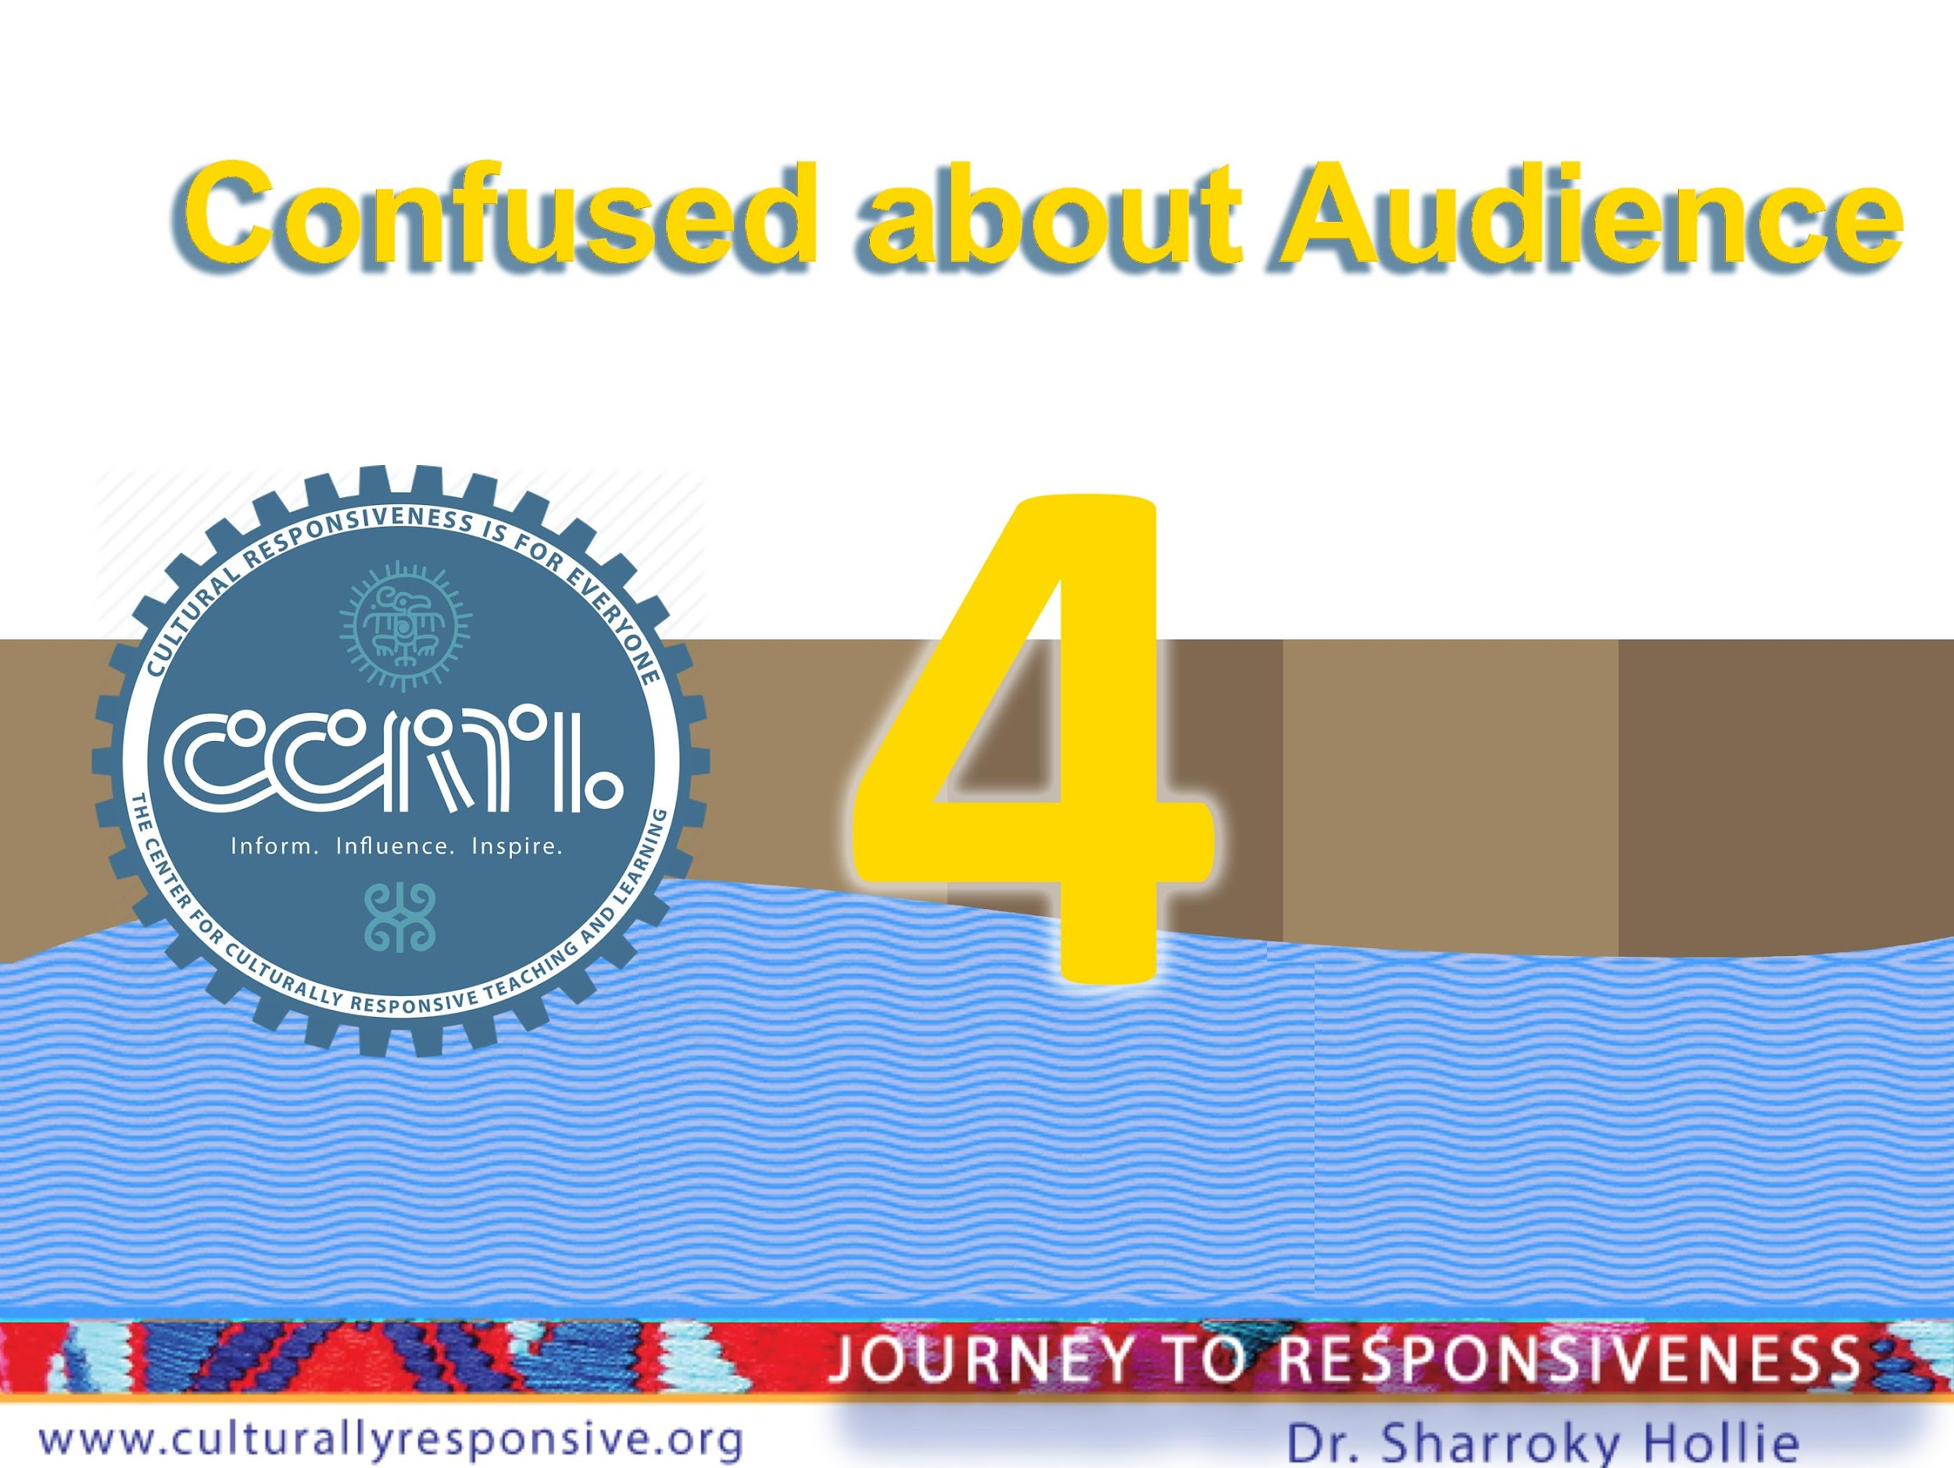

Slide 19
You Know Who You are Serving
Key term 2 is underserved:
An underserved student is any student who is not successful academically, socially, and/or behaviorally in school because the school as an institution is not being responsive to the student.
Words to consider when thinking of your underserved:
Disproportionality – Historic - Institutional

Slide 20


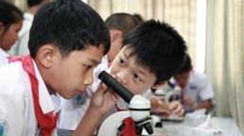
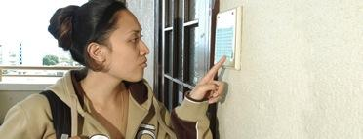
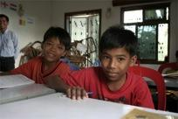
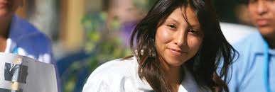

Top Five Underserved Populations
So-Called
Native Americans
African Americans
Latinx Americans
Hawaiian Americans
Asian Americans
No More
Generalizations

Slide 21
Go Four Deep (Variables).
No More Generalizations.
Racial/Economic/Special Needs Institutionally Generalized
Do we have any successful students in this generalized category?
Then, among the students who are not successful, who is most likely to be underserved?
First Deep Variable (repeat process 3 more times)

Slide 22


Slide 23
Who is Your Carrot? Who is Your Stick?
PBIS
RTI
Restorative Practices
Trauma- Informed Practices
SEL

Slide 24
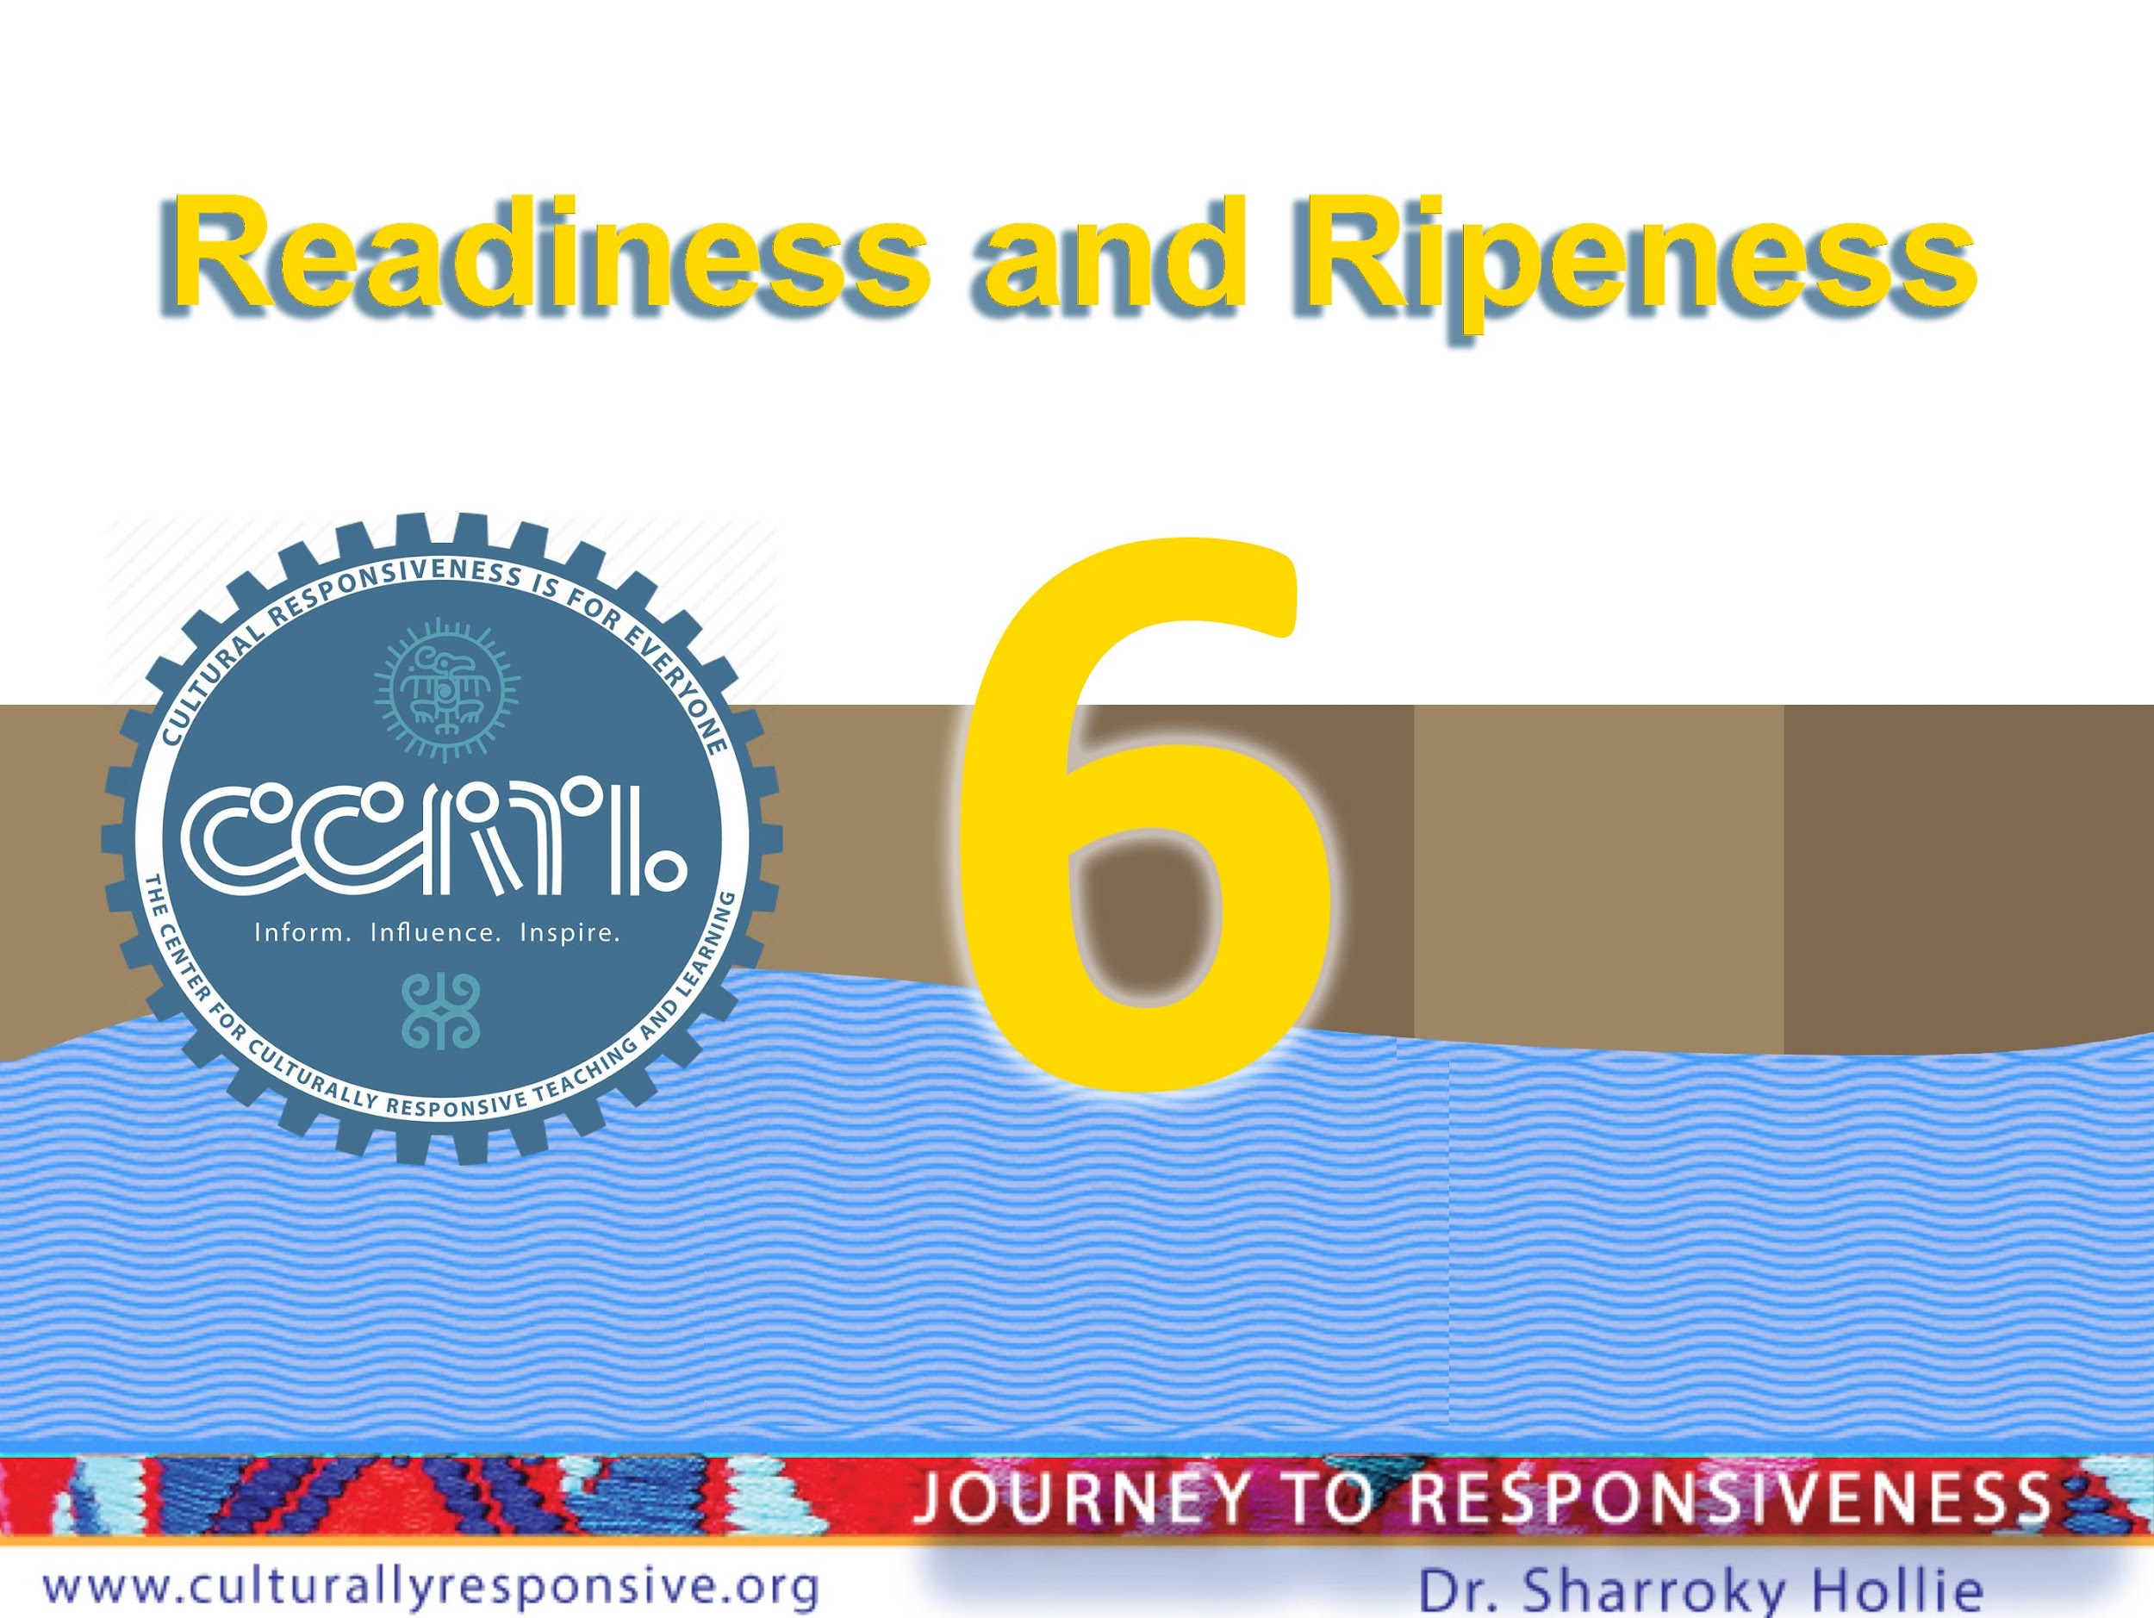

Slide 25
Are You Ready? Are You Ripe?
Readiness
Vision (Big Picture)
Leadership Capacity (Will and Skill)
Infrastructure (Functional)
Resources (PD Allocation/Funds)
Ripeness
Teacher buy-in (at least 60%, ideally 80%
Place to plug in (like all other initiatives)
Teachers empowered to lead CLR
Overlap of equity and instruction

Slide 26


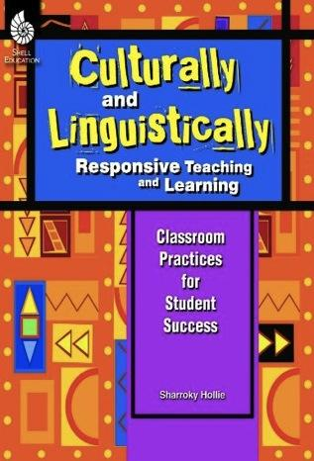




Stay Vabbulous! Stay Connected!
@validateaffirm
Notes:
https://www.culturallyresponsive.org/clrdistancelearning
https://www.culturallyresponsive.org/clrrespondstorace
https://www.culturallyresponsive.org/subscribe
https://www.culturallyresponsive.org/contact
https://www.youtube.com/channel/UCEshEHwGq-eOZvgeF8wO3UQ

Slide 27
