Slide 1
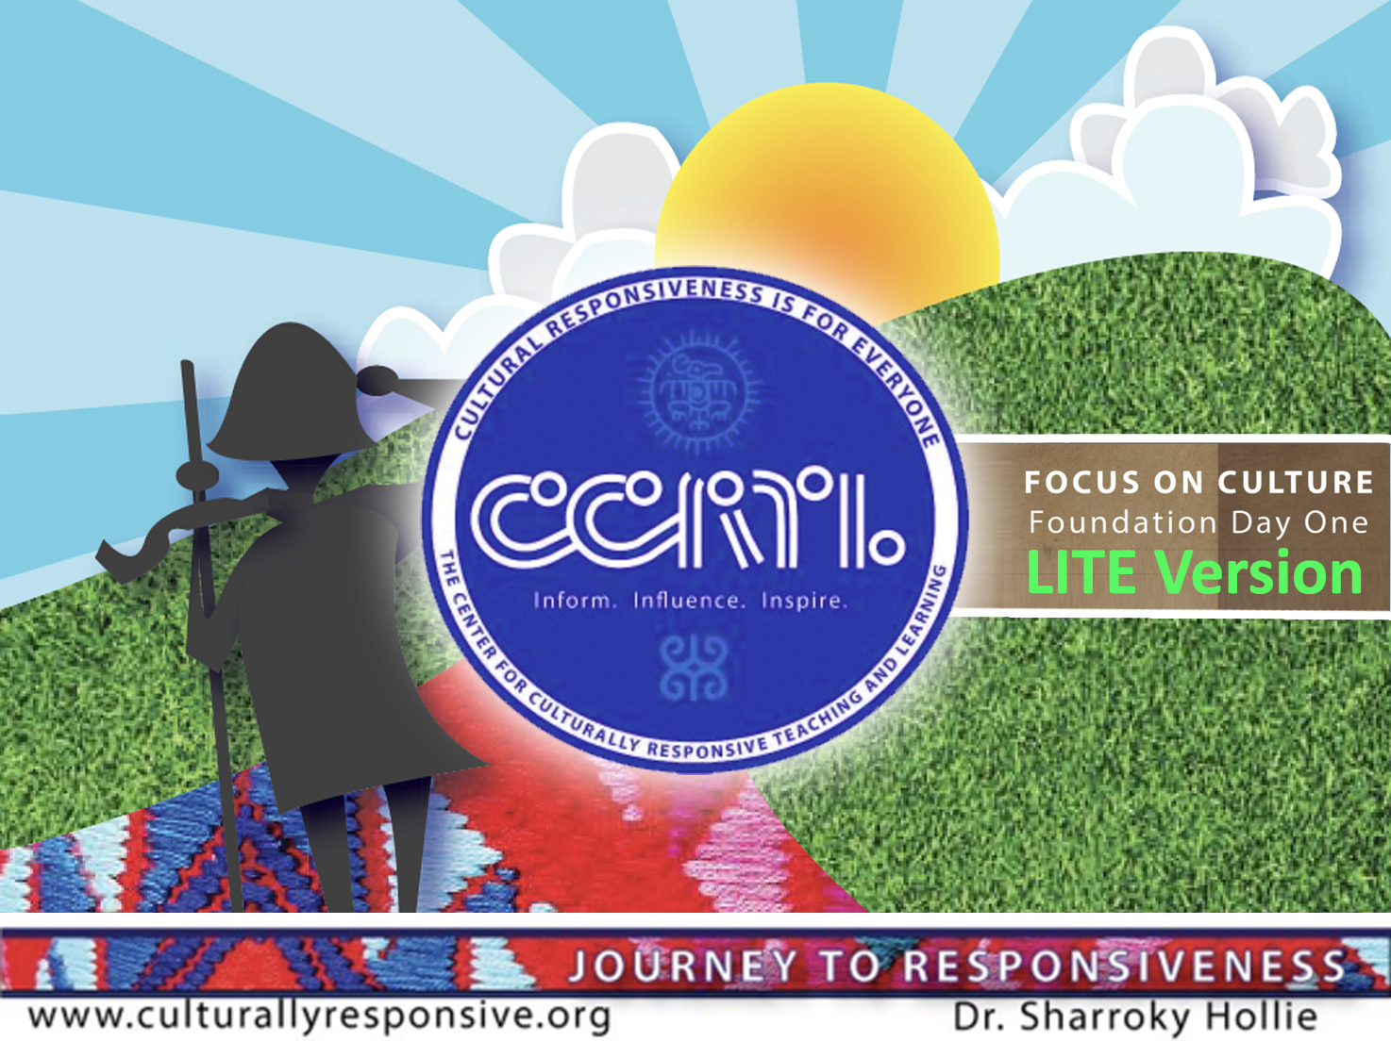

Slide 2
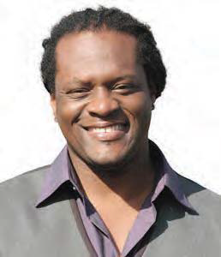

ABOUT Dr. Hollie
Professor Sharroky Hollie is a national educator who provides professional development to thousands of educators in the area of cultural responsiveness. Since 2000, Dr. Hollie has trained over 150,000 educators and worked in nearly 2000 classrooms. Going back 25 years, he has been a classroom teacher at the middle and high school levels, a central office professional development coordinator in Los Angeles Unified School District, a school founder and administrator, and university professor in teacher education at the Cal State University. Sharroky has also been a visiting professor for Webster University in St. Louis and a guest lecturer at Stanford and UCLA.

Slide 3
Our Flow
What is cultural and linguistic responsiveness (CLR)?
Why is it important for all students?
How does it look in the classroom?

Slide 4
TERMINOLOGY
METHODOLOGY
ANTHROPOLOGY

Slide 5
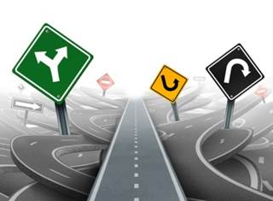

Slide 6
SECTION ONE: TERMINOLOGY
Where am I in my journey to responsiveness?
  Began when (year) Where?
Current
Future

Slide 7
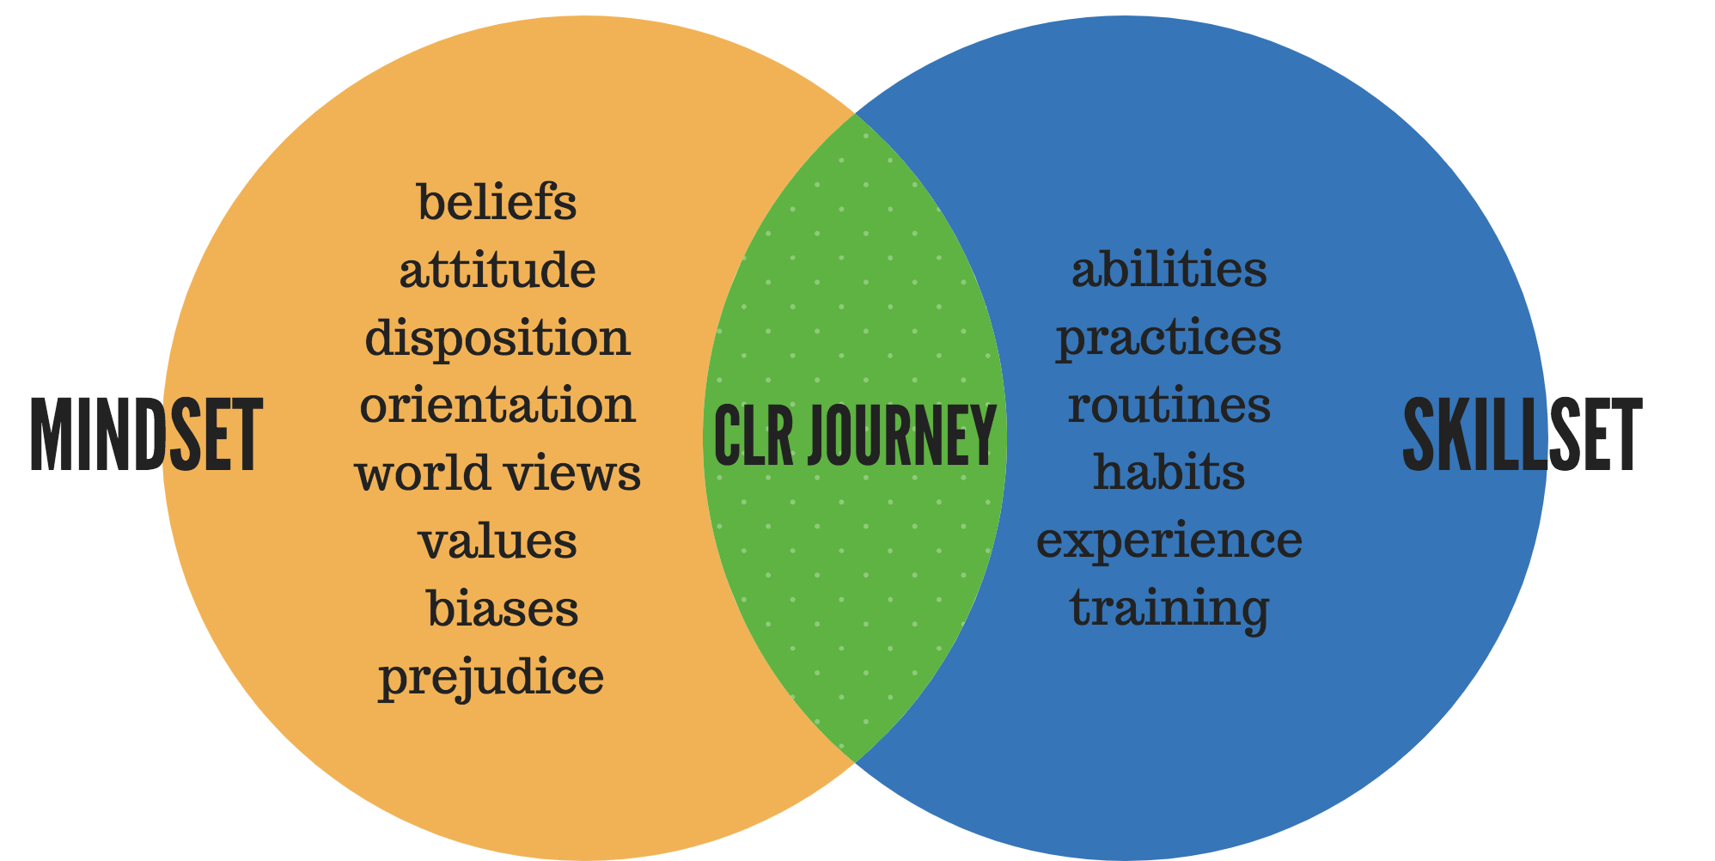

Slide 8

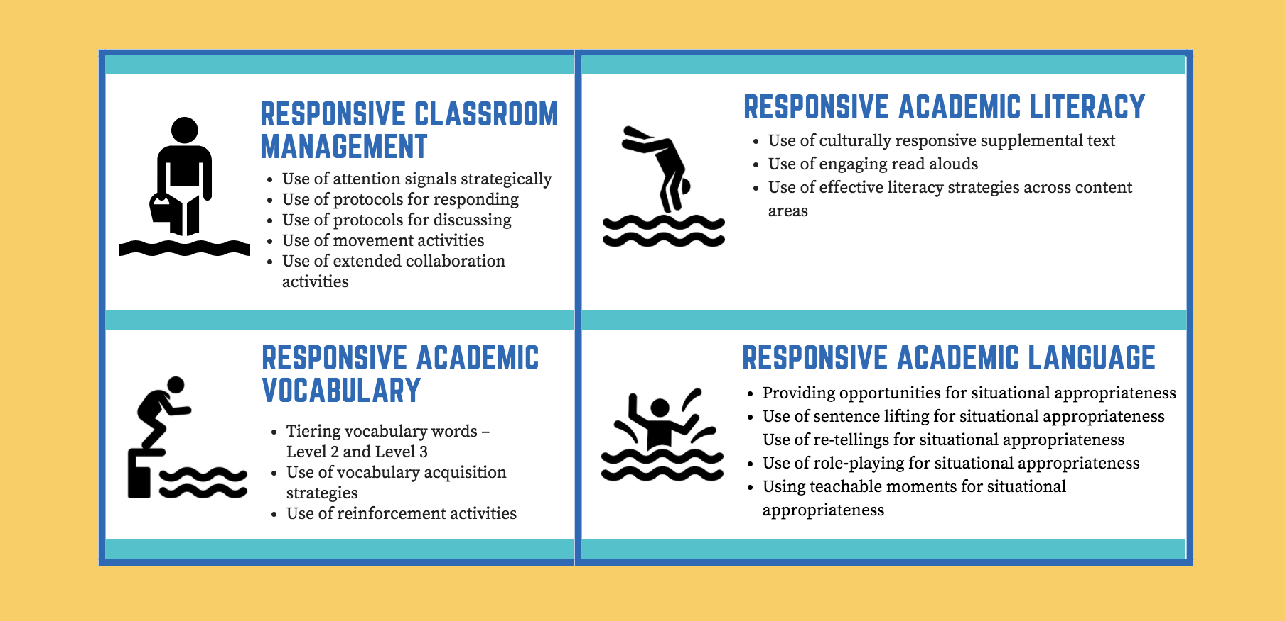
Diving Into Pool of CLR Activities
1
3
2
4

Slide 9
Why this Journey to Responsiveness?
Goal #1 Increase Student Engagement
Do students have a sense of belonging?
🔲 Yes 🔲 No
🔲 Yes 🔲 No
Are students engaged pedagogically? (instruction)

Slide 10
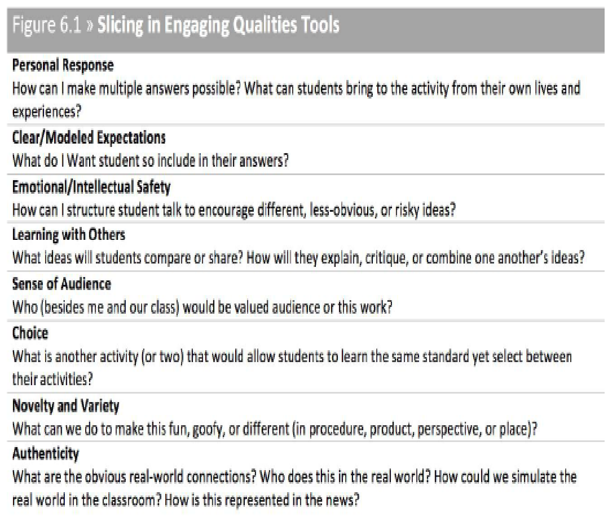
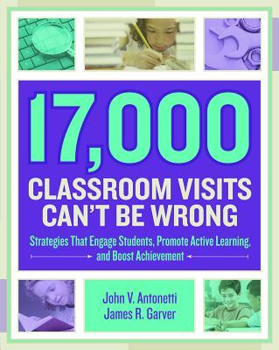

Slide 11
Why this Journey to Responsiveness?
Goal #2 Deal with Inequities
Courage. Articulation. Safe place and space.
SECTION ONE: TERMINOLOGY
What are the inequities(disproportionality) in my school, my classroom?
Our students are being treated unfairly because…..

Slide 12
Why this Journey to Responsiveness?
Goal #3 Give Outrageous Love
Who needs more love?
Is my heart and mind in the right place?
🔲 Yes 🔲 No
SECTION ONE: TERMINOLOGY
Am I a happy educator(capable and willing to give outrageous love, stretch my love)?
  Simple Gestures
Excellence Over Mediocrity
Show Love to Others

Slide 13
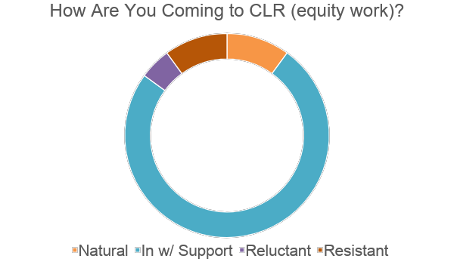

Slide 14
Equity
Equity is the umbrella term.
Instruction
Cultural Responsiveness (CLR)
Know your brand of cultural responsiveness.

Slide 15
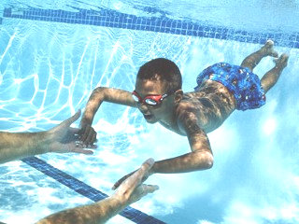
What Exactly Is Culturally and Linguistically Responsive Teaching and Learning (CLR)?
CLR is:
“The validation and affirmation of the home (indigenous) culture and home language for the purposes of building and bridging the student to success in the culture of academia and mainstream society.”
—Hollie, Culturally and Linguistically Responsive Teaching and Learning: Classroom Practices for Student Success (2017)
CLR is going where the students are culturally and linguistically for the purpose of bringing them where they need to be academically.
CLR is the opposite of the sink-or-swim approach to teaching and learning, or traditional schooling.

Slide 16
VALIDATE Make legitimate that which the institution (academia) and mainstream media have made illegitimate culturally and linguistically
V
A
AFFIRM Make positive that which the institution (academia) and mainstream media have made negative culturally and linguistically
BUILD Create the connections between the home culture/language and the school culture/language through instruction (teaching necessary skills) for success in school and the broader social context
B
B
BRIDGE Create opportunities for situational appropriateness or utilizing appropriate cultural or linguistic behaviors

Slide 17
Three Ways To VABB
Relate To Differently
Talk To Differently
Teach Differently
Difference =
Responsiveness

Slide 18
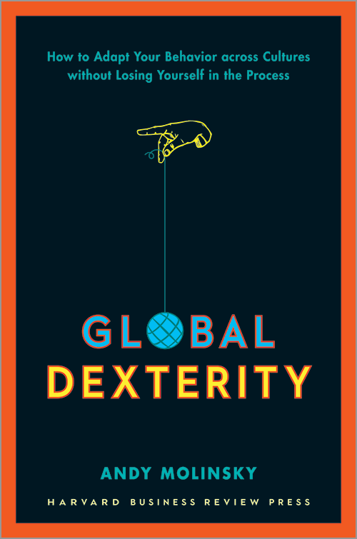
All book references on page 13
“Situational Appropriateness”
or
Global Dexterity
“Learning to adapt your behavior across cultures-no matter what culture you come from, what culture you are going to, or the situation you find yourself in. Global Dexterity is "fitting in without giving in."
- Molinsky 2013

Slide 19



Designs and Illustrations by Carleen Matts

Slide 20


Are you attuned to your biases?
“[We all] have reminiscences which [we] would not tell everyone but only to [our] friends. [We] have other matters in [our] mind which [we] will not reveal to even [our] friends, but only to [ourselves], and that in secret. But there are other things which [we] are afraid to tell even to ourselves, and every decent person has a number of such things stored away in [our] minds.”

Slide 21
Checking Your Filter
Questioning Your BS
Listening To Your Deficit Monitor

Slide 22
It may be your
FIRST
thought;
LAST
don’t let it be your
thought!
Dr. Sharroky Hollie
Design and Illustration by Carleen Matts

Slide 23
What is the core of my methodology?
SECTION TWO: METHODOLOGY
Traditional
Responsive
Culturally Responsive

Slide 24
CLR and Separating Content vs. Pedagogy
Content
What I Teach
Pedagogy
How I Teach It

Slide 25
Diving Into Pool of CLR Activities
1
3
2
4

Slide 26
Create Instructional Range
A Continuum of Traditional Instruction and Responsive Instruction
Culturally Responsive
Traditional
Responsive
You Need Instruction in all 3 Boxes
Traditional | Responsive | Culturally Responsive
Teacher-centered | Student-centered | Student-centered
One way | Two Ways | Two Ways
High affective filter | Lowered affective filter | Validate and Affirm Cultural Behaviors

Slide 27
Creating Instructional Range
Movement Activities
Response Protocols
Discussion Protocols
Give One, Get One
Vote With Your Feet
Shout Out
Help Line
Raise Hand
Campfire
Turn and Talk
Moment of Silence
Cultural Greetings
Socio-centrism
Physicality
Spontaneity
Taking Turns
Individualism
Color Key
Blue: CLR Category
Purple: Responsive Activity
Orange: Responsive Activity with Cultural Behavior Intent and Purpose
Red: Traditional Activity
Turquoise: Traditional Activity with School Cultural Behavior Intent and Purpose

Slide 28
Increase Engagement
Decrease Disengagement (classroom management/discipline issues)

Slide 29
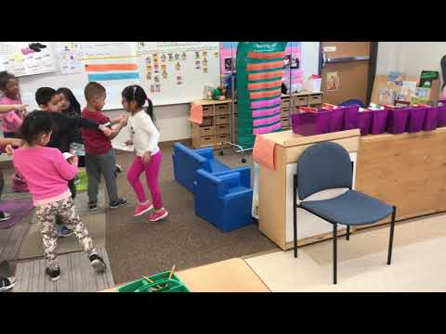

Slide 30
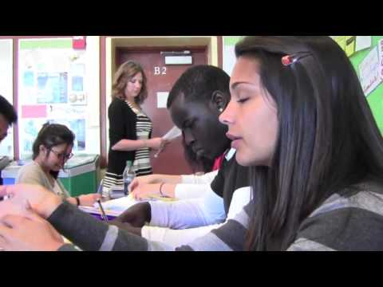

Slide 31
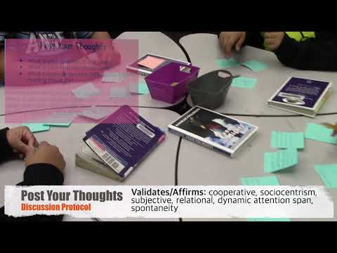

Slide 32
Refresh, Stretch, and Reflect Time
We will resume in 30 minutes (precise time)

Slide 33
Do You Know Who You Are…Culturally Speaking?
SECTION THREE: ANTHROPOLOGY
My Racial Identity
Identity
Behavior
My Ethnic Identity
Identity
Behavior

Slide 34
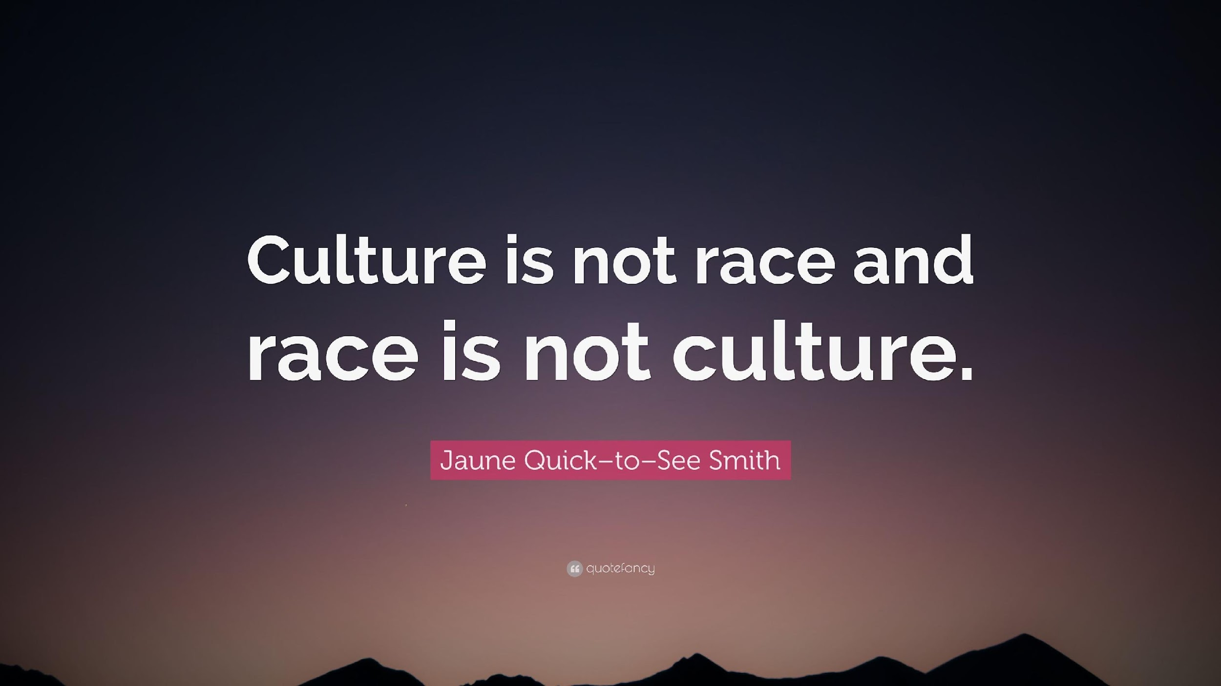

Slide 35
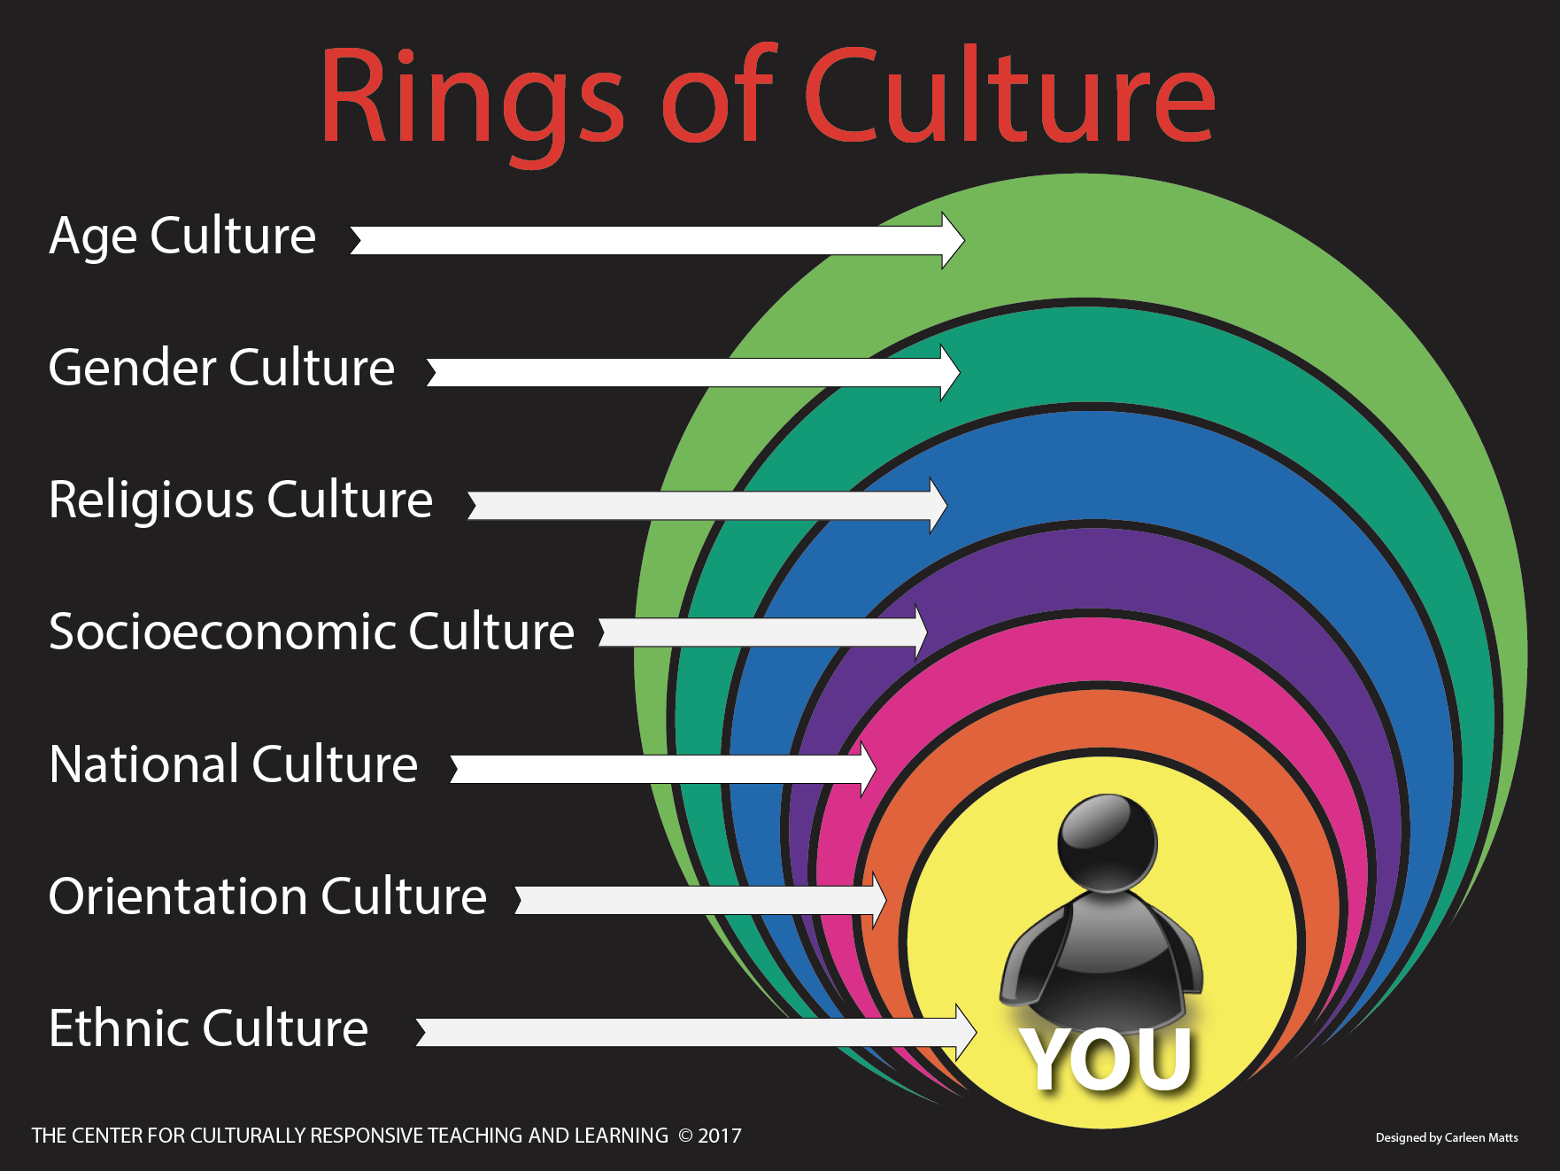

Slide 36
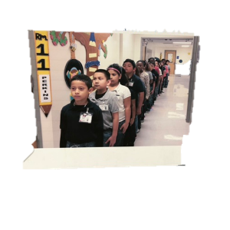

Slide 37
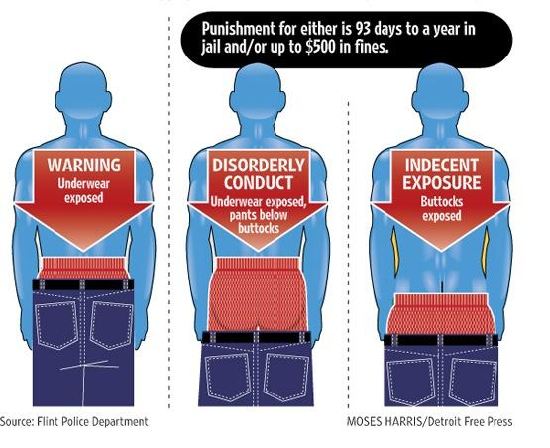

Slide 38
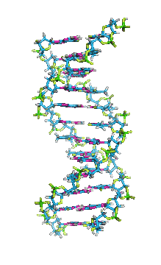
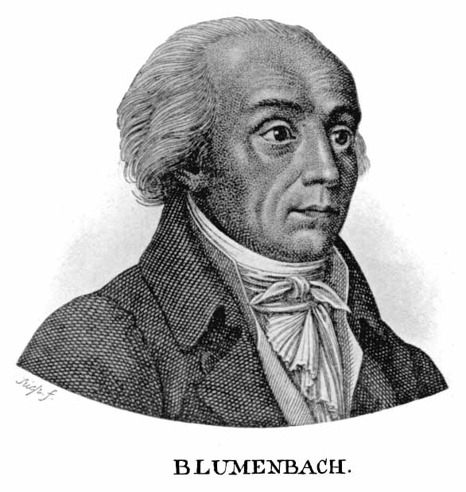
Have You Been Blumenbached?
How do you define race?
What is your
racial identity?
Notes:
Add note taking section (add his picture and note section)

Slide 39
History of Racial Classification
“Caucasian variety. I have taken the name of this variety from Mount Caucasus, both because its neighborhood, and especially its southern slope, produces the most beautiful race of men, and because … in that region, if anywhere, we ought with the greatest probability to place the autochthones [original forms] of mankind.”
—J. F. Blumenbach, German naturalist, quoted from his 1795 seminal work, On the Natural Variety of Mankind, in Gould, The Mismeasure of Man (1996)
Notes:
New background/theme

Slide 40
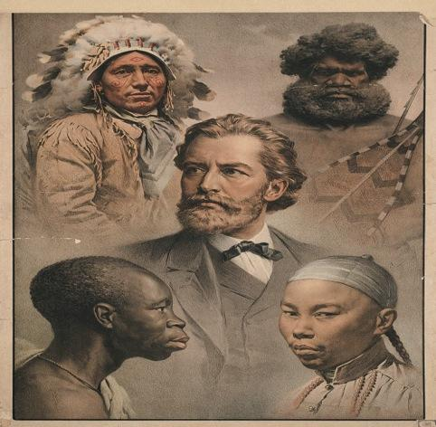
Original Five Classified Races
Mongolian (Eastern Asia)
Ethiopian (Africa)
Caucasian (Europe and adjacent areas)
Natives (Americas)
Malaysian (Pacific Islands)
Race is arbitrary.
Notes:
Cleaner image of five original races if you can find it.

Slide 41
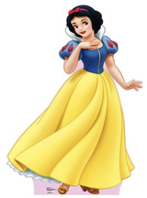
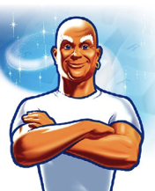
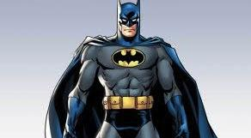
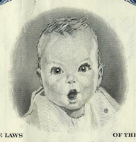
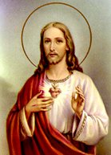
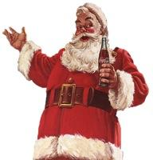
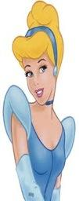
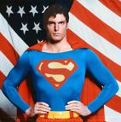
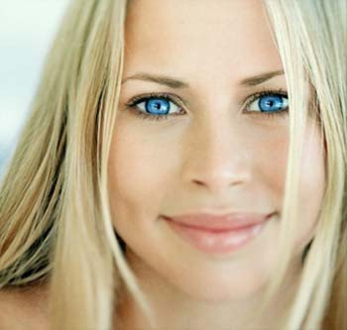
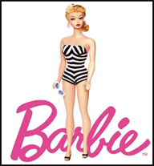

Slide 42
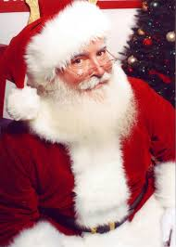
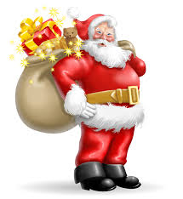

Slide 43
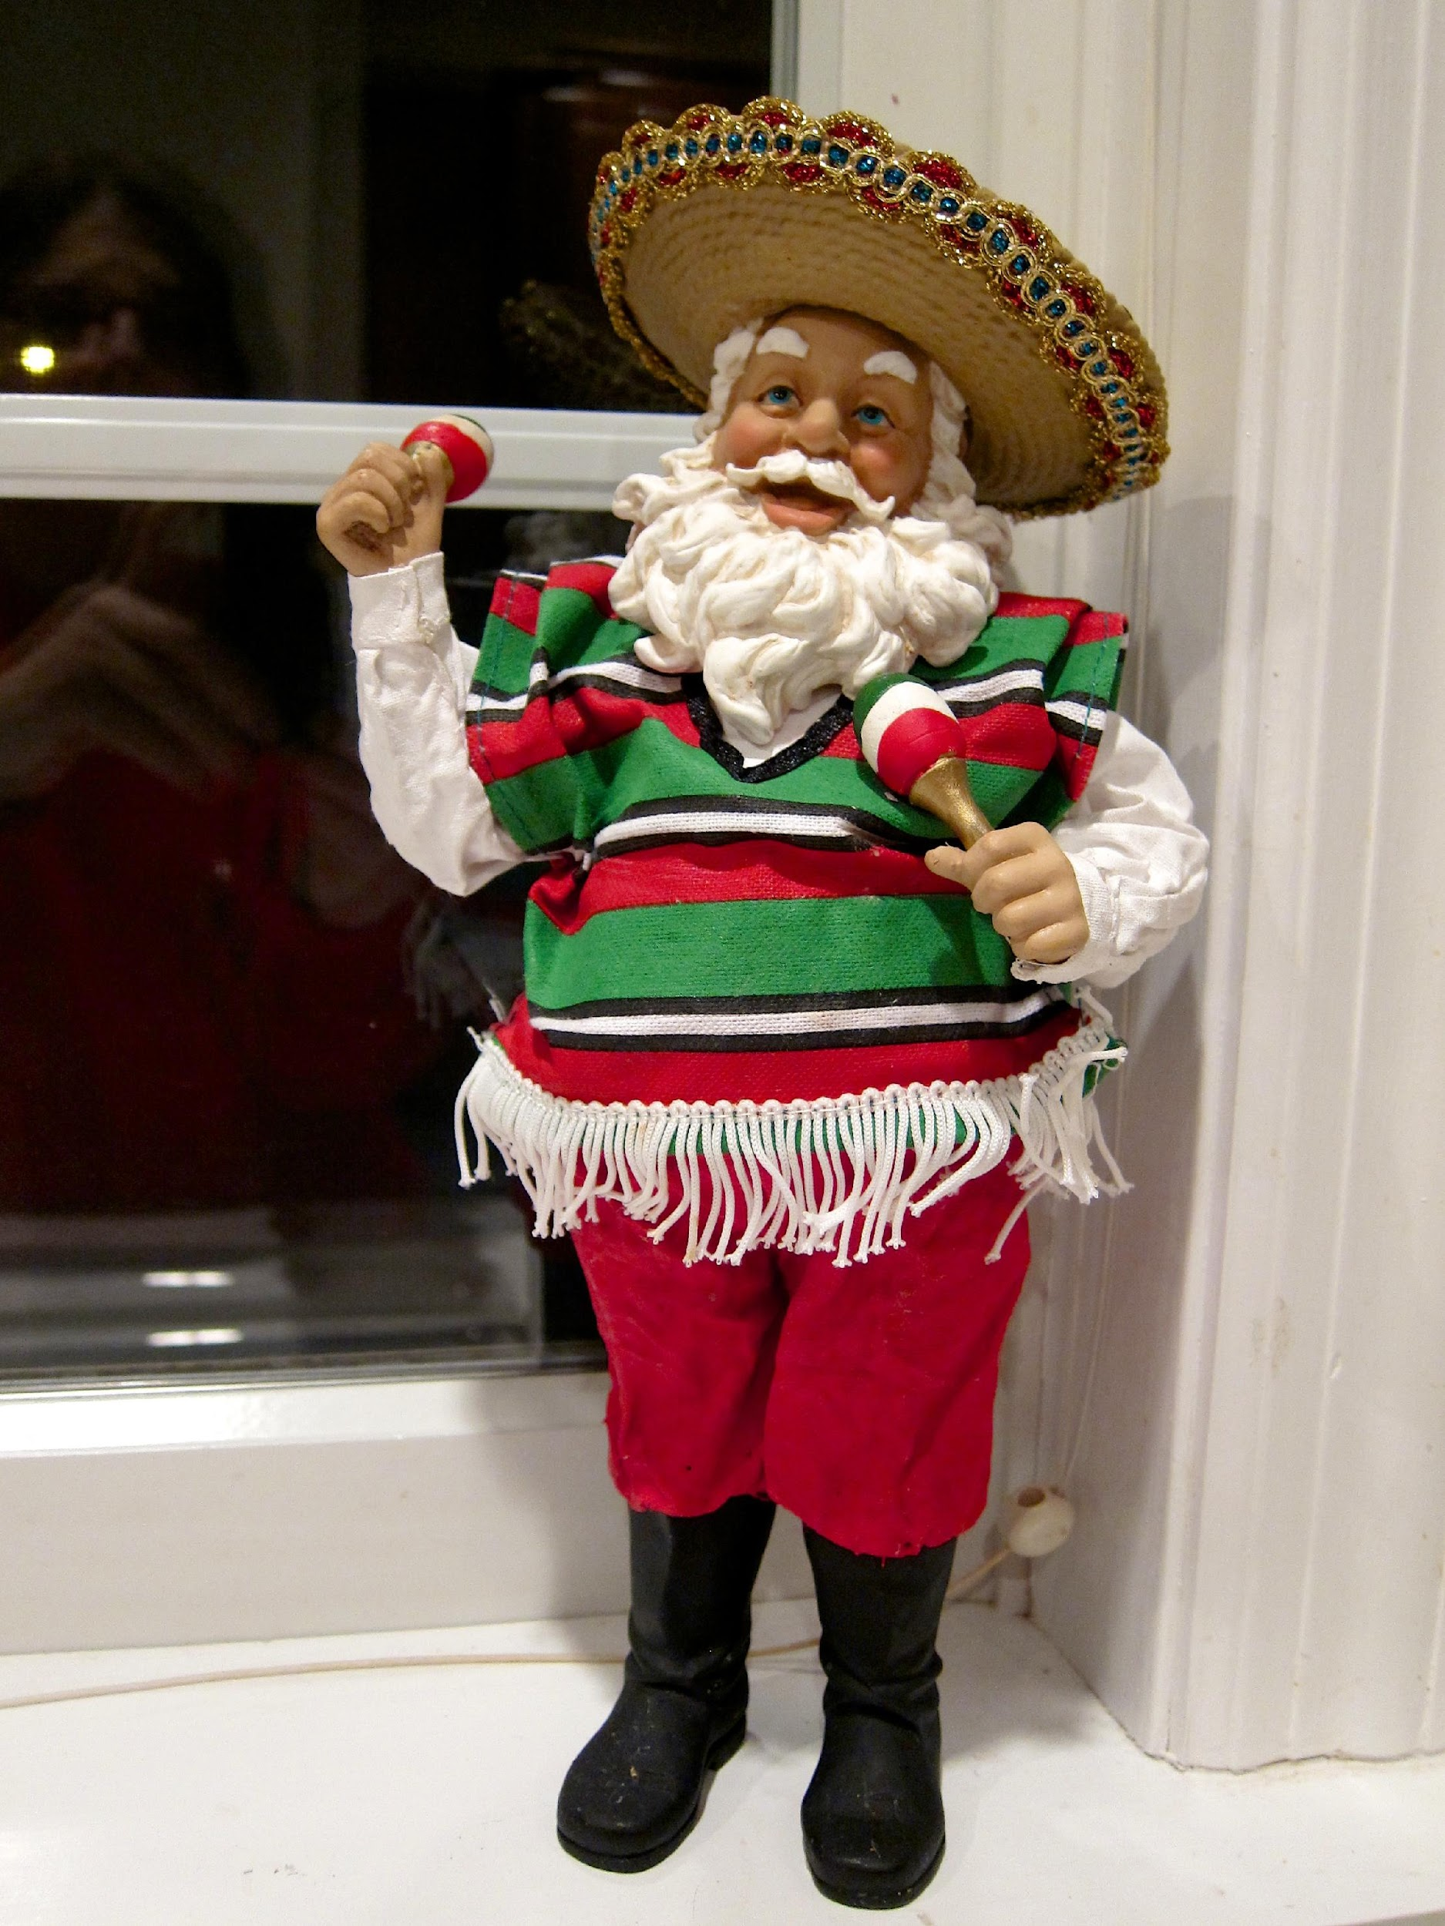
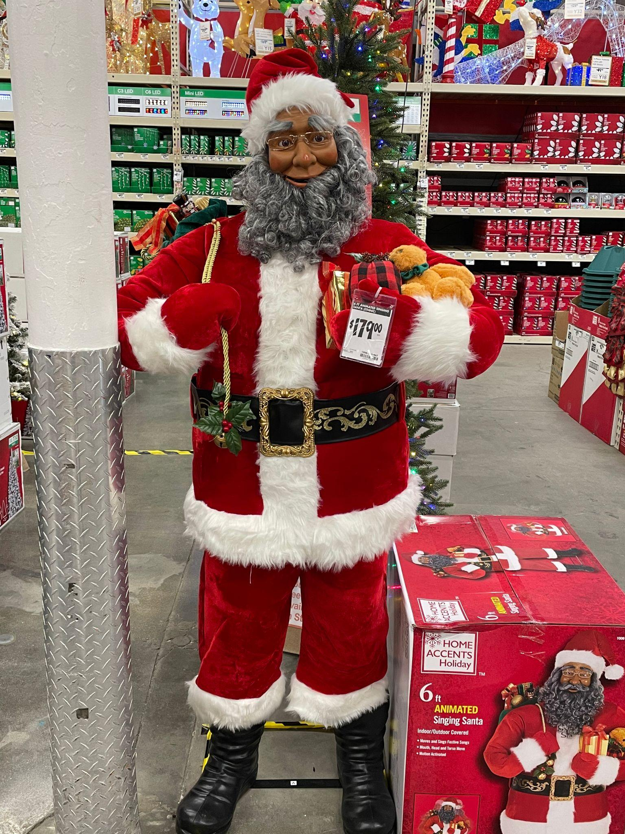
This Photo by Unknown Author is licensed under CC BY-SA
This Photo by Unknown Author is licensed under CC BY-NC-ND

Slide 44
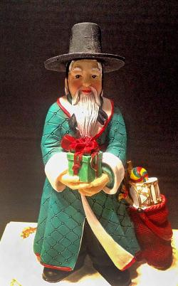
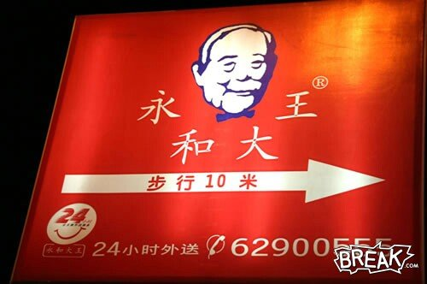

Slide 45
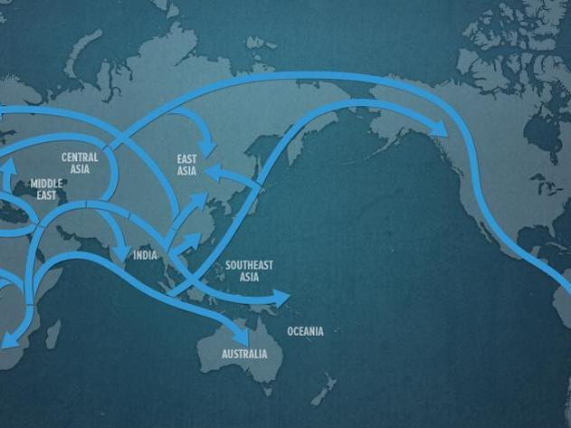
So, What is Race?
Genetic Lineage (forensic identification, possible diseases, phenotypes)
Story of human geography
Socially constructed (historically)

Slide 46
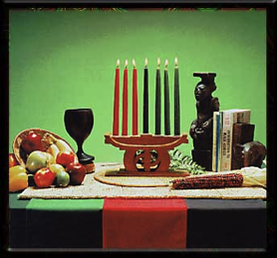
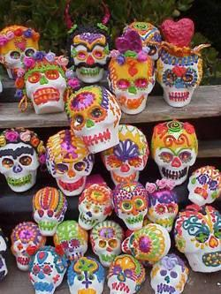
WHAT IS YOUR ETHNIC IDENTITY?
WHERE DOES YOUR SOUL RESONATE?
Ethnic Identity
Who are you?

Slide 47
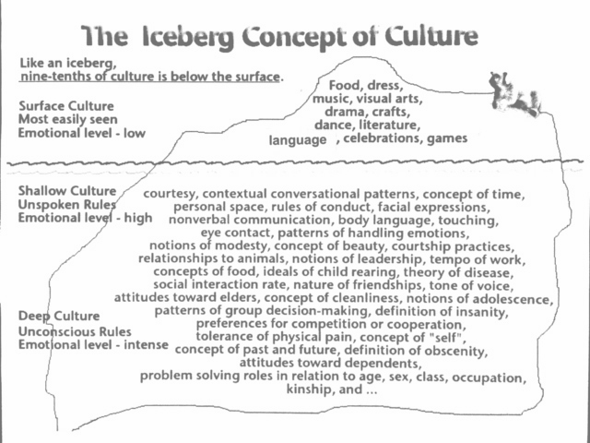

Slide 48
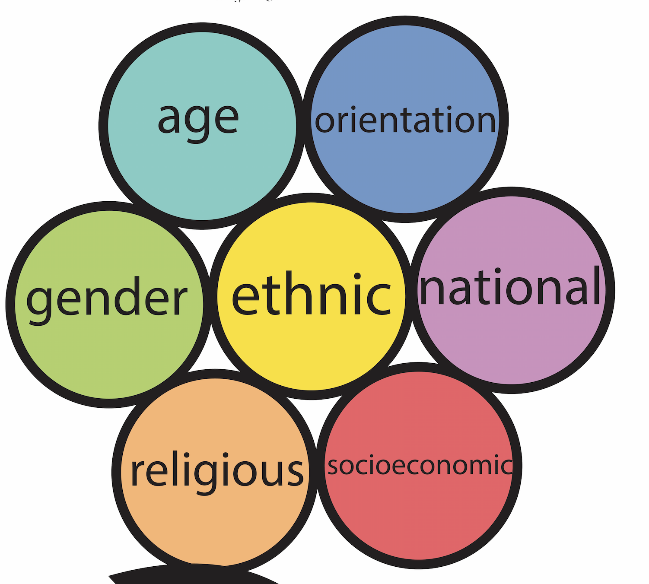
Rings of Culture

Slide 49
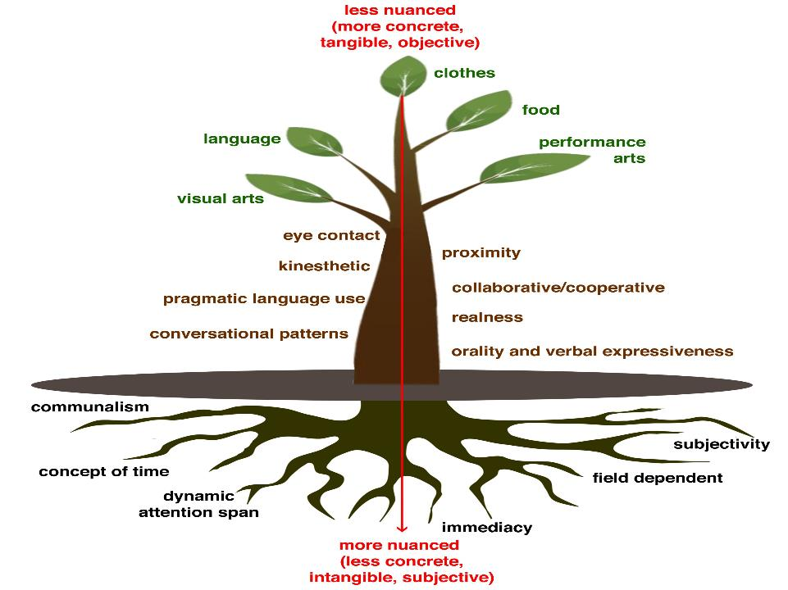
Food
Performing arts
Language
Clothes
Visual arts
Cultural Behaviors We Can See
Communalism
Cultural Behaviors We Cannot See
Proximity
Eye Contact
Non-Verbals
Concept of Time
Heritage
Adapted
Conversational
Patterns
Patterns for Handling Emotions
Tone
of Voice

Slide 50
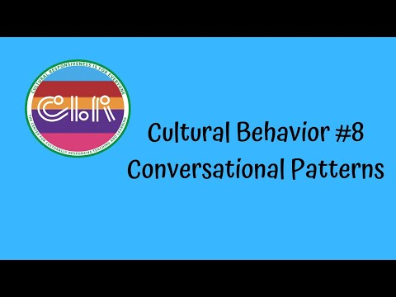

Slide 51
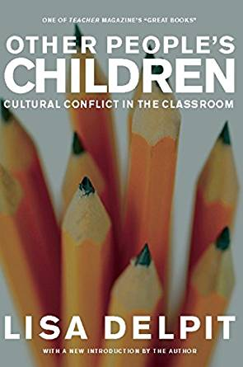
"We all interpret behaviors, information, and situations through our own cultural lenses; these lenses operate involuntarily, below the level of conscious awareness, making it seem that our own view is simply “the way it is.” Learning to interpret across cultures demands reflecting on our own experiences, analyzing our own culture, examining and comparing varying perspectives. We must consciously and voluntarily make our cultural lenses apparent. Engaging in the hard work of seeing the world as others see it must be a fundamental goal for any move"
—Delpit, Other People's Children (2006)

Slide 52
Our Thesis
Students come to school with valid cultural and linguistic behaviors that the school culture, as an institution, misconstrues or misunderstands, which then lead to a series of inequities.

Slide 53

Designs and Illustrations by Carleen Matts

Slide 54
Cultural Complexity Continuum
The Relativity of Culture
High Resonance Low Resonance
REALNESS, COMMUNALISM, EYE CONTACT, CONVERSATION PATTERNS, PROXIMITY, TONE OF VOICE, CONCEPT OF TIME, …
“Situational appropriateness is the concept of determining what cultural or linguistic behavior is most appropriate for the situation. Put another way, students are allowed to make choices around cultural and linguistic behaviors dependent on the situation but without giving up or sacrificing what they consider to be their base culture or language.”
—Hollie, Culturally and Linguistically Responsive Teaching and Learning:
Classroom Practices for Student Success (2017)
Notes:
Add in pages for 1st and 2nd edition
Add visual from handout to ppt

Slide 55
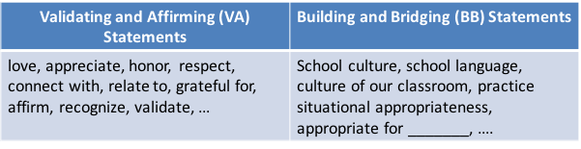
Cultural Elements
High Resonance Low Resonance
Communalism
Eye Contact
Realness
Orality and Verbal Expressiveness
Proximity
Concept of Time
Conversational Patterns
Recognize the behavior as cultural or (not)
If cultural, validate and affirm the behavior first
Then, build and bridge to situational appropriate behavior
If not cultural, then go to classroom management system
Notes:
Match handout and ppt (move handout to ppt)

Slide 56
Break The Code
My Who?
Are there any ____________ students having success?
Yes or No. If yes, go to next question.
If no, then stop here.
Among those students not having success, who is the most likely to be underserved?
Of that group, are there any ____________ students having success? Yes or No. If yes, go to next question. If no, then stop here.
Among those students not having success, who
is the most likely to be underserved?

Slide 57
Go Four Deep (Variables). No More Generalizations.
English Learners
Boys
Non-Spanish Language
Poor

Slide 58


Slide 59
How are you seeing your students differently? Culturally appropriate behavior, not unacceptable behavior?
What CLR instructional practices are actually in place? Where are the classrooms?
Start CLR Now!
In what ways are your students validated and affirmed – talk, relate, teach?
Who are your underserved and how are you being responsive to who they are? Culturally?

Slide 60
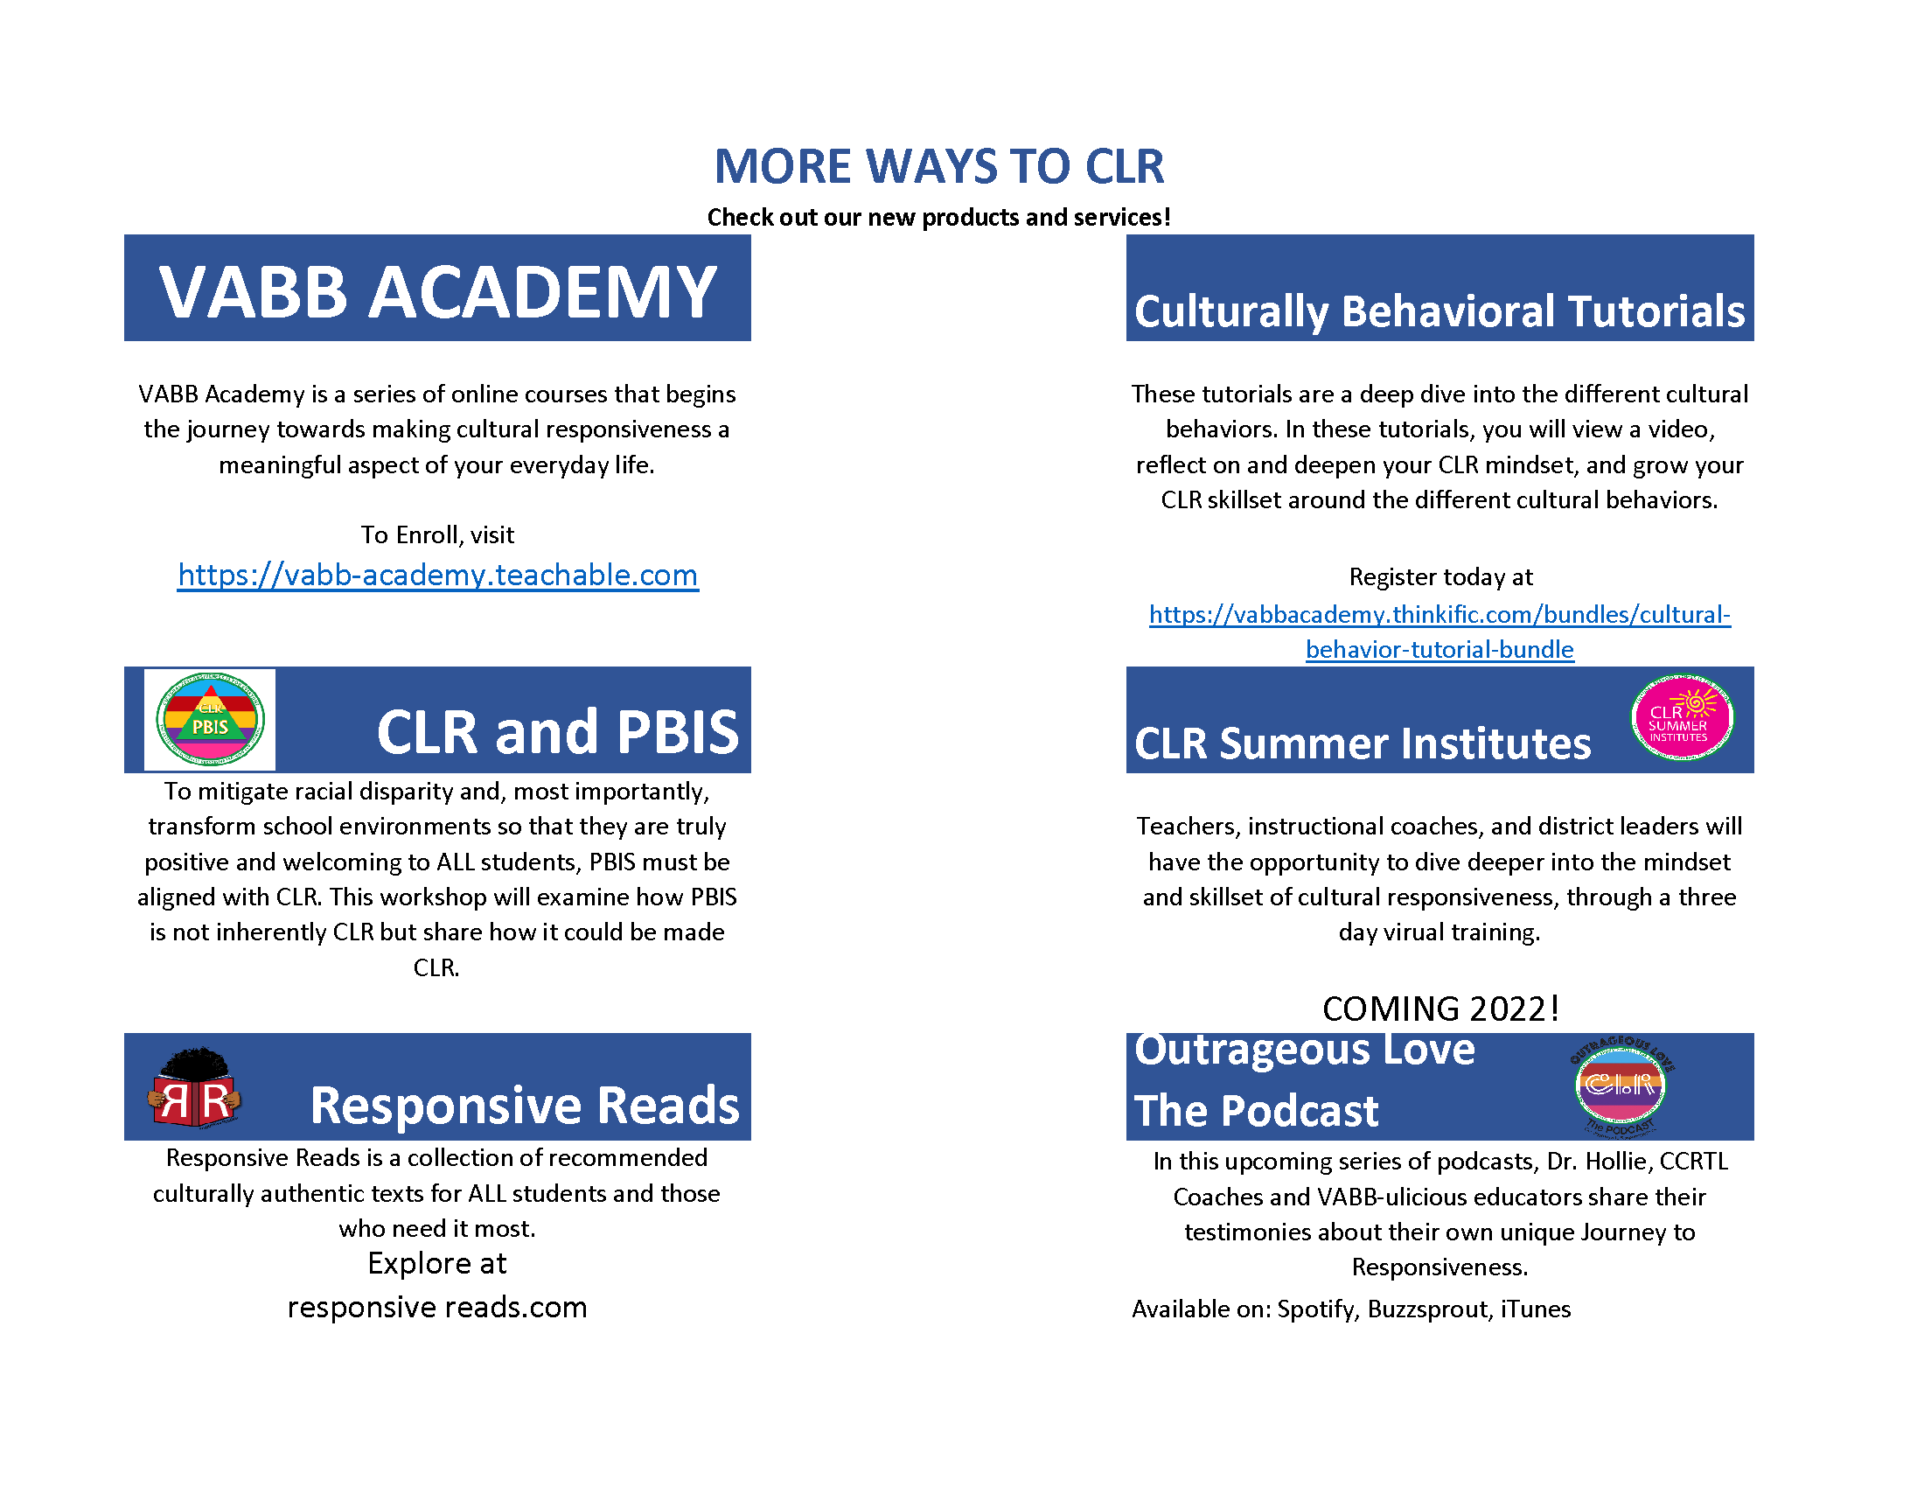
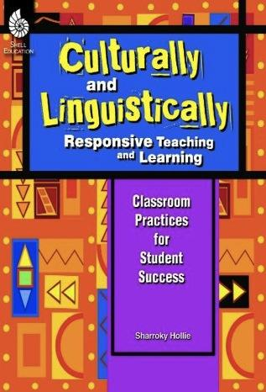
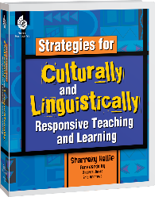

Slide 61
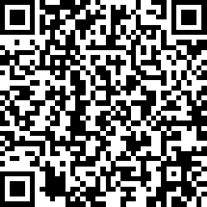
We Appreciate Your Feedback!

Slide 62
