Slide 1
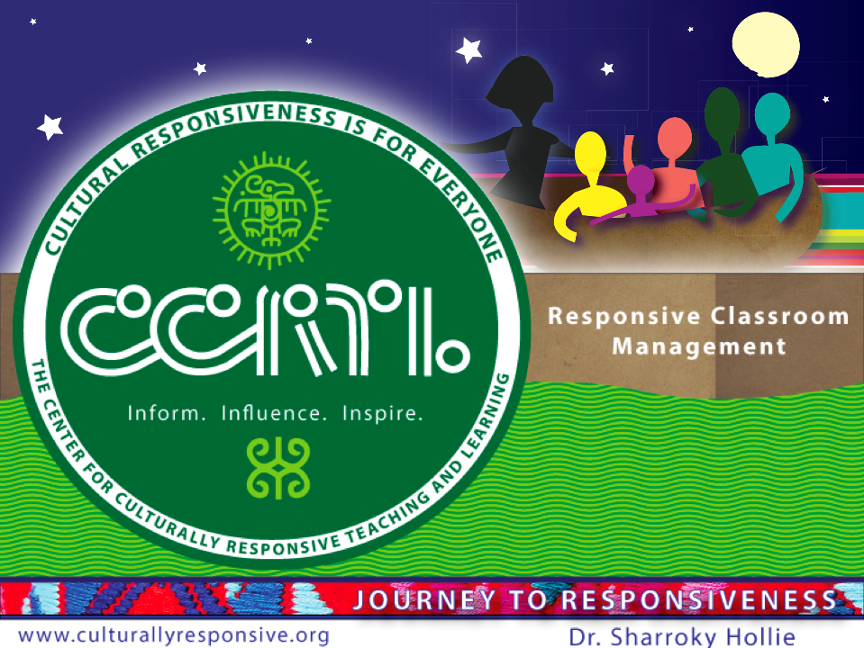

Culturally Responsive Classroom Management

Slide 2
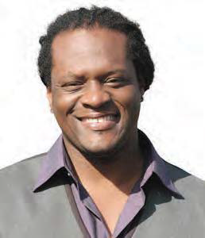
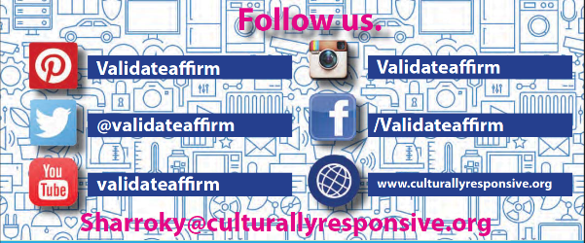
About our Executive Director
Professor Sharroky Hollie is a national educator who provides professional development to thousands of educators in the area of cultural responsiveness. Since 2000, Dr. Hollie has trained over 150,000 educators and worked in nearly 2,000 classrooms. Going back 25 years, he has been a classroom teacher at the middle and high school levels, a central office professional development coordinator in Los Angeles Unified School District, a school founder and administrator, and university professor in teacher education at Cal State University. Sharroky has also been a visiting professor for Webster University in St. Louis and a guest lecturer at Stanford and UCLA.

Slide 3
Today’s Flow
Quick Review of CLR Foundational Principles
No Recognition of Bias, No Validation and Affirmation
You Can’t Put New Clothes on a Dirty Body (Effective Classroom Management)
Is it Cultural or Is It Not?
What Do We Do Next?

Slide 4
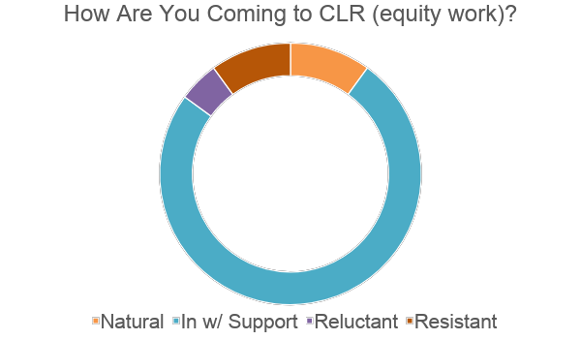

Slide 5
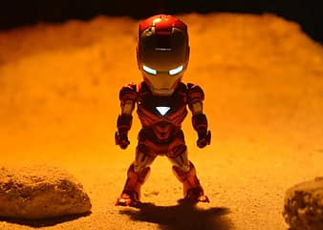

Slide 6
CLR PD Foundation Sequence
Classroom Management
Academic Vocabulary
Focus on Culture and Language
Academic Literacy
Academic Language

Slide 7
Mindset
Reflective
CLR
Skillset
Responsive

Slide 8
Validate
Legitimation of home language and culture
Must be intentional and purposeful
Affirm
Reversal of negative stereotypes of nonmainstream cultures and languages
Must be intentional and purposeful
Build
Make connections between the home culture and language with the school culture and language situation
Must consider situation and what is considered appropriate (situational appropriateness)
Bridge
Demonstration of situational appropriateness
Must use appropriate cultural or
linguistic behavior

Slide 9
Three Ways To VABB
Relate To Differently
Talk To Differently
Teach Differently
Difference =
Responsiveness

Slide 10

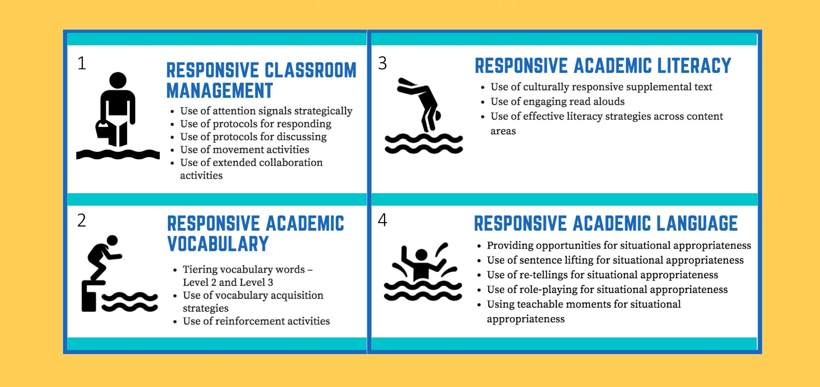
Diving Into Pool of CLR Activities
1
3
2
4

Slide 11
Create Instructional Range
A Continuum of Traditional Instruction and Responsive Instruction
Culturally Responsive
Traditional
Responsive
You Need Instruction in all 3 Boxes
Traditional | Responsive | Culturally Responsive
Teacher-centered | Student-centered | Student-centered
One way | Two Ways | Two Ways
High affective filter | Lowered affective filter | Elements of Culture and Language

Slide 12
Focus on Engagement
List at least two activities in each category
Attention Signals
Responding
Discussing
Movement

Slide 13
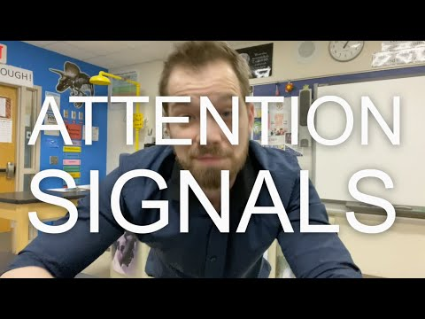

Slide 14



Designs and Illustrations by Carleen Matts

Slide 15
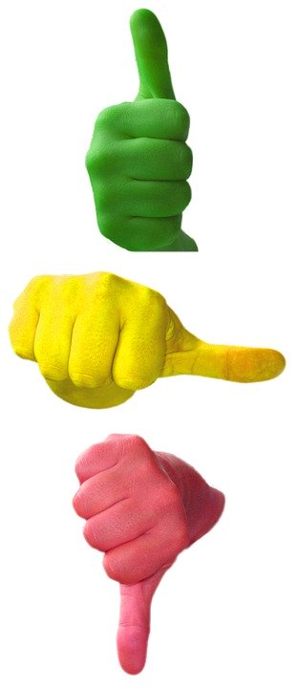
Your Top Three
Learnings thus far about CLR

Slide 16
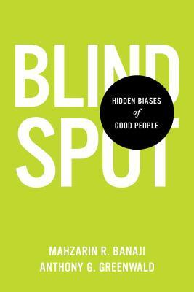
Blindspots or bits of knowledge about social groups
Once lodged in our minds, hidden biases can influence our behavior toward members of particular social groups, but we remain oblivious to their influence. Most people find it hard to believe that their behavior can be guided by mental content of which they are unaware.
-Banaji 2013

Slide 17

“We redefine what it means to be a good person as someone who is trying to be better, as opposed to someone who is allowing themselves to believe in the illusion that they are always a good person.” – Dolly Chugh
“[We all] have reminiscences which [we] would not tell everyone but only to [our] friends. [We] have other matters in [our] mind which [we] will not reveal to even [our] friends, but only to [ourselves], and that in secret. But there are other things which [we] are afraid to tell even to ourselves, and every decent person has a number of such things stored away in [our] minds.”

Slide 18
Changing Your Mindset
Recognize Bias
Mindset Shift
Validate and Affirm

Slide 19
All By Association = Stereotypes
Professions = Race/Gender
Traits = Groups
Surgeon
Pilot
Professional Athlete
CEO
Elementary School Teacher
Leadership (men or women)
Musical Talent (Native Americans or African Americans)
Legal Expertise (Christians or Jews)
Math Ability (Asians or Caucasians)
Criminality (Dutch or Italian)
Stereotypes are true in some way, partly false, and usually negative associated emotionally

Slide 20
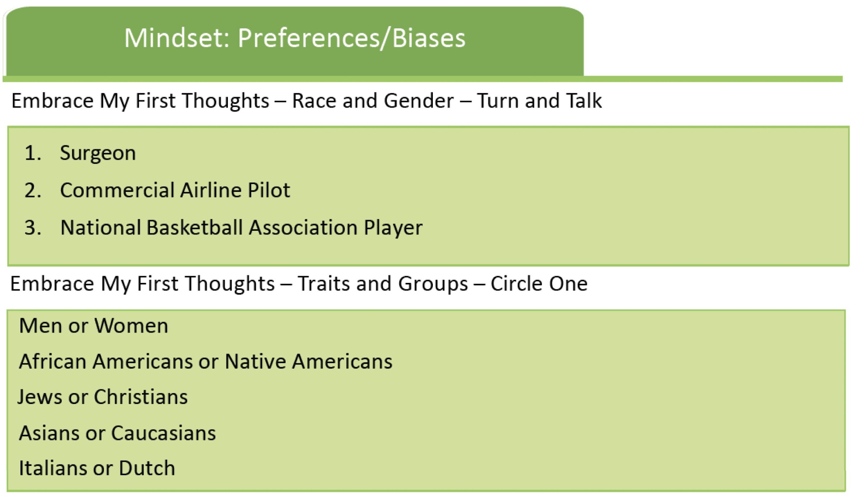

Slide 21
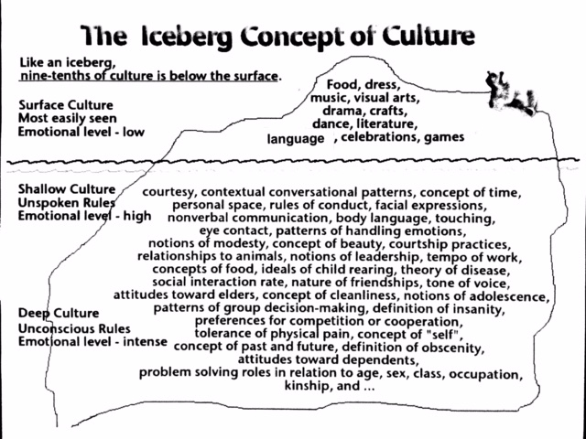

Slide 22
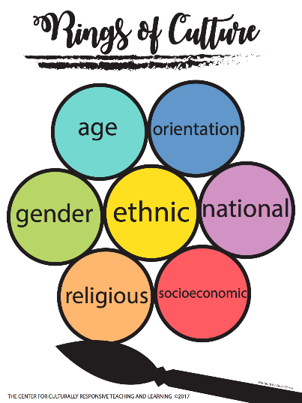

Slide 23

Rings of Culture as Intersections
Ethnic
Orientation
National
Class
Religious
Gender
Age

Slide 24
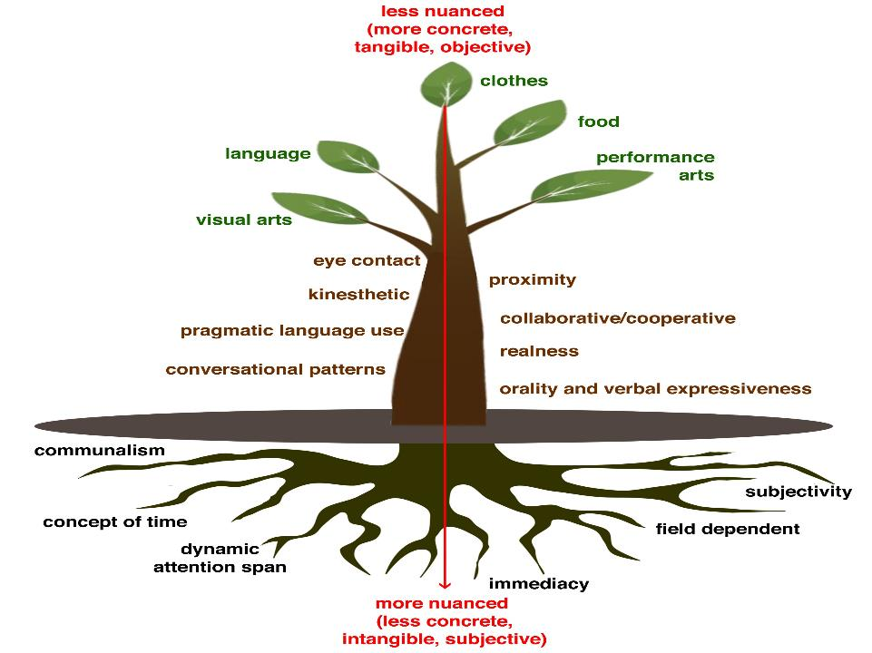
Food
Performing arts
Language
Clothes
Visual arts
Cultural Behaviors We Can See
Communalism
Cultural Behaviors We Cannot See
Proximity
Eye Contact
Non-Verbals
Concept of Time
Heritage
Adapted
Conversational
Patterns
Patterns for Handling Emotions
Tone
of Voice

Slide 25
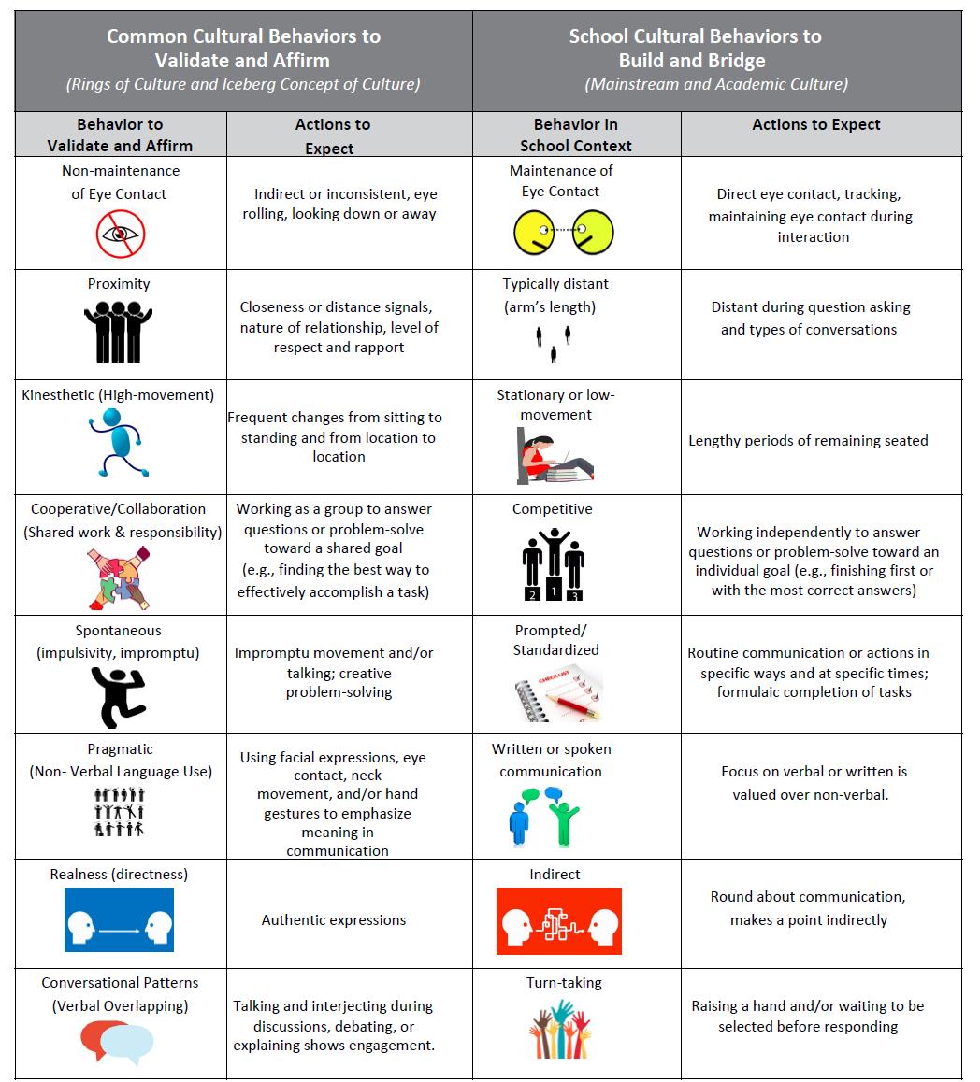
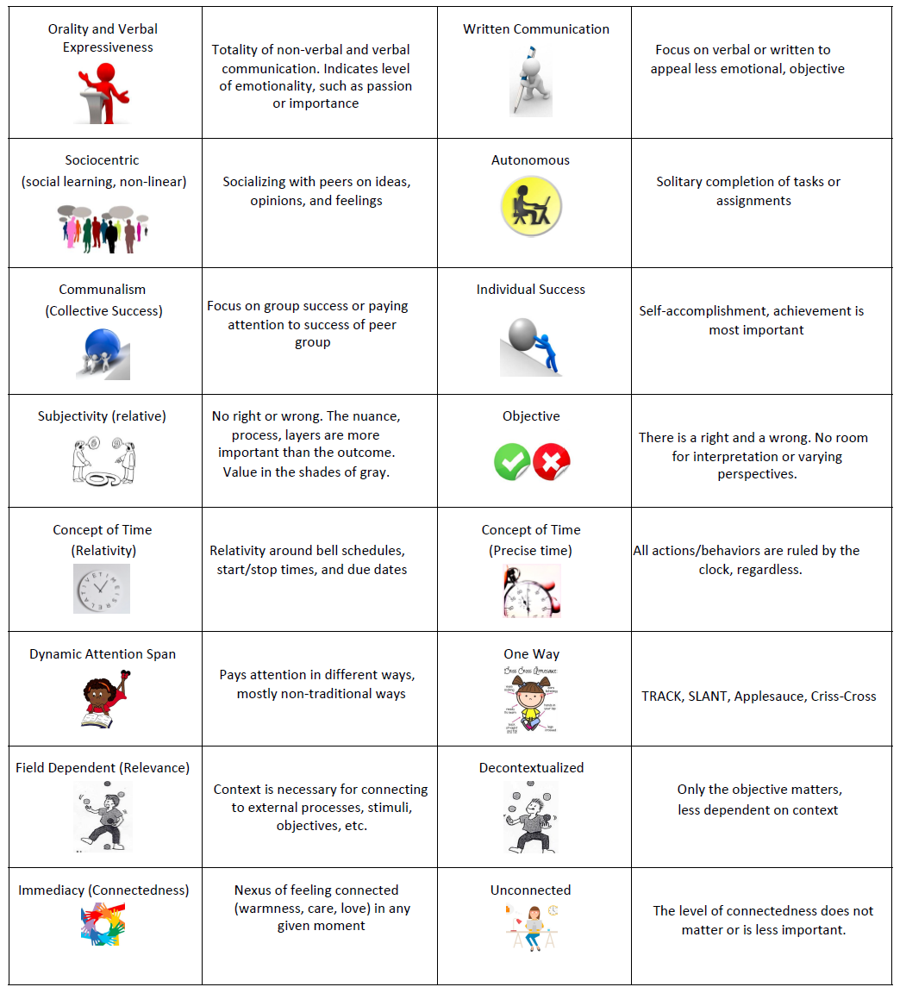

Slide 26
  Do we even consider it as a valid behavior?
  What are our biases?
  Where/when do we validate and affirm?
  Where/when do we build and bridge?
What are the preferred cultural behaviors at school?

Slide 27
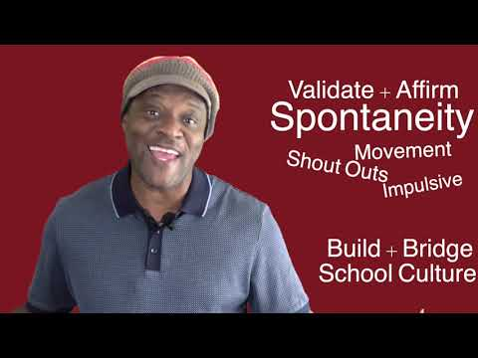

Slide 28
  Do we even consider it as a valid behavior?
  What are our biases?
  Where/when do we validate and affirm?
  Where/when do we build and bridge?
What are the preferred cultural behaviors at school?

Slide 29
Cultural Complexity Continuum
The Relativity of Culture
High Resonance Low Resonance
REALNESS, COMMUNALISM, EYE CONTACT, CONVERSATION PATTERNS, PROXIMITY, TONE OF VOICE, CONCEPT OF TIME, …
“Situational appropriateness is the concept of determining what cultural or linguistic behavior is most appropriate for the situation. Put another way, students are allowed to make choices around cultural and linguistic behaviors dependent on the situation, but without giving up or sacrificing what they consider to be their base culture or language.”
—Hollie, Culturally and Linguistically Responsive Teaching and Learning:
Classroom Practices for Student Success (2017)

Slide 30
Three Components of CRCM
Classroom Management System
Belief System
Progressive Discipline System

Slide 31
Current Classroom Management Reflection
What school of thought do you aspire to?
How does the three PPP approach work for you?
Are you aware of how to survive with your management system?

Slide 32
Three Philosophies
Authoritarian
Collaborative/Democratic
Permissive

Slide 33
Three Ps
Positive (vs negative)
Proactive (vs reactive)
Procedures (vs rules)

Slide 34
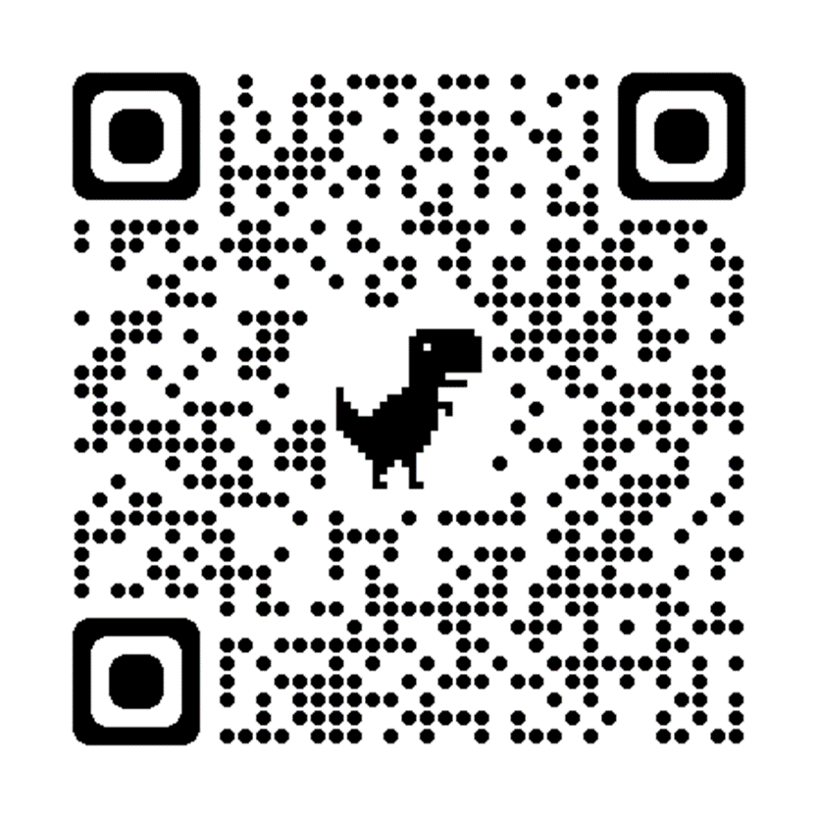
+ - 0
What officially begins class…
What students do when work is completed…
When students do not have supplies or are in need of sharpening a pencil
Use of cell phones, headphones, or other technologies
Turning in late assignments/work
Preparing for fire drills, lockdowns, other emergencies
Getting your attention during independent work
Entering/exiting the classroom

Slide 35
Numbers To Live By
80%
15%
5%

Slide 36
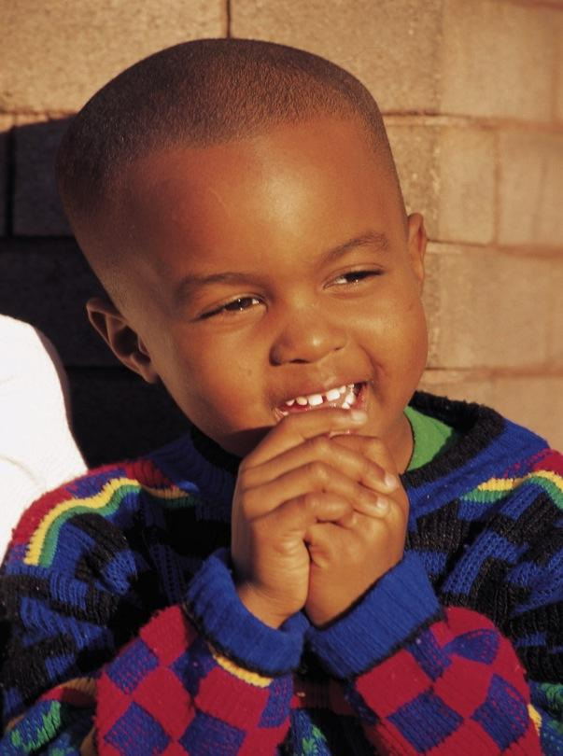
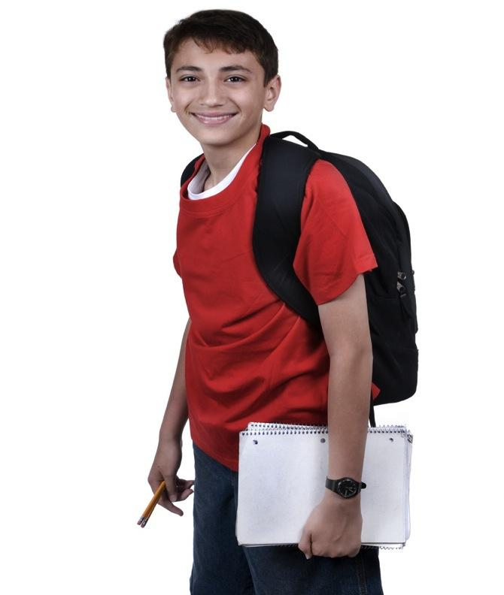
Simply Comes Down To What We Believe

Slide 37
Do You Believe In Cultural Behaviors?
“Cognitive styles (cultural behaviors) are the intellectual aspects of learning styles and represent culturally attuned ways of perceiving, organizing, and evaluating information. These aspects include and affect perceptions, conceptualizations, and decision making. Culture acts as a filter in this process.”
-Barbara Shade’s Creating Culturally Responsive Classrooms

Slide 38
Traditional School Culture Underserved Cultures
*standardized/rule-driven
*quiet
*stationary/low movement
*time specific
*competitive
*deductive
*turn-taking
*mainly verbal communication
*teacher-centered and led
*field independent
*intrapersonal
*preference for variation/
spontaneity
* sociocentric
*high movement
*cooperative
*inductive
*overlap
*many ways to communicate
*purpose-driven
*affective
*field-dependent
*interpersonal

Slide 39

Designs and Illustrations by Carleen Matts

Slide 40
- - - - - - - - - - - - - - - - - -
·-- -- ·-·---·-
14
Identify the behaviors as Cultural or NOT. If it is cultural, state the cultural behavior?
You decide!
Student is talking while teacher is talking, but in an affirming way.
Student is tapping on desk while other students are working quietly.
Student is picking on another student.
Student says mean and degrading things to the teacher. .
Student in one collaborative group paying attention to other students in another collaborative group.
Student is stealing.
Student is aggressively talking back, trying to make a point with the teacher.
Student is throwing paper across the class.
Students are interjecting, without raising their hands, during a class discussion segment.
Student stands up sometimes, when completing his/her assignments.
31

Slide 41
Talk to, Relate to, Teach Differently
Identify
Identify behavior as being culturally inappropriate, unacceptable, or egregious
Recognize
If culturally inappropriate, recognize cultural behavior using rings of culture or iceberg concept of culture (anthropology) or other possible reason, such as special needs, trauma, etc.
Check
Check belief system. Either you believe or you do not!
Validate and affirm
If you believe, then validate and affirm first and build and bridge.

Slide 42
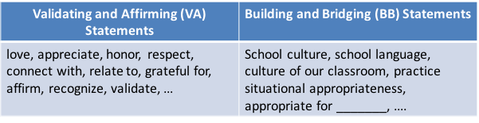
Cultural Elements
High Resonance Low Resonance
Communalism
Eye Contact
Realness
Orality and Verbal Expressiveness
Proximity
Concept of Time
Conversational Patterns
Recognize the behavior as cultural or (not)
If cultural, validate and affirm the behavior first
Then, build and bridge to situational appropriate behavior
If not cultural, then go to classroom management system

Slide 43
Culturally Inappropriate Behaviors | Unacceptable | Egregious

Slide 45
VALIDATION AND AFFIRMATION
Negative or Deficit
Neutral
Validation and Affirmation
“Should, ought to, wrong, value-based terms, fix it, correctly, right way, our way, your way, or the only way“ | “Understand, tolerate, allow, another chance, consequence-based terms, this time or next time,“ | “Appreciate, honor, value, love, respect, inspired, moved, affirm, connect, empathize, can relate or am grateful“

Slide 46
Let’s Get Rid of the D Words
What does it mean to be:
Disruptive
Distracted
Insubordinate
Disrespectful
Defiant
What is the difference between Classroom Management and Disciplining?
How can we distinguish these words from cultural misunderstandings?

Slide 47
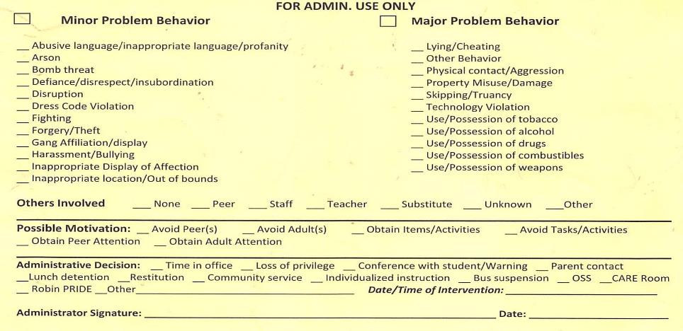
How Do We Avoid Cultural Misunderstandings?

Slide 48
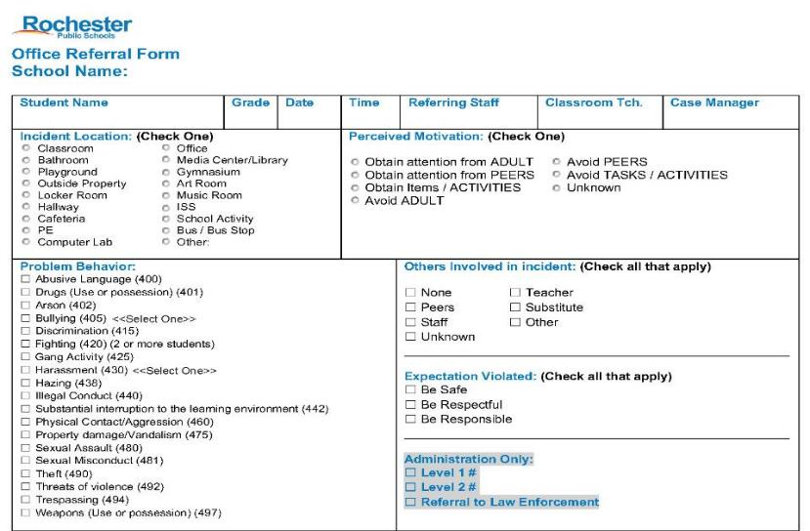

Slide 49
Focus on Engagement
List at least two activities in each category
Attention Signals
Responding
Discussing
Movement

Slide 50
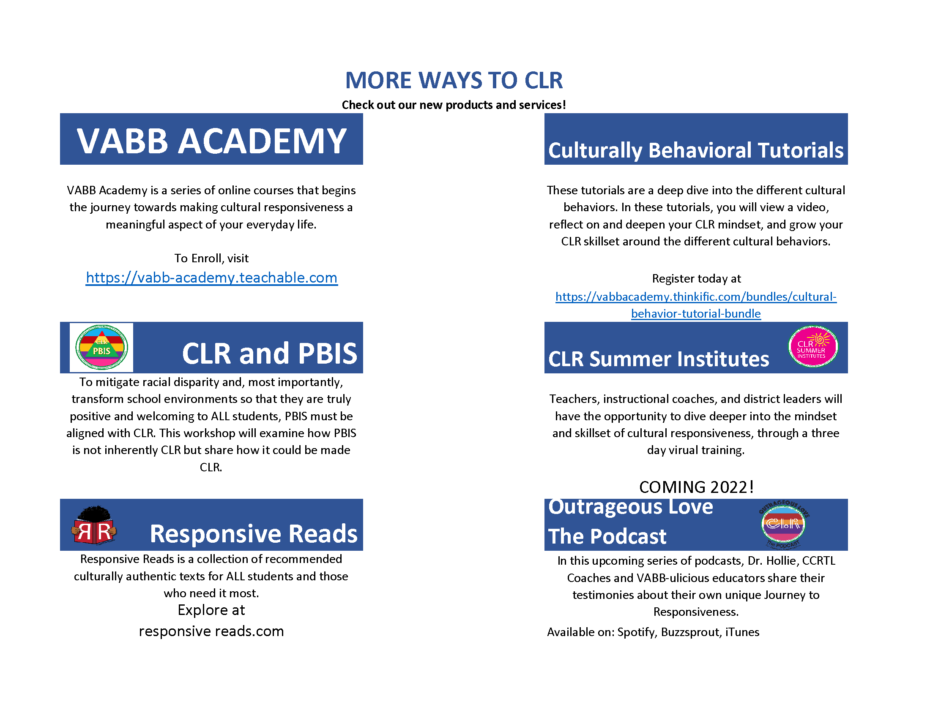




Slide 51
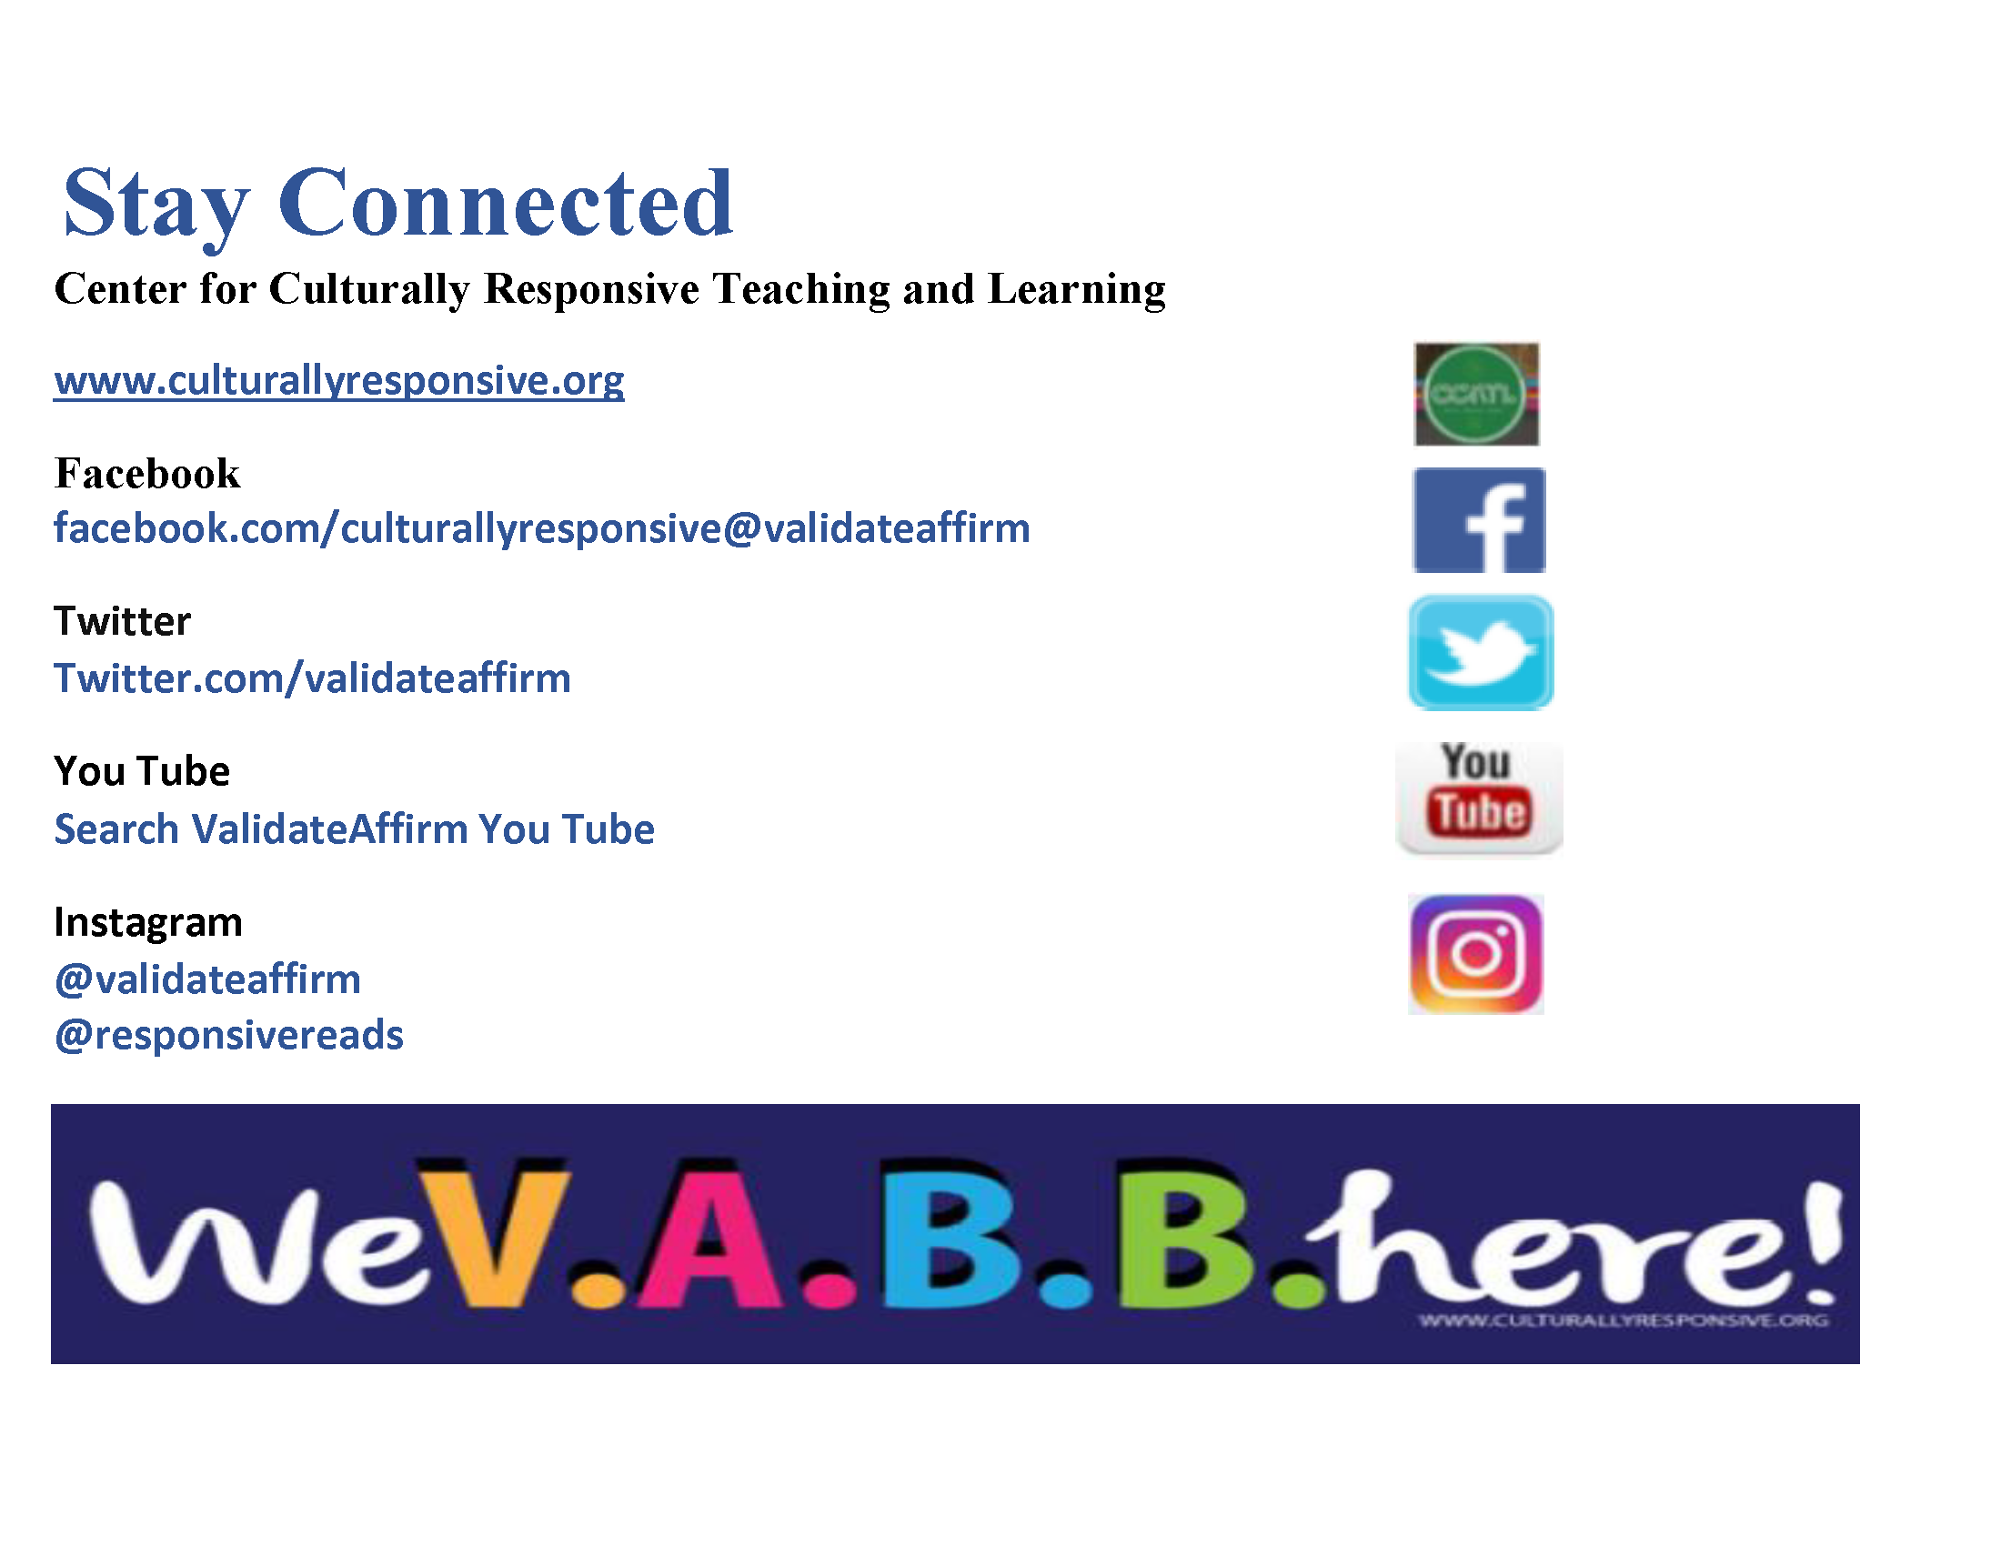

Slide 52
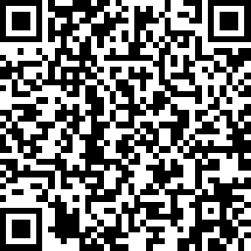
We Appreciate Your Feedback!

