Slide 1


Slide 2



Our Flow
Improve our skillsets
Four different methods for linguistic validation and affirmation
Questions and Answers

Slide 3
Reflective
CLR
Responsive

Slide 4
CLR in One Sentence
Students come to school with valid cultural and linguistic behaviors that the school culture, as an institution, misunderstands and/or misconstrues which leads to a series of inequities over time.

Slide 5
Three Ways To VABB
Relate To Differently
Talk To Differently
Teach Differently
Difference =
Responsiveness

Slide 6

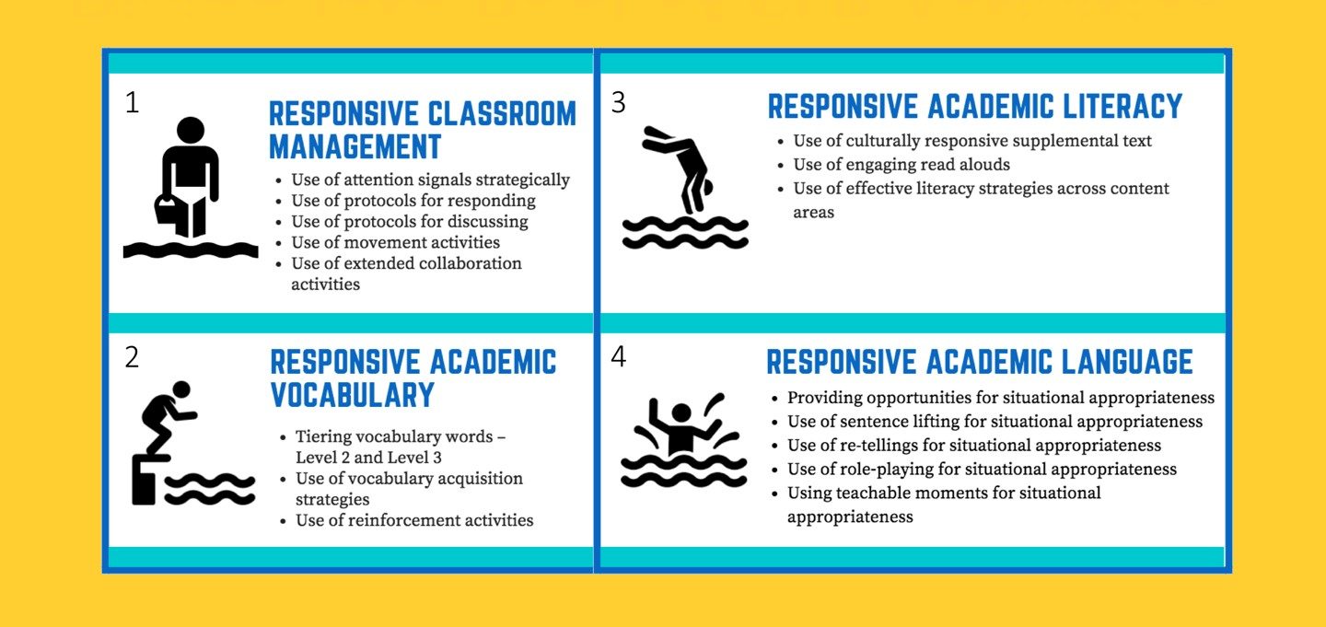
Diving Into Pool of CLR Activities
1
3
2
4

Slide 7
Title of a Song, Movie, or Book
that captures what CLR/VABB means to you (as a group)
Pick a spokesperson to share your title, including the reason why you chose that title.

Slide 8
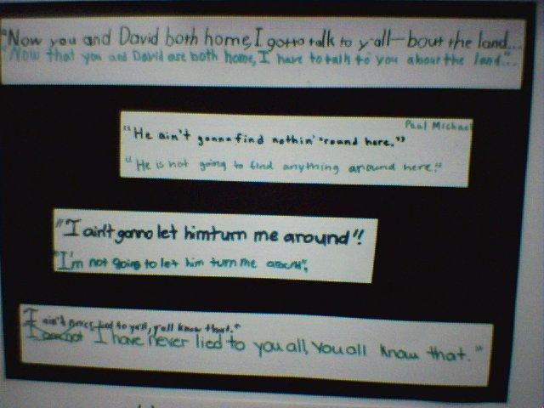
Linguistically Responsive Teaching
Notes:
*

Slide 9

Linguistically Responsive Teaching
Linguistically responsive instruction validates and affirms the home languages of students. It builds awareness of the rule-governed structure of all languages.
Linguistically responsive instruction is additive and seeks to effectively add Standard English and Academic Language to the students linguistic repertoire, but not at the expense of devaluing the home language.

Slide 10
Have You Checked Your Linguistic Biases?
Proper English
Say it the right way
You sound ghetto
That’s not how you say it
Don’t talk like that
English only

Slide 11
Checking Your Filter
Questioning Your BS
Listening To Your Deficit Monitor
The Power of the Bilingual Brain
Learning a second language can produce a nimbler mind. Now some schools are finding new ways to help students tap the benefits.
Why Save a Language?
“A central aspect of any culture’s existence as a coherent entity is the fact of having its own language, regardless of what the language happens to be like.”
John McWhorter
NY Times Op-Ed

Slide 12
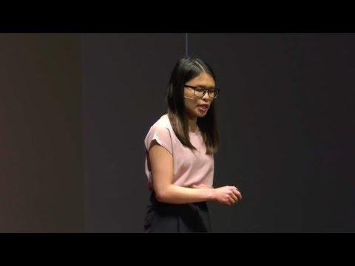

Slide 13
Key Terms to Know
Language
a legitimate linguistic entity defined around the parameters of phonics, markers, grammar, vocabulary, non-verbal uses, and discourse styles with a heritage and purpose tied to a people as a community or citizenry
Home Language
the language utilized by family members in the home and others in the community that is different enough in the parameters defined by language from Standard English
School Language
the language utilized in the context of school, commonly associated with Standard English
Standard English
the accepted linguistic entity of the dominant or mainstream culture in the United States
Academic Language
the language used in textbooks, in classrooms, and on tests. It is different is structure (heavier on compound, complex, and compound-complex sentences) and vocabulary from Standard English.

Slide 14
Three Linguistic Absolutes
All language is good. There is NO such thing as a bad language. No deficit language allowed (fix, make better, correct, improper, street, or “that rap talk.”)
We acquire the language that is spoken by the primary caregivers (home) beginning at pre-birth to pre-k (normally developing situation)
All linguistic forms are rule-governed and patterned. It is not made up.
Notes:
*

Slide 15
Major Dimensions of Language
SOUNDS
SYNTAX
  The level of combination of features of sounds into significant speech sounds
  Words put in sentences
PRAGMATICS AND DISCOURSE
WORD BITS
  Language in big chunks as it functions and is used in a social context
  The level of combination of sounds into basic units of meaning (morphemes)
META-LINGUISTICS
WORD MEANINGS
  Semantics
  Thinking about language

Slide 16
Standard English Learner (SELs):
Noma LeMoine (1998) defines SELs as:
Students who come from homes where their home language differs enough from Standard English and Academic Language in the following ways – phonologically, morpho-syntactically, syntactically, semantically, pragmatically, and rhetorically.
Commonly known in the linguistic research as the non-standard languages: Representing the languages of many underserved students.
Superficially, these students have an apparent proficiency in Standard English and Academic language, but a critical examination of their reading and written skills, coupled with the demand of school language, paints a different picture.

Slide 17

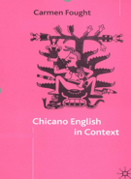
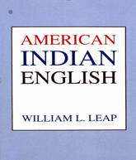


Slide 18
The Forgotten (or Ignored) EL – Long Term ELs
Six or more years in US (Born and raised in US)
False perception of academic achievement
Adequate grades, but low test scores
Lack of quality and/or inconsistent bilingual instruction
Their elementary education did not serve them the best (lost in the cracks)
Strong BICS, Weak CALPS
Estimated that 74% of secondary ELS are LT-Els (2015)
Education experience mirrors that of SELs
Linguistically misunderstood
Require similar instructional methodology
CLR directly applies to both groups.

Slide 19
Continuum of Standard English Proficiency
Over ½ of all of California’s students are in the process of mastering Standard English
All of California’s students are in the process of mastering Academic Language
Traditional English Learners
Standard English Learners
Proficiency of Standard English
Mastery of Standard English
Mastery of Academic Language
How proficient are you?

Slide 20
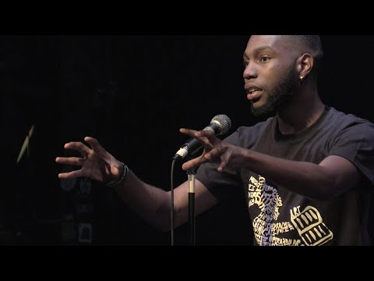

Slide 21
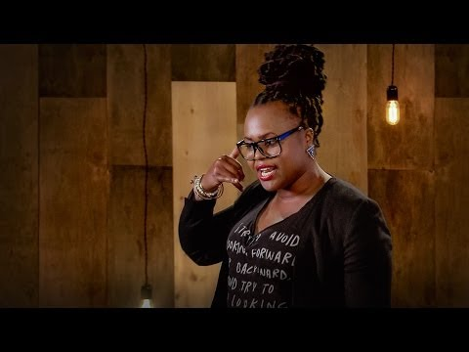

Slide 22
Language shapes how we think, how we experience the world
What is your linguistic identity?
Where did you acquire your home language?
How many languages/ways do you speak?
To what extent are you proficient in Standard English/Academic Language?
What is your measure?
Around the world people communicate with one another using a dazzling array of languages—7,000 or so all told—and each language requires very different things from its speakers. For example, suppose I want to tell you that I saw Uncle Vanya on 42nd Street. In Mian, a language spoken in Papua New Guinea, the verb I used would reveal whether the event happened just now, yesterday or in the distant past, whereas in Indonesian, the verb wouldn’t even give away whether it had already happened or was still coming up. In Russian, the verb would reveal my gender. In Mandarin, I would have to specify whether the uncle is maternal or paternal and whether he is related by blood or marriage, because there are different words for all these different types of uncles and then some (he happens to be a mother’s brother, as the Chinese translation clearly states). And in Pirahã, a language spoken in the Amazon, I couldn’t say “42nd,” because there are no words for exact numbers, just words for “few” and “many.” - Lera Boroditsky

Slide 23
Cultural Complexity Continuum
The Relativity of Language
Home Language Academic Language
…
“Situational appropriateness is the concept of determining what cultural or linguistic behavior is most appropriate for the situation. Put another way, students are allowed to make choices around cultural and linguistic behaviors dependent on the situation but without giving up or sacrificing what they consider to be their base culture or language.”
—Hollie, Culturally and Linguistically Responsive Teaching and Learning:
Classroom Practices for Student Success (2017)
Notes:
Add in pages for 1st and 2nd edition
Add visual from handout to ppt

Slide 24

W
5 ’s of Situational Appropriateness
With WHOM is the student communicating?
WHAT is the topic of the communication?
WHEN is the communication occurring?
WHERE is the communication taking place?
WHY the communication (purpose)?

Slide 25

Communication in the classroom vs. communication on the playground.
Conversation with your financial planner vs. a conversation with your friend (conversational vs. academic language).
Writing an essay to get into college vs. writing a letter in order to win free tickets to a concert.

Slide 26
Rationale
Metalinguistic Awareness
Facilitates the students’ acquisition of the language of instruction
Understanding that the language of home and school differ
Notes:
*

Slide 27
Why Contrastive Analysis?
Increased ability to recognize the differences between standard English and the language of SELs
More proficient editing of their work in grammar, vocabulary, and syntax
Greater facility in the use of Standard English
Affirmation and acceptance of home language
Notes:
*

Slide 28
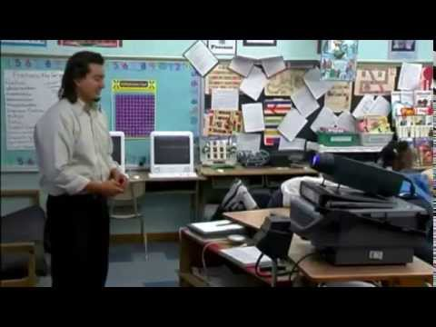

Slide 29
Teachable Moments
The teacher elicits spontaneous verbalizations/responses from the students about material read or presented and creates teachable moments for conducting contrastive analysis of AAL/CE and SAE.
Notes:
*

Slide 30
Multiple Negation
African-American Language Rules
Standard English Rules
“My mother don’t never let me go nowhere!”
Multiple negation refers to the use of multiple negative words in a sentence.
With multiple negation, the more negative words in a sentence, the greater the negative sentiment being expressed by the speaker.
The negative words act as negative intensifiers.
An intensifier heightens or lowers the intensity of meaning of an item.
“My mother rarely ever lets me go anywhere!”
This is not to be confused with “double negatives” which is a Standard English grammar rule.
Standard English grammar rules dictate that a sentence can only have one negative word.
Two negative words, double negatives, cancel each other out; therefore, expressing a positive sentiment.
In Standard English, intensifiers are considered adverbs.

Slide 31
Do You Know The Features?
Don’t nobody do nothin’ for me no mo’ around here.
This movie is new, it barely came out!
She be lyin’ too much.
I done done that for you already.

Slide 32
Sentence Lifting
Using literature, poetry, songs, plays, student elicited sentences, or prepared story scripts which incorporates specific SAE and AAL/CE form contrasts, the student performs the contrastive analysis translations to determine the underlying rules that distinguish the two language forms.
Notes:
*

Slide 33
Mother To Son by Langston Hughes
Well, son, I'll tell you:
Life for me ain't been no crystal stair.
It's had tacks in it,
And splinters,
And boards torn up,
And places with no carpet on the floor --
Bare.
But all the time
I'se been a-climbin' on,
And reachin' landin's,
And turnin' corners,
And sometimes goin' in the dark
Where there ain't been no light.
So boy, don't you turn back.
Don't you set down on the steps
'Cause you finds it's kinder hard.
Don't you fall now --
For I'se still goin', honey,
I'se still climbin',
And life for me ain't been no crystal stair.

Slide 34
Retellings
The student reads or is told a story that is heavily embedded with the target form (SE) and is then required to tell the story. The student’s story retelling is taped and compared and contrasted with the language of the text.
Notes:
*

Slide 35
Roleplaying
Students contrast and analyze the mainstream versions of the targeted language forms with an emphasis on situational appropriateness, i.e., communication, environment, audience, purpose, and function.
Directions: Choose a language (home language, academic language, or youth language - use of profanity/slang). Describe in 3 to 5 sentences your weekend plans.
Notes:
*

Slide 36
Focus on Thought
Lessons that address the underlying cognitive elements of language and communication
  Focus on:
    Communication intent and what the speaker is trying to tell the audience
    Classroom activities that provide maximum opportunities for students to communicate with each other as partners or in small groups
    Teacher emphasis on facilitating student interaction
      Questioning
      Knowledge and experience sharing
    A risk-free learning environment
    Expansion of students’ fund of information through the integration of their own ideas with those from literature, etc.
Notes:
*

Slide 37
Focus on Function
Students take into account the intent of their messages for various audiences & purposes
  Students should be able to determine the type of communication behavior most appropriate to a given situation or audience
  Students should be given an opportunity to decide, prior to a given activity, the type of communication behaviors that would be most appropriate
  Students should have opportunities to role play commonly encountered situations and relate these situations to acceptable language usage
Notes:
*

Slide 38
Focus on Structure
Students are given opportunities to listen to, contrast, and practice patterns of Standard English with their indigenous language through:
  Lessons that address specific features:
    Phonetic
    Lexical
    Grammatical
  Opportunities to use the targeted structures in various communication activities
    Choral reading
    Listening to various forms of literature
    Conversations and discussions with SE speakers
    Readers theater
Notes:
*

Slide 39

TAKE-AWAYS

Slide 40


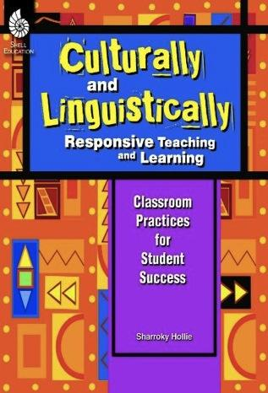



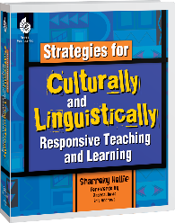
Stay Vabbulous! Stay Connected!
@validateaffirm
Notes:
https://www.culturallyresponsive.org/clrdistancelearning
https://www.culturallyresponsive.org/clrrespondstorace
https://www.culturallyresponsive.org/subscribe
https://www.culturallyresponsive.org/contact
https://www.youtube.com/channel/UCEshEHwGq-eOZvgeF8wO3UQ

Slide 41
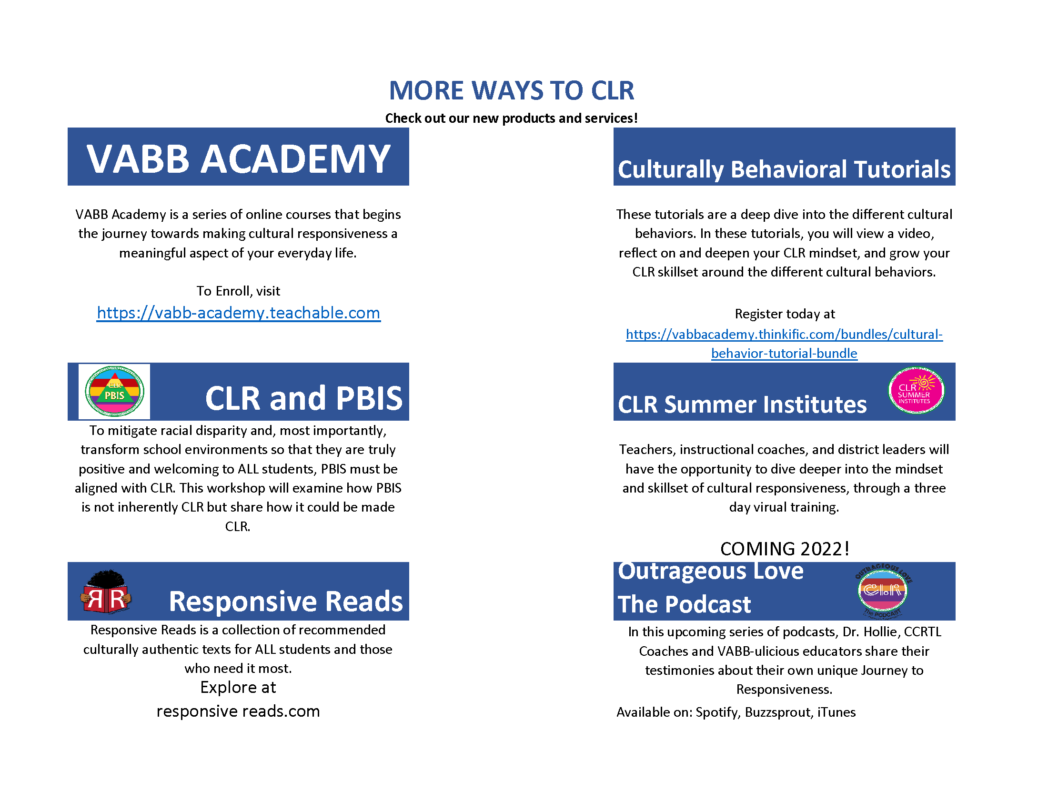

Slide 42
